Slide 1
ChromeOS Kiosk Installation for Technology Coordinators
The Office of Student Assessment Services
January 13, 2026

Slide 2
Presenters
Jodie Zalk, Manager of Test Administration and Publications
Shannon Cullen, MCAS Test Administration Coordinator
Abbie Currier, eMetric Sr. Project Manager
Kaelee Harper, eMetric Project Manager

Slide 3
Logistics for This Session
Use the Q&A feature to ask a question.
  We will answer some questions aloud at specified times during this training session, and we will email the Q&A afterwards.
  Use the thumbs-up icon to “upvote” someone else’s question.
  Email specific questions about your organization’s technology to mcas@cognia.org instead of asking here.
Closed captioning has been enabled for participants who need it.
This session is being interpreted into ASL. Our interpreting team will be onscreen with the presenters.
Please be advised that DESE does not authorize attendees to record or to use AI transcription tools during the meeting and DESE does not endorse any unauthorized transcripts created by third parties of its meetings.

Slide 4
Slides for This Session
Slides were emailed to participants before this session from MCASEvents@cognia.org.
Slides are now being posted in the chat.
    If you cannot access the slides in the chat, ask in the Q&A.
After the session, we will send the slides again to participants, and they will be posted in the MCAS Resource Center along with the recording.

Slide 5
Today’s Agenda
Overview of ChromeOS Kiosk Installation
Installing the New MCAS Web App for ChromeOS
Configure Device Settings
Steps to Take After Installation
Resources, Support, and Next Steps
Live “Sandbox” Time

Slide 6
Poll Question
Has your school/district already installed the new PWA MCAS Student Kiosk for Chromebooks?
Yes
No

Slide 7
Poll Question
Did your school/district use the PWA MCAS Student Kiosk for Chromebooks during the November 2025 Retest administration?
Yes
No
I’m not sure

Slide 8
1. Overview of ChromeOS Kiosk Installation

Slide 9
ChromeOS Requirements
Operating System | Version | Version Release Date | End of Support Date | eMetric Support Policy
ChromeOS™ | 138+ 132+ LTS | July 2025 April 2025 | End of 2025–26 school year (June 2026) | eMetric supports the versions of ChromeOS that are current as of July of each school year. These versions will be supported through the end of the school year (June). Schools are not recommended to use beta versions of ChromeOS, as this may result in errors.

Slide 10
Progressive Web App
New for 2025–26: As part of Google’s ongoing updates to ChromeOS, support for legacy ChromeOS Apps, including the MCAS Chrome app, is being phased out. Starting in the 2025–26 school year, a new Progressive Web App (PWA) is required for all online testing on ChromeOS devices.
The PWA will work alongside a Chrome extension to support secure kiosk testing.

Slide 11
Steps for Technology Coordinators
Technology Setup: Review general guidelines and setup information (refer to sections II and III of the MCAS Student Kiosk Technology Guide).
Uninstall the legacy MCAS Chrome App: Remove the legacy MCAS Chrome app from your Google Admin Console if it was previously installed.
Install the new MCAS Web App for ChromeOS: Install the new PWA and its accompanying extension.
Configure Device Settings: Configure your Google Admin Console with the recommended device settings.
Conduct Site Readiness Testing: Conduct both parts of Site Readiness on 2–3 devices for each device configuration.

Slide 12
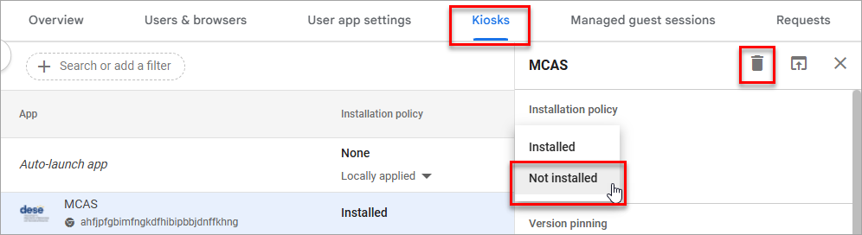

Uninstalling the Legacy Chrome App (used for spring 2025 testing)
Uninstall the 2025 MCAS Student Kiosk app on Chromebooks.
Sign in to the Google Admin Console.
On the left side, navigate to: Devices > Chrome > Apps & extensions.
Select the Kiosks tab at the top of the page.
Select the organizational unit for which you want to uninstall the legacy MCAS Chrome App.
Select Not installed and then Save to remove the app from the Chromebooks in the organizational unit. Alternatively, you can go to your top-most organization unit and select the Delete icon and then select Save to delete the app completely from your Google Admin Console.

Slide 13
2. Installing the New MCAS Web App for ChromeOS

Slide 14
Demonstration
Installing the PWA

Slide 15
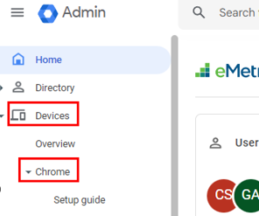
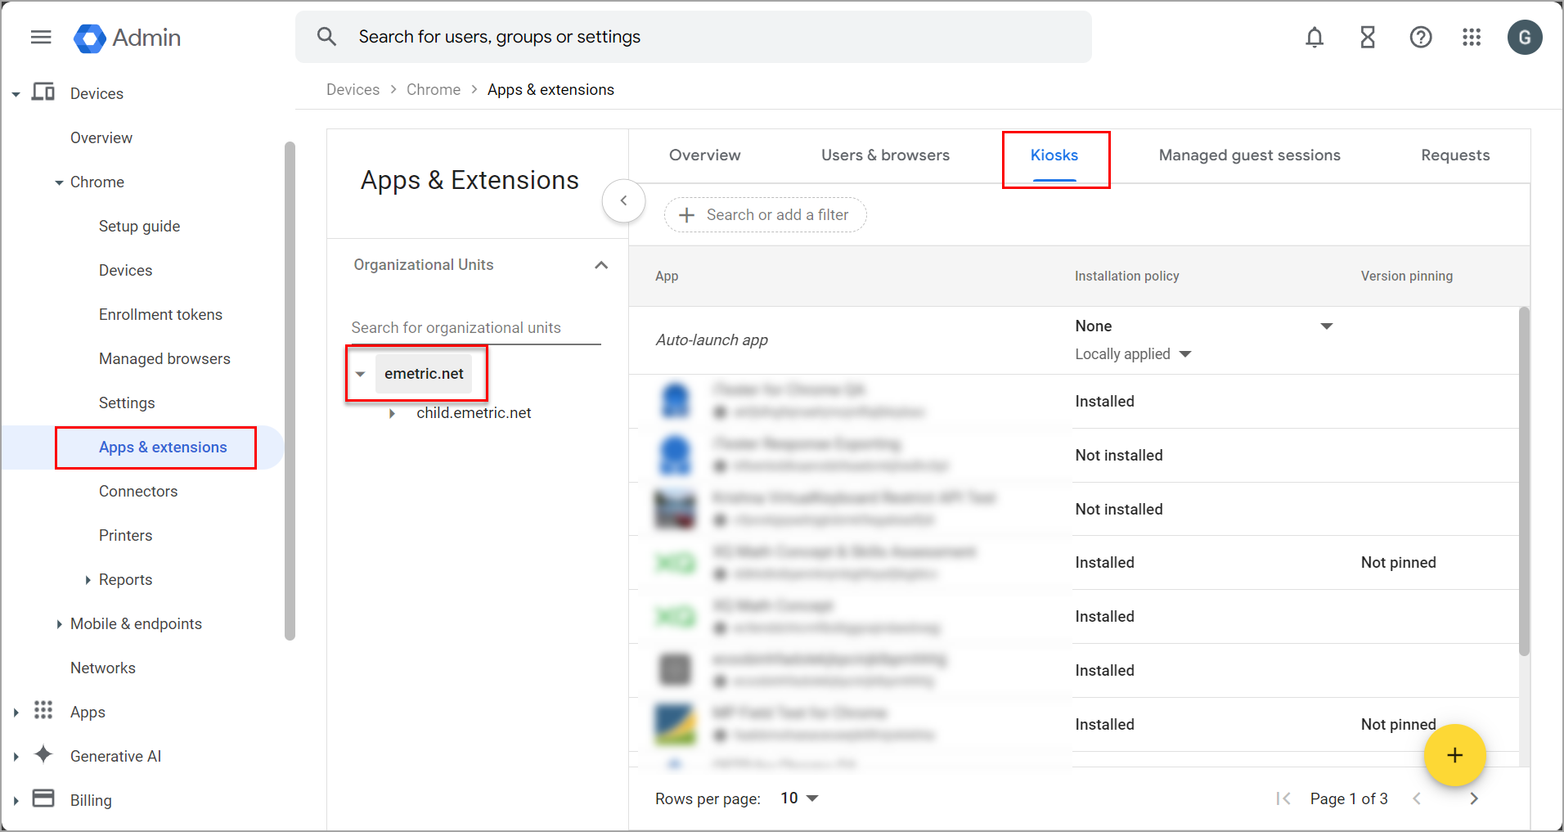

Installing the PWA
As the Chromebook administrator, log in to your ChromeOS management console (https://admin.google.com).
Expand the Devices menu, and then select Chrome.
Select Apps & Extensions and then Kiosks and select the organizational unit for which you want to install the MCAS Web App and Extension for ChromeOS.
Note: Ensure that child organizational units (OU) inherit the app and policy settings from the parent OU. If inheritance is disabled, the kiosk app will not appear on devices in those child OUs and the policy settings and app must be installed locally in the desired child OU.

Slide 16
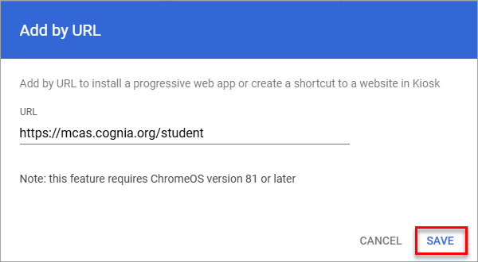
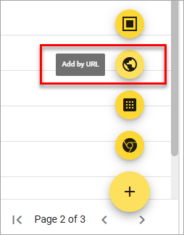
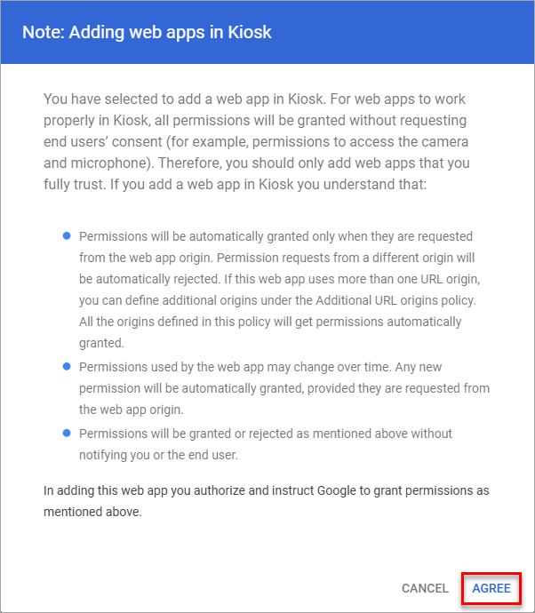
Installing the PWA (cont’d)
Expand the yellow + button in the bottom-right corner and select Add by URL.
Enter https://mcas.cognia.org/student and select Save.
Google will then prompt you to allow permissions to this app. Select Agree.

Slide 17
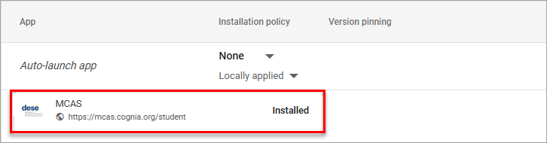
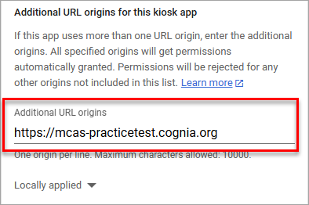
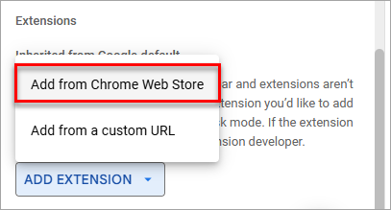
Installing the PWA (cont’d)
Check that the new MCAS web app for ChromeOS appears in the app list.
Select the MCAS app and scroll down the right-side bar to Additional URL origins field to add the following URL, exactly as shown:
Scroll down farther on the right-side bar to the Extension section. Click ADD EXTENSION and from the pop-up list select Add from Chrome Web Store.
https://mcas-practicetest.cognia.org

Slide 18
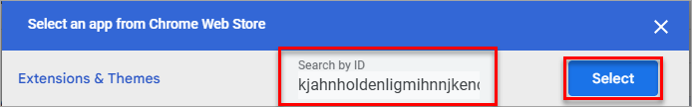
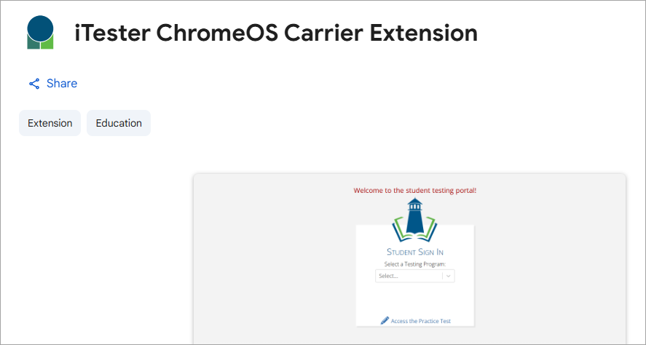
Installing the PWA (cont’d)
In the Chrome Web Store, type or copy/paste the iTester ChromeOS Carrier extension ID is entered exactly as it is shown below, with no additional spaces, in the Search by ID text box and then select the Select button to add the extension.
kjahnholdenligmihnnjkencnbfdbpdd

Slide 19
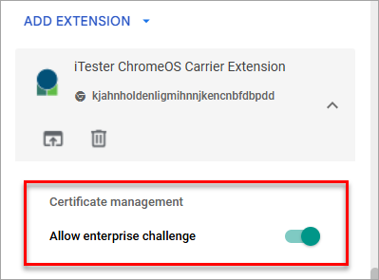
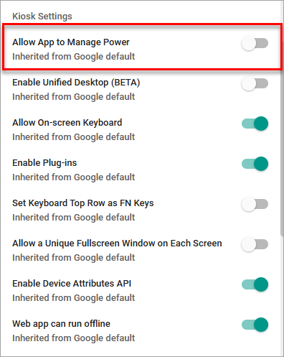
Installing the PWA (cont’d)
Once the extension has been added you need to enable Allow enterprise challenge. Under Certificate management, enable Allow enterprise challenge setting by moving the slider to the right. When it is enabled, it will show as green.
Important Note: Verify in Kiosk Settings that “Allow App to manage power” is disabled. To do this, click on Devices, Apps & Extensions and then select Kiosks. Click on the MCAS app name and check to make sure the setting Allow app to manage power is disabled (slider is moved to the left and not green).

Slide 20
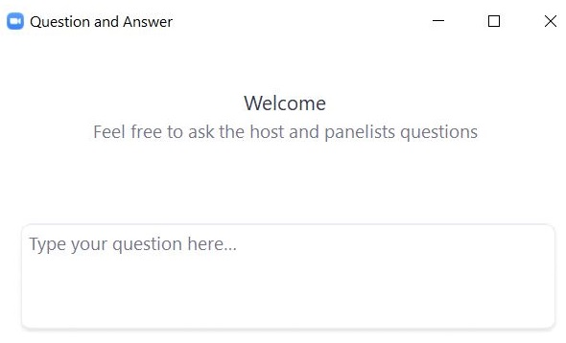
Questions & Answers
Use the “Q&A” feature
to ask questions.

Slide 21
3. Configure Device Settings

Slide 22
Demonstration
Configure device settings

Slide 23
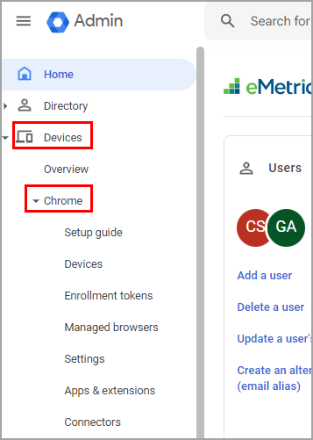
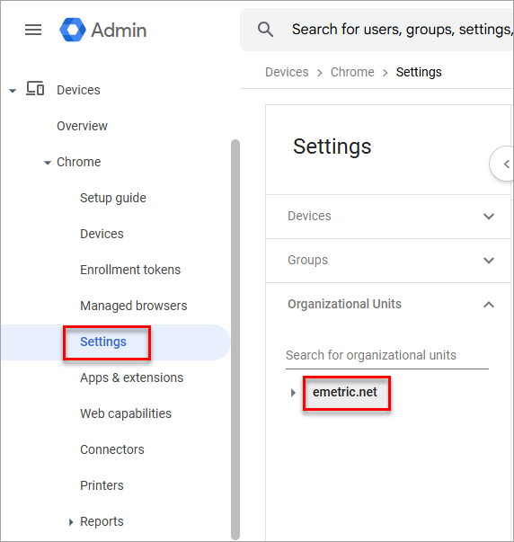
Configure Device Settings
In your Google Admin console, navigate to Devices, then select Chrome.
Click on Settings and then choose the relevant Organizational Unit where the MCAS web app is installed. In the example on this slide, the top Organizational Unit is emetric.net.

Slide 24
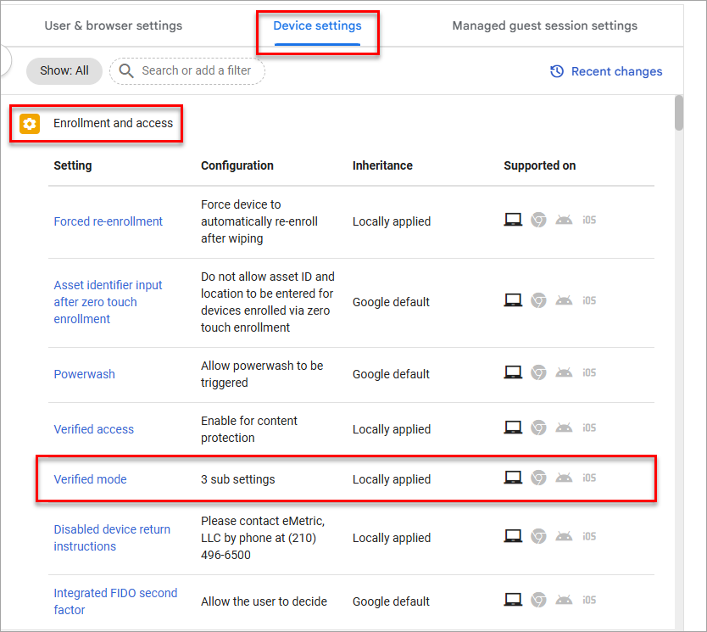
Configure Device Settings (cont’d)
Select the Device settings tab. Scroll to Enrollment and access and select Verified mode. Verified Mode ensures that only enrolled and trusted ChromeOS devices can run the ChromeOS PWA, and your testing environment remains secure and authenticated.

Slide 25
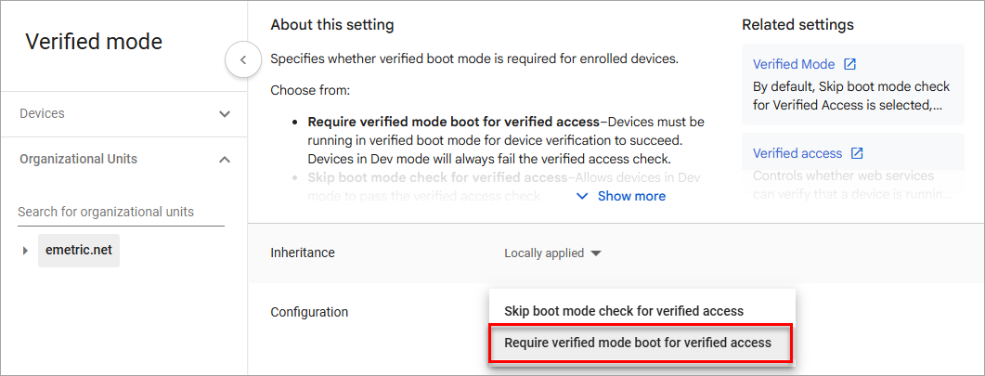
Configure Device Settings (cont’d)
Set configuration to: Required verified mode boot for verified access.

Slide 26
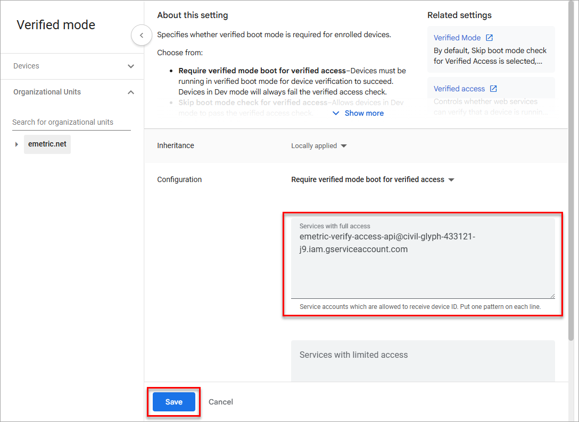
Configure Device Settings (cont’d)
5. In Verified mode, ensure the verified access service account is entered exactly as displayed below in the Services with full access section. We recommend entering this manually.
If using copy-paste, right click the email address and select Copy email address.
Then select Save.
emetric-verify-access-api@civil-glyph-433121-j9.iam.gserviceaccount.com
Note: Pay close attention when entering the service account, as any typos, missing hyphens, or added characters will prevent the app from entering kiosk mode.

Slide 27
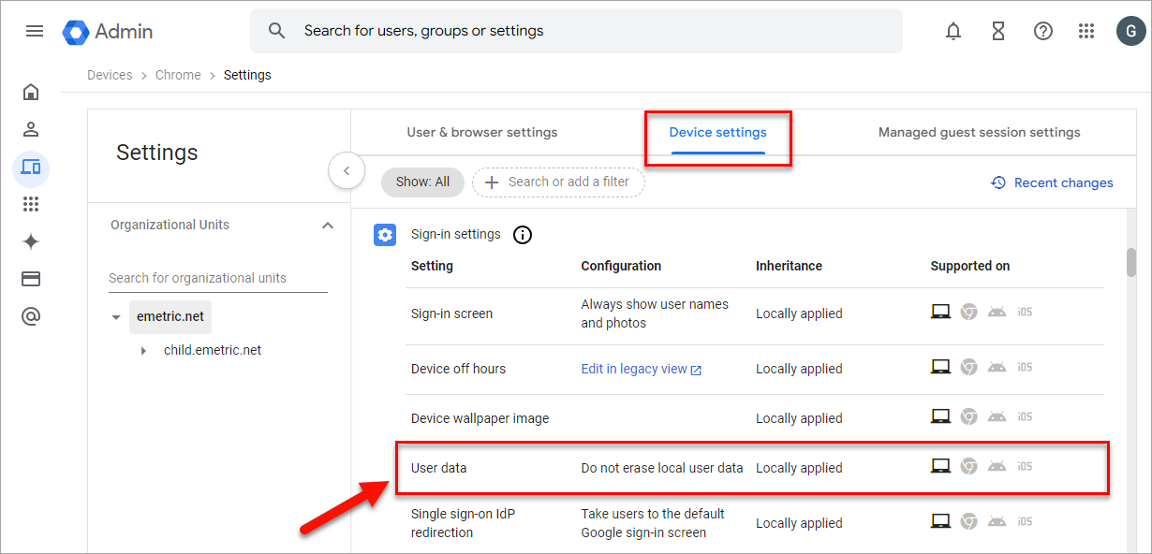
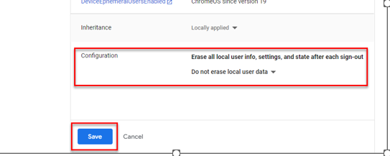
Configure Device Settings (cont’d)
Scroll to the User Data section under Sign-In Settings.
Verify that Do not erase all local data is set; if not, click on User Data to update the setting with the drop-down menu and click Save.
Note: This setting is crucial to allow Chrome local storage to be used to store student responses if network connectivity is lost. If this is not configured, student responses will not be saved to the device in the case of internet disruptions.

Slide 28
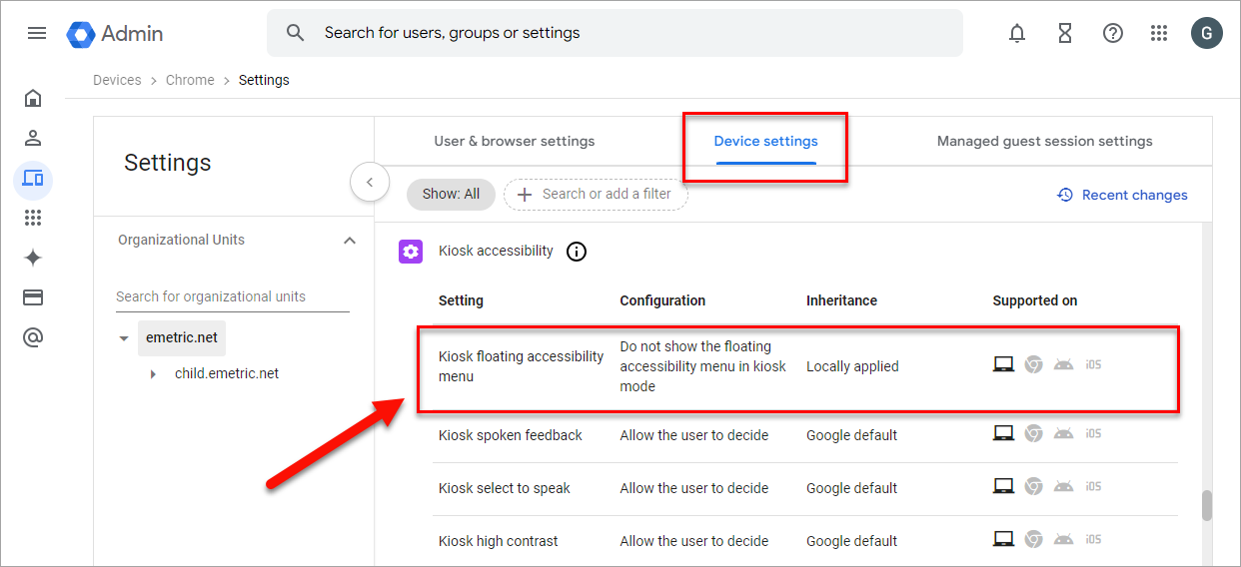
Configure Device Settings (cont’d)
Scroll to the Kiosk Floating Accessibility Menu in the Kiosk Accessibility section.

Slide 29
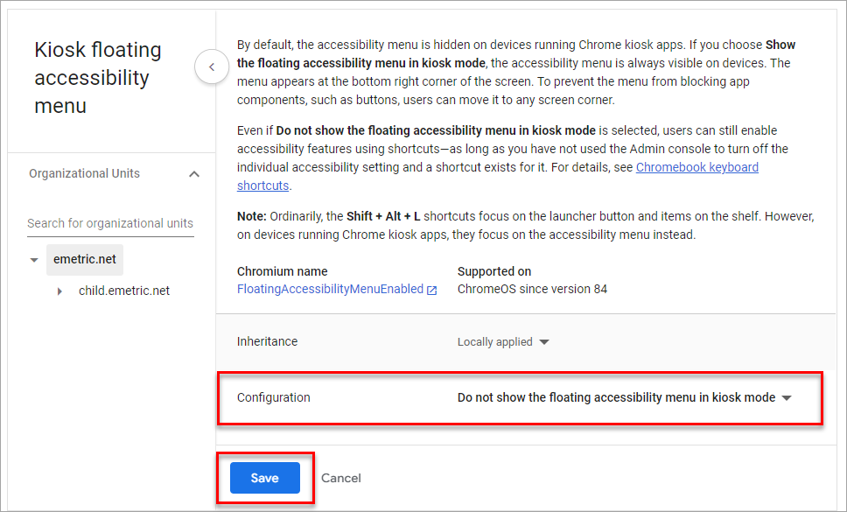

Configure Device Settings (cont’d)
Verify that Do not show the floating accessibility menu in kiosk mode is set; if not, click on Kiosk Floating Accessibility Menu to update the setting with the drop-down menu and click Save.
Note: Students with accommodations that are embedded within the MCAS Student Kiosk, including text-to-speech, word prediction, and speech-to-text, will access these accommodations directly through the MCAS Student Kiosk as they are delivered by the test platform. ChromeOS contains native accessibility features that may appear within the kiosk with a floating menu. Technology coordinators should disable the floating accessibility menu in Google Admin before testing occurs to avoid issues.

Slide 30
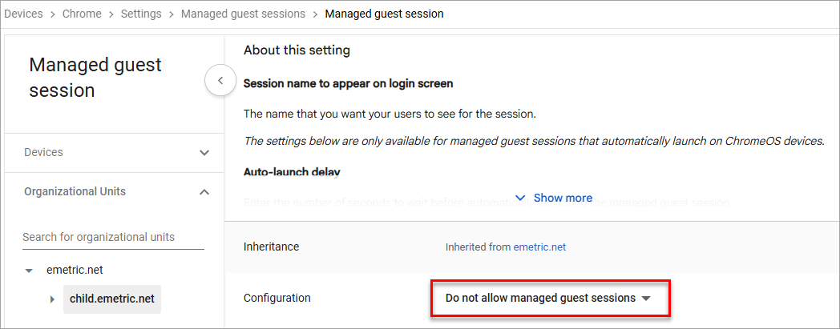
Configure Device Settings (cont’d)
Note on Managed Guest Sessions: To avoid students inadvertently entering guest sessions, we recommend disabling managed guest sessions on OUs used for testing. To disable, on the Settings page select the Managed guest session settings tab and then select Managed guest session. Ensure that Managed guest session is set to Do not allow managed guest sessions and click Save.

Slide 31
Important Reminders – Installing the PWA
Pay close attention when copy/pasting during installation and configuration as any typos, missing hyphens, added spaces, or added characters will prevent the app from entering kiosk mode.
If inheritance for the child organization is set to "Locally Applied" the Device Settings will not be inherited from the parent organization. If schools wish to keep the child organization set to Locally Applied, they must edit the Device Settings in that organization to match the parent organizational unit (OU) settings.
Verify in Kiosk Settings that “Allow App to manage power” is disabled. To do this, click on Devices, Apps & Extensions and then select Kiosks. Click on the MCAS app name and check to make sure the setting Allow app to manage power is disabled (slider is moved to the left and not green).

Slide 32
Important Reminders – Configuring Device Settings
The setting “Do not erase all local data” is crucial to allow Chrome local storage to be used to store student responses if network connectivity is lost. If this is not configured, student responses will not be saved to the device in the case of internet disruptions.
Students with accommodations that are embedded within the MCAS Student Kiosk, including text-to-speech, word prediction, and speech-to-text, will access these accommodations directly through the MCAS Student Kiosk as they are delivered by the test platform. ChromeOS contains native accessibility features that may appear within the kiosk with a floating menu. Technology coordinators should disable the floating accessibility menu in Google Admin before testing occurs to avoid issues.

Slide 33
Questions & Answers
Use the “Q&A” feature
to ask questions.

Slide 34
4. Steps to Take After Installation

Slide 35
Site Readiness Testing and Site Certification
After installing the ChromeOS PWA, all schools and districts must conduct site readiness testing. The Site Readiness tool includes the System Set-Up Test and the Student Interface Test and both parts must be completed.
  The System Set-Up Test tests bandwidth, connectivity, screen resolution, and the text-to-speech function.
  The Student Interface Test provides sample test questions to determine whether the device is capable of correctly displaying and navigating test content in the MCAS Student Kiosk.

Slide 36
Important Notes on Site Readiness
If you run the Check Student Interface test on a Chromebook and you receive the error message “This test must be taken with the kiosk or mobile app”, this is an indication that the MCAS web app and extension are not installed correctly in Google Admin console.
Results for Site Readiness testing will only display in the MCAS Portal if both parts of the Site Readiness test are taken.
Step-by-step instructions on completing Site Readiness and Site Certification are available in section V of the MCAS Student Kiosk Technology Guide.
Site Readiness steps will be covered during the February 2 Technology Coordinator Training.

Slide 37
Questions & Answers
Use the “Q&A” feature
to ask questions.

Slide 38
5. Resources, Support, and Next Steps

Slide 39
Additional Resources
Resource | Location
MCAS Resource Center | mcas.onlinehelp.cognia.org
MCAS Portal user guides | https://mcas.onlinehelp.cognia.org/portal/
MCAS Student Kiosk Technology Guide (including excepts) | https://mcas.onlinehelp.cognia.org/technology-setup/
Student Assessment Updates (Biweekly email with important updates about the MCAS program) | www.doe.mass.edu/mcas/updates.html If you do not already receive this email, subscribe using this link: http://eepurl.com/ghSOhH

Slide 40
Next Steps
Today: Complete the evaluation form.
  Responses are associated with the name and email address used to log in.
  Email your input to mcas@mass.gov if you have problems accessing or completing the form.
Within one week:
  Receive an email with the Q&A from this session
  Recording will be available

Slide 41
Email and Phone Support
DESE Student Assessment Services
MCAS Service Center
Questions on logistics and technology
  Web: https://mcas.onlinehelp.cognia.org/
  Email: mcas@cognia.org
  Phone: 800-737-5103
  TTY: 888-222-1671
  Live chat is available at the link on the bottom of the page at the MCAS Resource Center
Policy questions (e.g., student participation, accommodations)
  Web: www.doe.mass.edu/mcas
  Email: mcas@mass.gov
  Phone: 781-338-3625
  TTY: 800-439-2370

Slide 42
6. Live “Sandbox” Time

Slide 43
Poll Question
Which demonstrations would you like to see again?
Installing the PWA
Configuring device settings
Reviewing Site Readiness results

Slide 44




THANK YOU
The Office of Student Assessment Services
781-338-3625
mcas@mass.gov
www.doe.mass.edu/mcas
135 Santilli Highway, Everett, MA 02149

