Slide 1
Scoring of Grade 10 Mathematics
MCAS
Constructed Response Questions
February 29, 2024

Slide 2
Agenda
Overview of MCAS test development and scoring process
Grade 10 Constructed Response (CR) scoring
  Question 1: Statistics and Probability – S-ID.B.5
  Question 2: Number and Quantity – N-Q.A.1
Practice with scoring student work samples
Review of resources available on the Department’s website

Slide 3
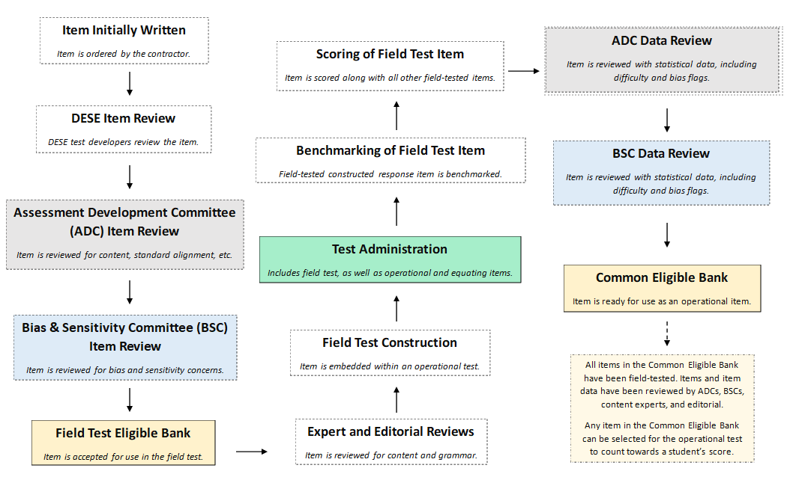
Life Cycle of a MCAS Mathematics Question

Slide 4
Constructed Response (CR) Questions
Students write a response to a multi-part question.
Responses are scored holistically.
Students are often asked to "Show or explain" how they got their answer.
All parts of a CR must be answered for full credit.
Student performance is based on the overall demonstration of understanding.

Slide 5
Things to Know
  Spelling, grammar, and punctuation are not considered in the scoring of a response​.
  A response does not need to be in a complete sentence​.
  Information not related to what is being asked does not detract from the score a response receives​.
  In multi-step problems, the same error is counted only once.
  Only whole score points for overall responses. E.g. A student cannot receive 2.5 points.
  How a student explains their answer/reasoning can often vary. For instance,
    student 1 may show all their calculations and their final answer, and
    student 2 may write an explanation in sentence form explaining a step-by-step process along with their answer.

Slide 6
Scoring Overview: Benchmarking Process
Hundreds of student responses are reviewed for training materials.
Training materials consist of:
  Detailed training notes:
    More detailed than scoring guides
    Include exemplary responses, calculations, and other content information
    Include instructions for scoring different types of responses
    Include how points should be distributed
  Benchmarked student responses: selected anchor papers that show a full range of scores.

Slide 7
Scoring Overview: Scorer Process
Scoring leaders and individual scorers are trained for each question. They must have content expertise.
Each MCAS mathematics constructed response scorer must:
  participate in constructed response specific training
  qualify to score each constructed response question
All leaders/scorers must show accuracy and consistency on practice papers before they are allowed to score “live” papers
A scorer’s performance is monitored during the scoring process by measures such as read-behinds and embedded responses to ensure accuracy
All responses are scored by more than one scorer for score accuracy

Slide 8
First Scoring Demonstration
Question 1: S-ID.B.5 (Released 2021)
  Review the following:
    the Question,
    the Sample Response,
    the Scoring Guide, and
    the Scoring Notes.
  Analyze the Training responses

Slide 9
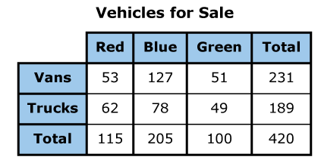
Question 1: Grade 10 – Statistics & Probability – Released 2021
On page 2 of your Packet
This question has four parts
The types and colors of the vehicles for sale at a dealership are shown in this table.
Part A
Based on the table, what percentage of the vehicles for sale at the dealership are trucks? Show or explain how you got your answer.
Enter your answer and your work or explanation in the space provided.
Part B
What fraction of the vans for sale at the dealership are blue? Show or explain how you got your answer.
Enter your answer and your work or explanation in the space provided.
Part C
What fraction of the vehicles for sale at the dealership are red or are vans? Show or explain how you got your answer.
Enter your answer and your work or explanation in the space provided.
Part D
How many of the vehicles for sale at the dealership are vans and are either red or green? Show or explain how you got your answer.
Enter your answer and your work or explanation in the space provided.

Slide 10
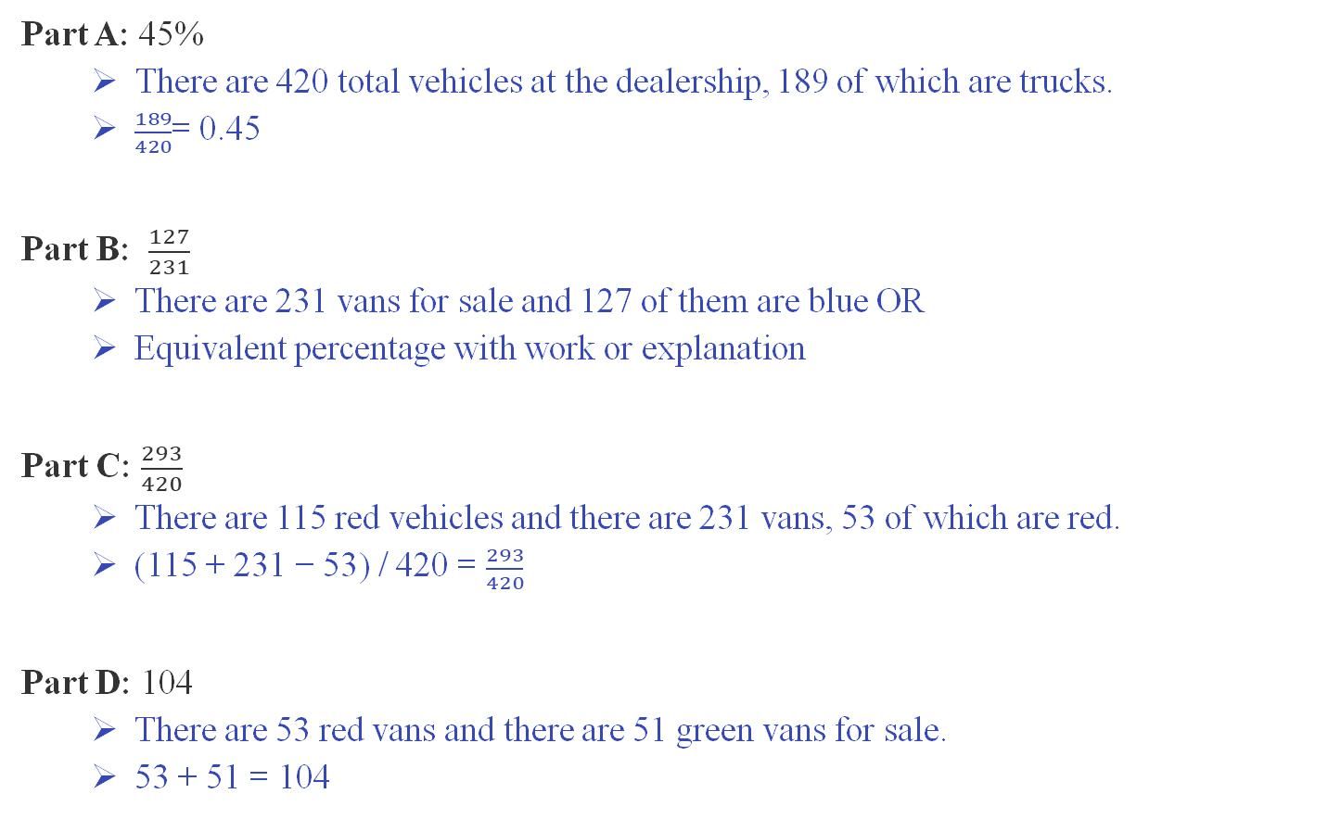
Grade 10 Question Sample Response
On page 3 of your Packet
Part A: 45%
  There are 420 total vehicles at the dealership, 189 of which are trucks.
  $\frac{189}{420}$= 0.45
Part B: $\frac{127}{231}$
  There are 231 vans for sale and 127 of them are blue OR
  Equivalent percentage with work or explanation
Part C: $\frac{293}{420}$
  There are 115 red vehicles and there are 231 vans, 53 of which are red.
  (115 + 231 − 53) / 420 = $\frac{293}{420}$
Part D: 104
  There are 53 red vans and there are 51 green vans for sale.
  53 + 51 = 104

Slide 11
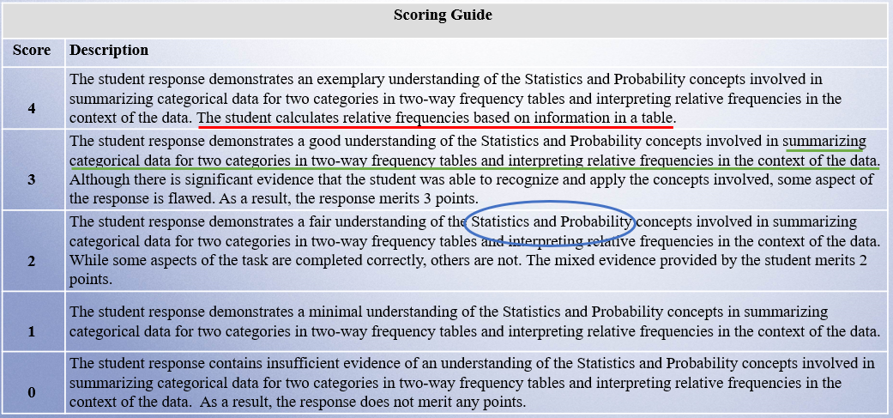
Grade 10 Scoring Guide
On page 4 of your Packet

Slide 12
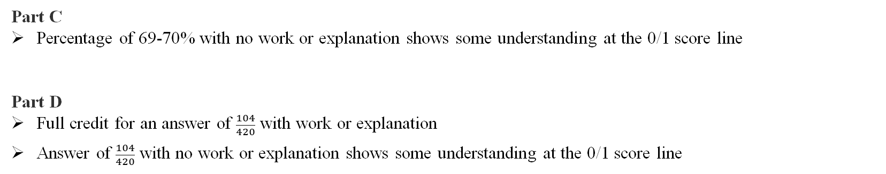
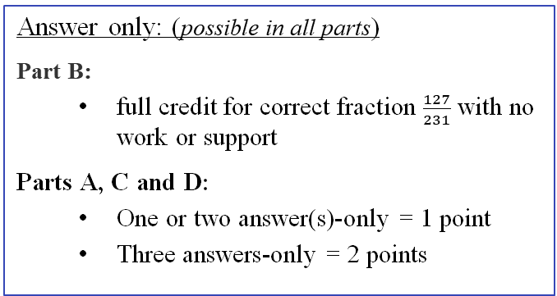
Grade 10 Question Scoring Notes
On page 5 of your Packet
Part A
Correct fraction with incorrect percentage is scored as answer-only
Part B:
Full credit for correct fraction with no work/explanation since information can only be found by reading table correctly
Full credit for a correct percentage with correct fraction in work or explanation
Answer only: (possible in all parts)
Part B:
  full credit for correct fraction $\frac{127}{231}$ with no work or support
Parts A, C and D:
  One or two answer(s)-only = 1 point
  Three answers-only = 2 points
Part C
Percentage of 69-70% with no work or explanation shows some understanding at the 0/1 score line
Part D
Full credit for an answer of $\frac{104}{420}$ with work or explanation
Answer of $\frac{104}{420}$ with no work or explanation shows some understanding at the 0/1 score line

Slide 13
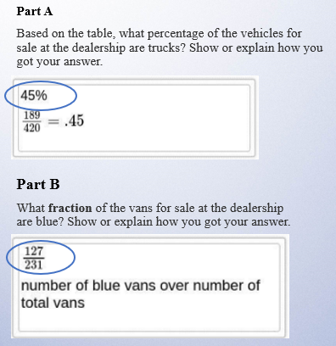
Training Response: Score 4
On page 7 of your Packet
This question has four parts
The types and colors of the vehicles for sale at a dealership are shown in this table.

Slide 14
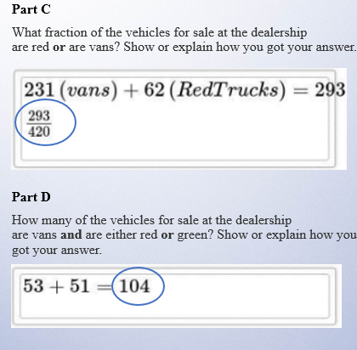
Training Response: Score 4 Cont'd
On page 7 of your Packet
This question has four parts
The types and colors of the vehicles for sale at a dealership are shown in this table.

Slide 15
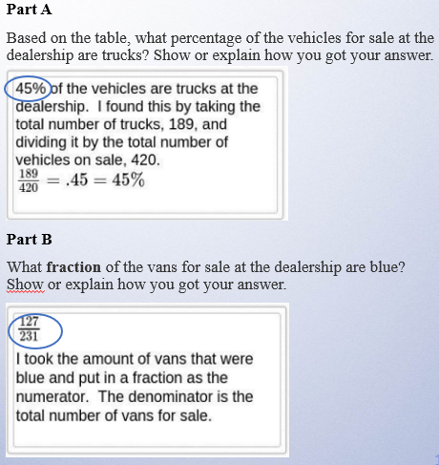
Training Response: Score 3
On page 8 of your Packet
This question has four parts
The types and colors of the vehicles for sale at a dealership are shown in this table.

Slide 16
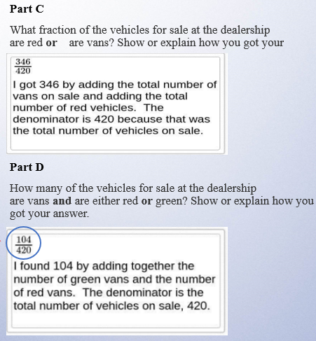
Training Response: Score 3 Cont'd
On page 8 of your Packet
This question has four parts
The types and colors of the vehicles for sale at a dealership are shown in this table.
Correct with explanation per Scoring notes

Slide 17
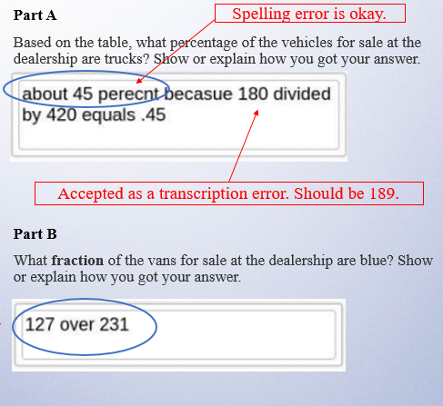
Training Response: Score 2
On page 9 of your Packet
This question has four parts
The types and colors of the vehicles for sale at a dealership are shown in this table.
Description of fraction is okay.

Slide 18
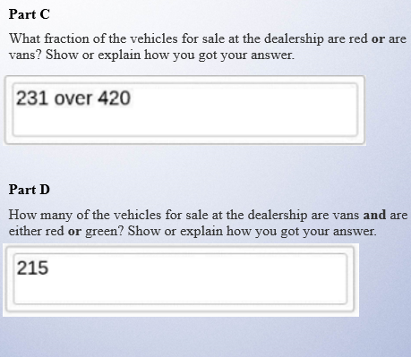
Training Response: Score 2 Cont'd
On page 9 of your Packet
This question has four parts
The types and colors of the vehicles for sale at a dealership are shown in this table.

Slide 19
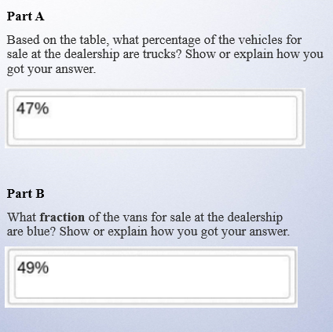
Training Response: Score 1
On page 10 of your Packet
This question has four parts
The types and colors of the vehicles for sale at a dealership are shown in this table.

Slide 20
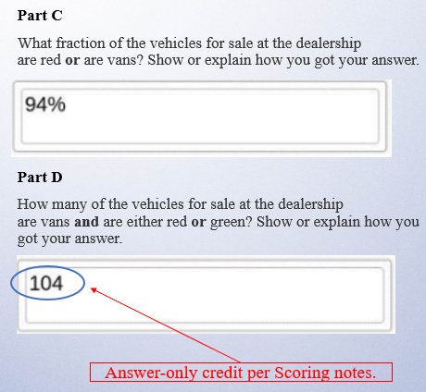
Training Response: Score 1 Cont'd
On page 10 of your Packet
This question has four parts
The types and colors of the vehicles for sale at a dealership are shown in this table.

Slide 21
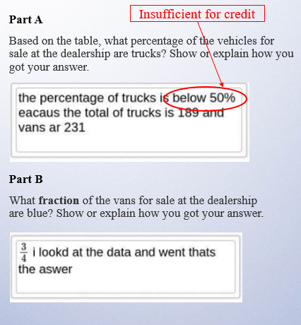
Training Response: Score 0
On page 11 of your Packet
This question has four parts
The types and colors of the vehicles for sale at a dealership are shown in this table.

Slide 22
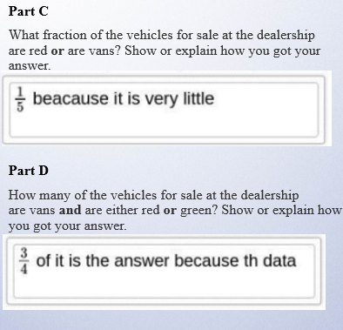
Training Response: Score 0 Cont'd
On page 11 of your Packet
This question has four parts
The types and colors of the vehicles for sale at a dealership are shown in this table.

Slide 23
Individual Practice of Scoring Student Responses
Question 1: S-ID.B.5 (Released 2021)
  Revisit the following:
    the Question,
    the Sample Response,
    the Scoring Guide, and
    the Scoring Notes.
  Read the Sample Response
  Use the Training Response papers to score the response
  Choose one score that you think best represents the response.

Slide 24

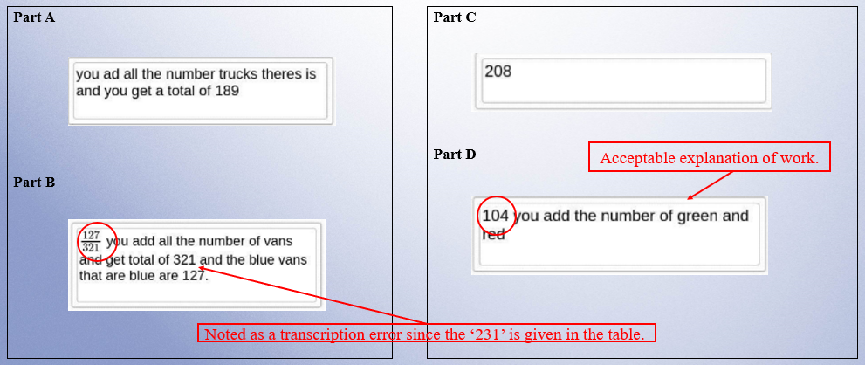
Practice Response A
On page 13 of your Packet

Slide 25

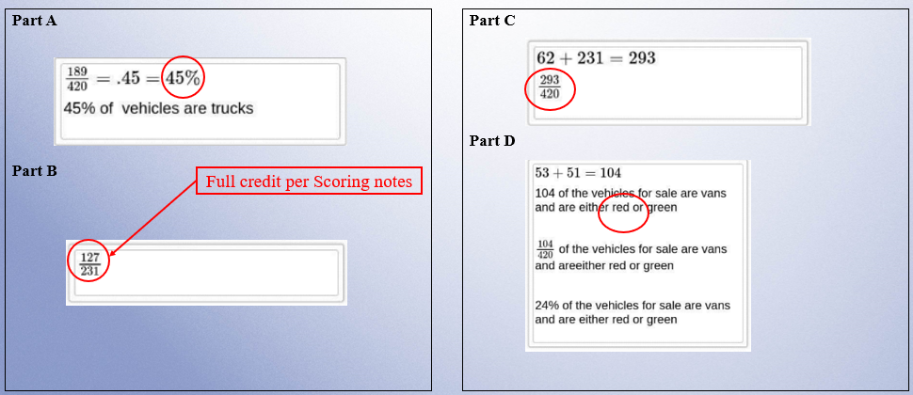
Practice Response B
On page 14 of your Packet

Slide 26

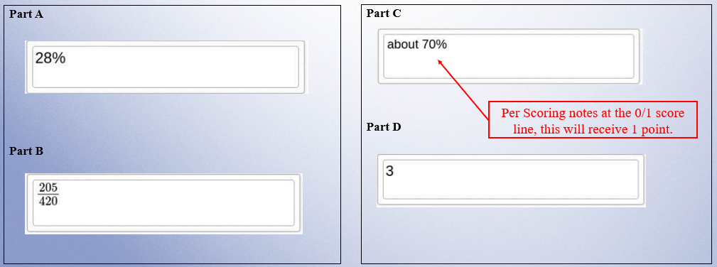
Practice Response C
On page 15 of your Packet

Slide 27

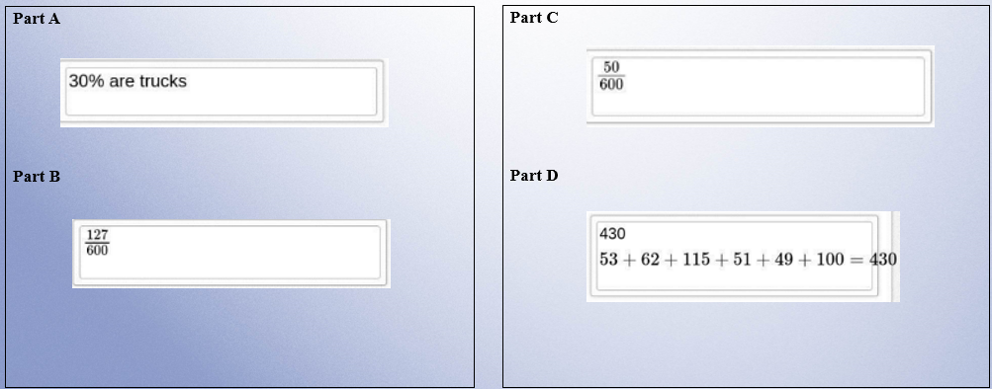
Practice Response D
On page 16 of your Packet

Slide 28

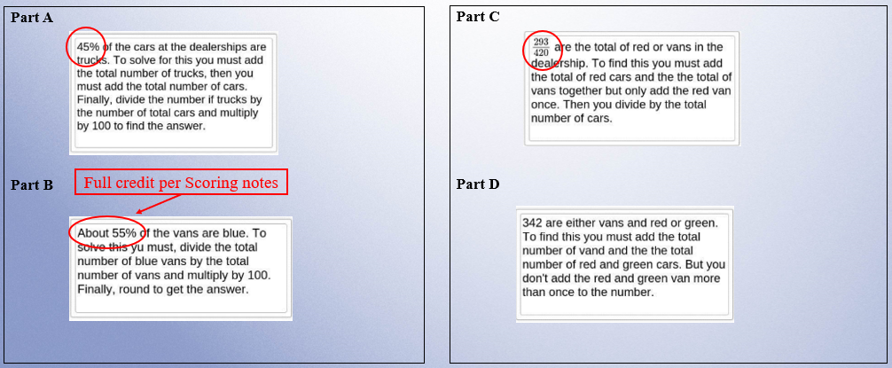
Practice Response E
On page 17 of your Packet

Slide 29
Second Scoring Demonstration
Question 2: N-Q.A.1 (Released 2023)
  Review the following:
    the Question,
    the Sample Response,
    the Scoring Guide, and
    the Scoring Notes.
  Analyze the Training responses

Slide 30
Question 2: Grade 10 – Number & Quantity – Released 2023
On page 18 of your Packet
This question has four parts
Ellis runs around a track at a constant speed.
The distance around the track is ¼ mile.
It takes Ellis 3.2 minutes to run around the track once.
Part A
What is the total amount of time, in minutes, it takes Ellis to run one mile? Show or explain how you got your answer.
Enter your answer and your work or explanation in the space provided.
Part B
What is the total distance, in feet, Ellis runs in 1 minute? Show or explain how you got your answer.
Enter your answer and your work or explanation in the space provided.
Part C
What is the rate, in miles per hour, Ellis runs around the track? Show or explain how you got your answer.
Enter your answer and your work or explanation in the space provided.
Part D
Ellis will run for 40 minutes every day for 5 days, with a goal of running a total of 15 miles. Will Ellis meet this goal? Explain your reasoning.
Enter your answer and your explanation in the space provided.

Slide 31
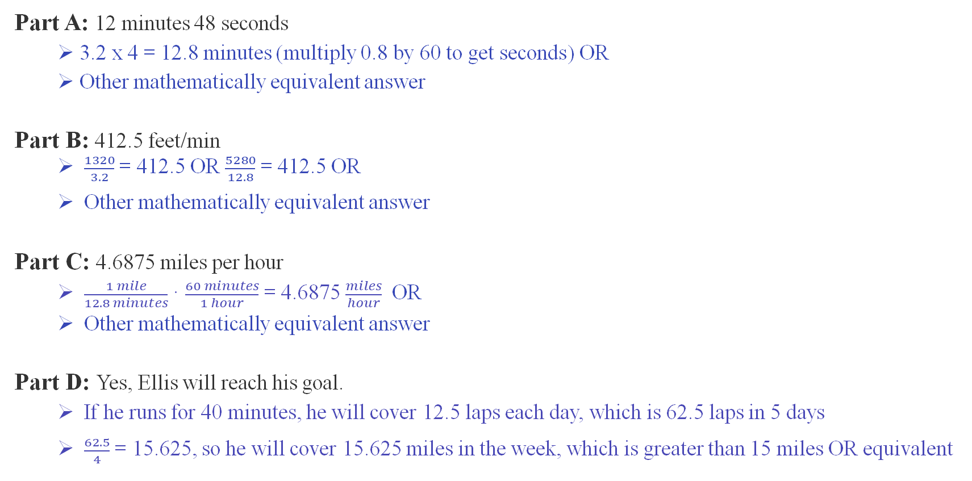
Grade 10 Question Sample Response
On page 19 of your Packet
Part A: 12 minutes 48 seconds
  3.2 x 4 = 12.8 minutes (multiply 0.8 by 60 to get seconds) OR
  Other mathematically equivalent answer
Part B: 412.5 feet/min
  $\frac{1320}{3.2}$ = 412.5 OR $\frac{5280}{12.8}$ = 412.5 OR
  Other mathematically equivalent answer
Part C: 4.6875 miles per hour
  $\frac{1 mile}{12.8 minutes}$ · $\frac{60 minutes}{1 hour}$ = 4.6875 $\frac{miles}{hour}$ OR
  Other mathematically equivalent answer
Part D: Yes, Ellis will reach his goal.
  If he runs for 40 minutes, he will cover 12.5 laps each day, which is 62.5 laps in 5 days
  $\frac{62.5}{4}$ = 15.625, so he will cover 15.625 miles in the week, which is greater than 15 miles OR equivalent

Slide 32
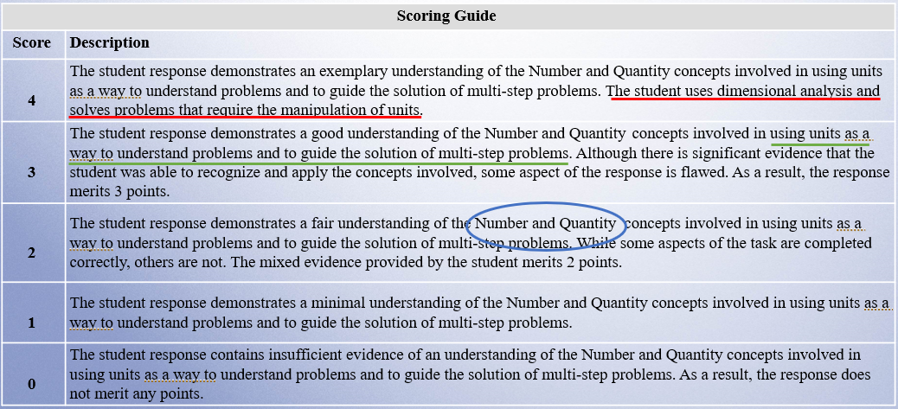
Grade 10 Scoring Guide
On page 20 of your Packet

Slide 33
Grade 10 Question Scoring Notes
On page 21 of your Packet
Part A:
Full credit for rounding to 13 or truncating to 12 with appropriate work/explanation.
No credit for rounding/truncating to 13 or 12 with no work/explanation. It is not accepted as answer-only.
Part B:
Full credit for truncating 412.5 to 412 with appropriate work/explanation.
No credit for calculating 1320 feet per ¼ mile
Part C:
A response of 4.6 or 4.7 (or more precise) is acceptable without support and is scored as answer-only.
Full credit for rounding to 5 or truncating to 4 with appropriate work/explanation.
No credit for a response of 4 or 5 only.
Part D:
This question is dichotomous, so no credit for a response of “yes” only.
Full credit for a response of “yes” with supporting work or explanation to show more than 15 miles running.
Full credit for a response of “yes” with supporting work or explanation to show fewer than 200 minutes running.
Answer only (possible in Parts A, B and C):
One or two answer(s)-only = 1 point
Three answers-only = 2 points
Handy conversions:
1 mile = 5280 feet
1 mile = 1760 yards
¼ mile = 1320 feet
¼ mile = 440 yards

Slide 34
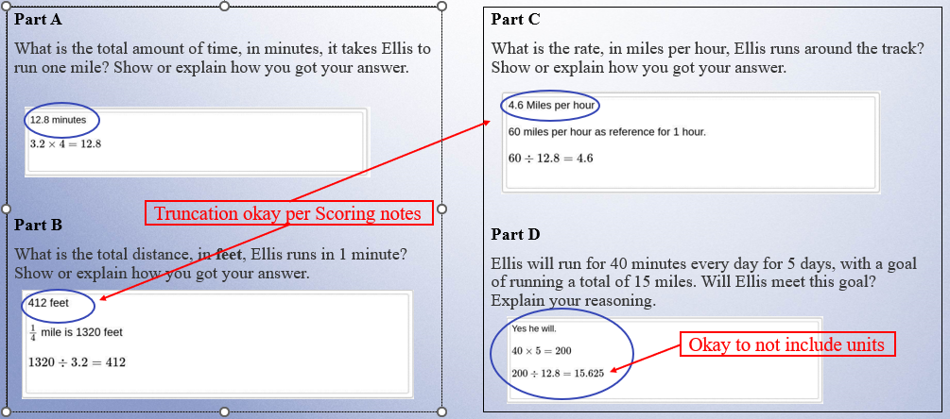
Training Response: Score 4
On page 23 of your Packet

Slide 35
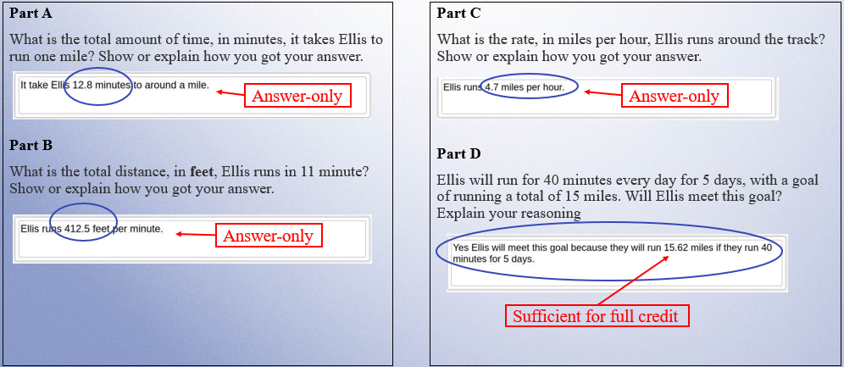
Training Response: Score 3
On page 24 of your Packet

Slide 36
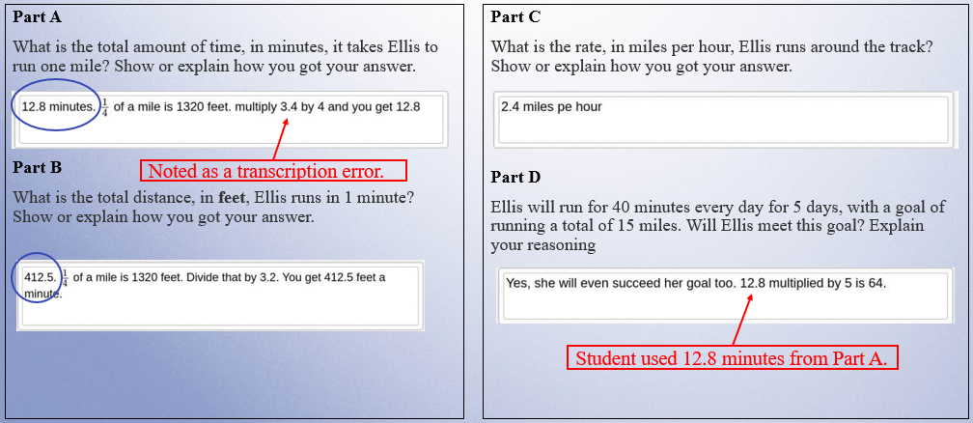
Training Response: Score 2
On page 25 of your Packet

Slide 37
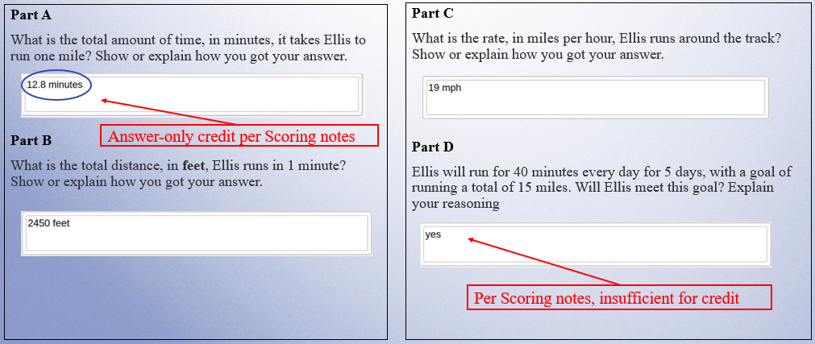
Training Response: Score 1
On page 26 of your Packet

Slide 38
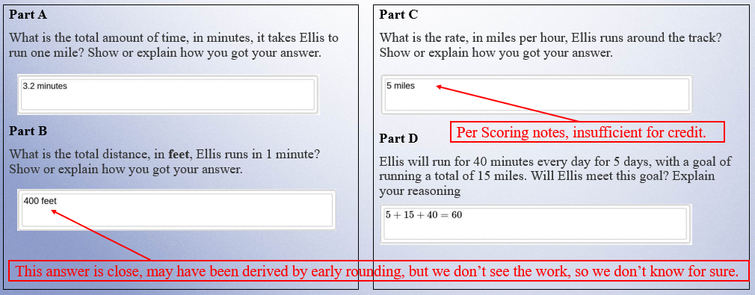
Training Response: Score 0
On page 27 of your Packet

Slide 39
Individual Practice of Scoring Student Responses
Question 2: N-Q.A.1 (Released 2023)
  Revisit the following:
      the Question,
      the Sample Response,
      the Scoring Guide, and
      the Scoring Notes.
  Read the Sample Response
  Use the Training Response papers to score the response
  Choose one score that you think best represents the response

Slide 40

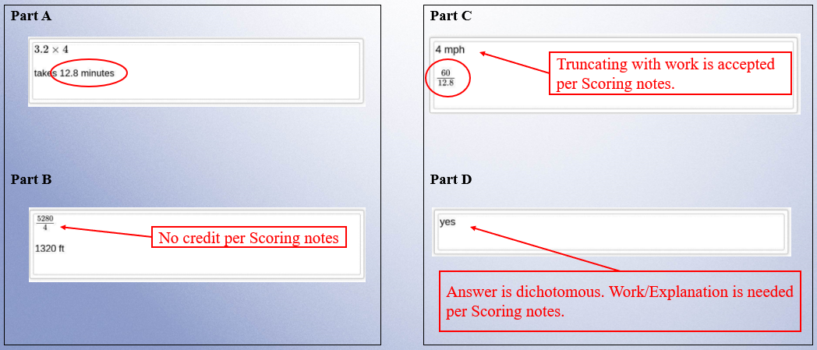
Practice Response A
On page 29 of your Packet

Slide 41

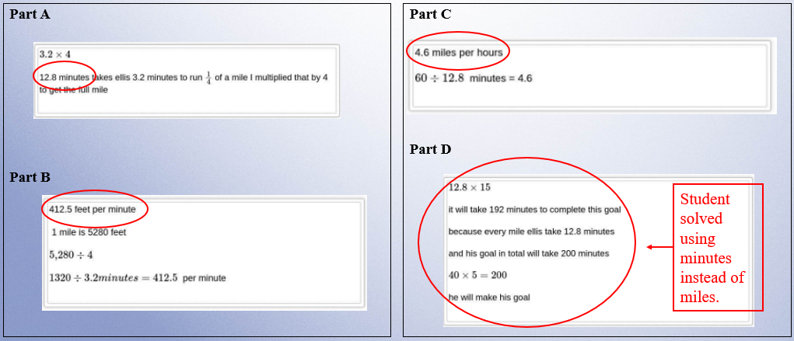
Practice Response B
On page 30 of your Packet

Slide 42

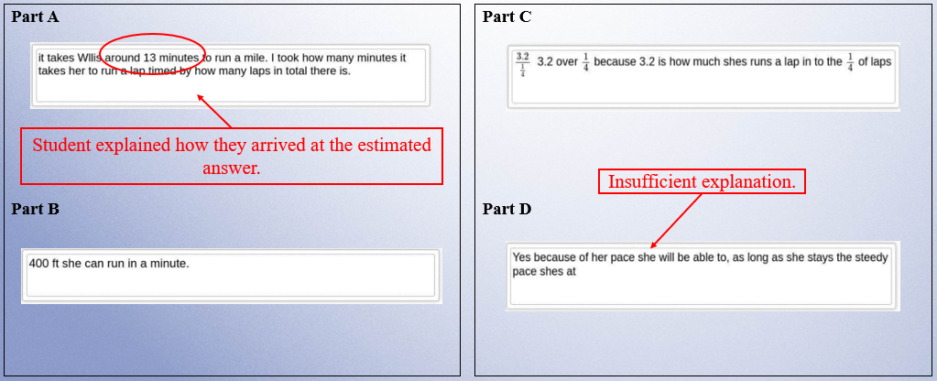
Practice Response C
On page 31 of your Packet

Slide 43

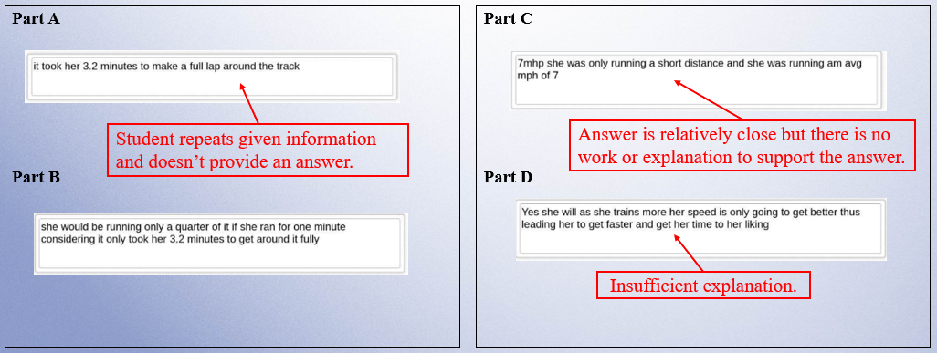
Practice Response D
On page 32 of your Packet

Slide 44

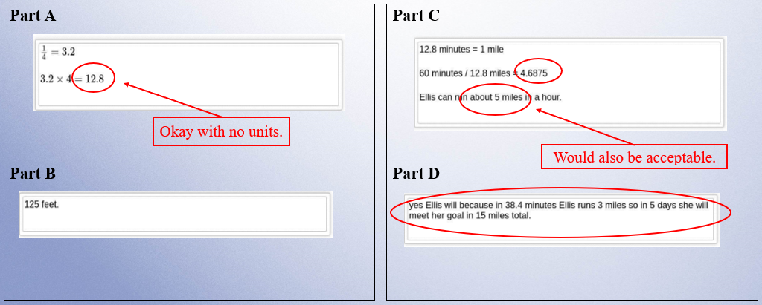
Practice Response E
On page 33 of your Packet

Slide 45
Resources on DESE Website
Resource | Link
MCAS headlines and links to MCAS site | https://www.doe.mass.edu/mcas/
Mathematics Test Designs | https://www.doe.mass.edu/mcas/tdd/math.html?section=testdesign
List of Standards Assessed on Grade 10 | https://www.doe.mass.edu/mcas/tdd/testdesign/g10-math-nextgen-standards.docx
Student Work Samples | https://www.doe.mass.edu/mcas/student/default.html
Released Questions | http://mcas.pearsonsupport.com/released-items/math
Practice Tests and Tutorial | http://mcas.pearsonsupport.com/student/

Slide 46
Contact Information
DESE Office of Student Assessment for policy questions
(e.g., test designs, accommodations)
Web: www.doe.mass.edu/mcas
Email: mcas@mass.gov (new)
Phone: 781-338-3625
MCAS Service Center
Web: http://mcasservicecenter.com
Phone: 1-800-737-5103

Slide 47

THANK YOU

