Slide 1
MCAS Scoring of
Science & Technology/Engineering
Constructed-Response Items:
Introductory Physics
2024

Slide 2

Today’s Agenda
Overview of MCAS test development and scoring process
Introductory Physics constructed-response (CR) scoring
  Roller Coaster CR
  Series Circuit CR
Review resources available on the Department’s website

Slide 3
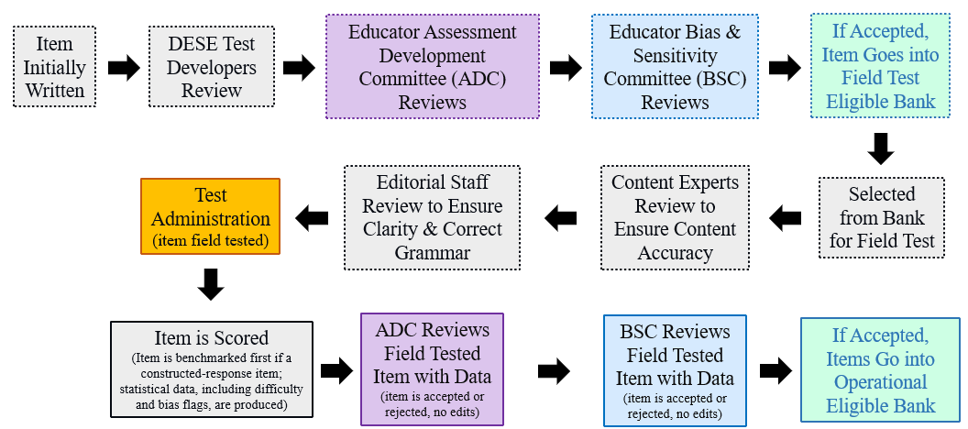
Life Cycle of Science and Technology/Engineering (STE) Item

Slide 4
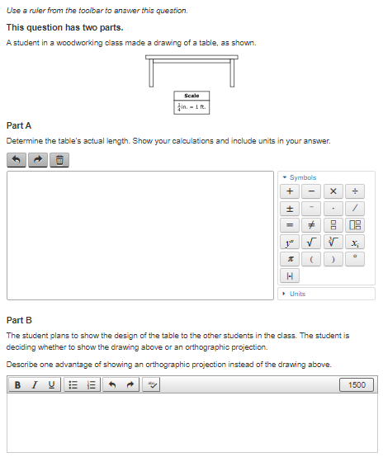
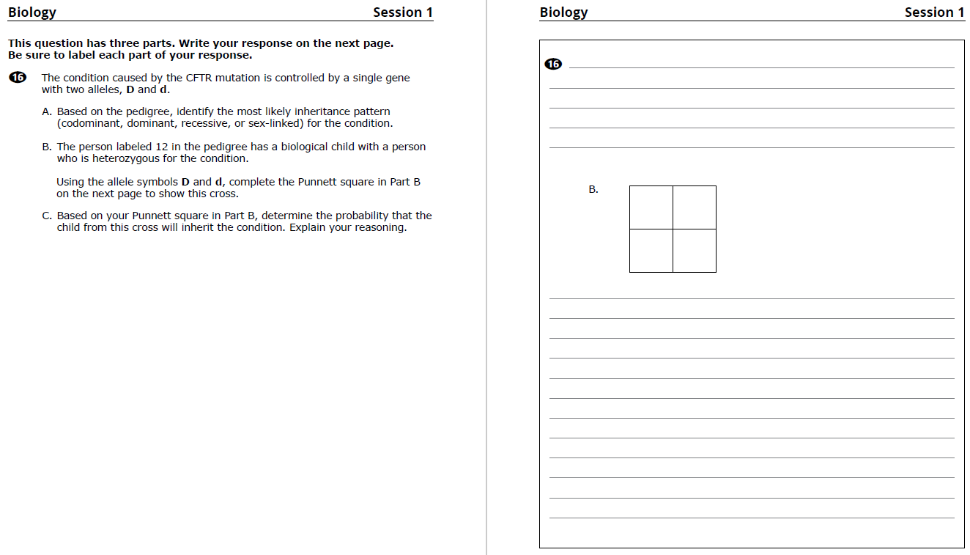
Constructed-Response (CR) Questions
Students write a response to a multi-part question
Often ask students to explain their reasoning, use evidence from data, or show their work
Scored holistically with partial credit
CBT
PBT

Slide 5

Things Not Scored on Science Tests
Spelling, grammar, and punctuation
Above grade-level misconceptions
Extra or irrelevant information (though caution against this)
Using an incorrect calculation from a previous part of an item (typically)
Significant figures

Slide 6

Full Credit
Students who earn full credit:
Answer all parts
Apply correct content knowledge and practices
Follow instructions, such as:
    Explaining reasoning
    Using data from a table or graph to support an answer
    Showing calculations and including correct units

Slide 7

Scoring Overview: Benchmarking
Review and discuss the scoring of student responses
Adjust detailed scoring notes, which include:
  Correct responses with reasoning/calculations
  How points are assigned
  Scoring rules for holistic scoring
Training packs are put together, which include:
  3 “anchor” papers for each score level
  1+ practice papers for each score level

Slide 8
Scoring Overview: How Responses are Scored
Scoring leaders/scorers have content expertise, including college-level courses for the assigned test
Before scoring each question, every scorer must:
  Participate in a detailed training on how to score the responses
  Satisfactorily score a qualification set made up of actual student responses
Embedded responses and read-behinds by scoring leaders are used to monitor a scorer's performance and ensure scoring accuracy
All high school responses are scored by two scorers

Slide 9
Constructed Response Scoring Training and Practice
Question, score guide, and scoring notes review
Anchor papers
Individual scoring of student responses

Slide 10
Introductory Physics Energy
Question
2022
Roller Coaster

Slide 11
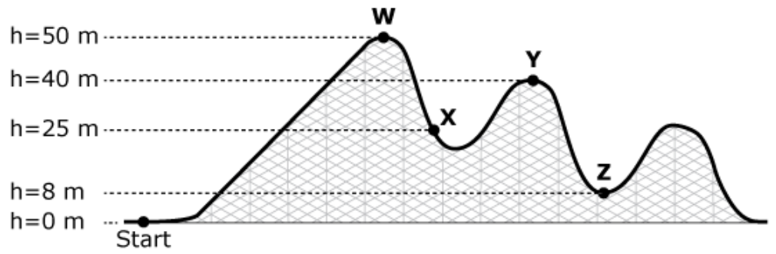

Question –Page 2
A diagram of a roller coaster track at an amusement park is shown. The location where passengers get into a car to ride along the track is labeled “Start.” Four additional points along the track are labeled W, X, Y, and Z.
For one ride, a car and its passengers had a total mass of 4500 kg. The car was pulled with a motor from the starting point to point W. The car was held at rest at point W until it was released. The car then moved along the track to point Z with negligible friction.
Part A
Identify the point on the roller coaster track where the car and its passengers had the greatest amount of gravitational potential energy.
Part B
Calculate the amount of gravitational potential energy the car and its passengers had at the point you identified in Part A. Show your calculations and include units in your answer.
Part C
Compare the amount of kinetic energy of the car and its passengers at point Y to the amount of kinetic energy of the car and its passengers at point Z. Explain your reasoning.
Part D
Identify the height at which the kinetic energy of the car and its passengers was equal to the gravitational potential energy of the car and its passengers. Explain your reasoning.

Slide 12
Item Information
Standard Alignment: HS-PS3-1
  Use algebraic expressions and the principle of energy conservation to calculate the change in energy of one component of a system when the change in energy of the other component(s) of the system, as well as the total energy of the system including any energy entering or leaving the system, is known. Identify any transformations from one form of energy to another, including thermal, kinetic, gravitational, magnetic, or electrical energy, in the system. Clarification Statement: Systems should be limited to two or three components and to thermal energy; kinetic energy; or the energies in gravitational, magnetic, or electric fields.
Practice Category Alignment: B. Mathematics and Data
  Analyzing and Interpreting Data
  Using Mathematics and Computational Thinking

Slide 13
Scoring Guide – Page 3
Score | Description
4 | The response demonstrates a thorough understanding of energy conservation, including the transformation of gravitational potential energy to kinetic energy. The response correctly identifies the point where the car had the greatest gravitational potential energy and correctly calculates the car's gravitational potential energy at that point. The response correctly compares the car's kinetic energy at point Y to the car's kinetic energy at point Z and clearly explains the reasoning. The response also correctly identifies the height at which the kinetic energy of the car was equal to the gravitational potential energy of the car and clearly explains the reasoning.
3 | The response demonstrates a general understanding of energy conservation, including the transformation of gravitational potential energy to kinetic energy.
2 | The response demonstrates a limited understanding of energy conservation, including the transformation of gravitational potential energy to kinetic energy.
1 | The response demonstrates a minimal understanding of energy conservation, including the transformation of gravitational potential energy to kinetic energy.
0 | The response is incorrect or contains some correct work that is irrelevant to the skill or concept being measured.

Slide 14
Scoring Notes – Page 4
Part A
Point W
Part B
PE = mgh = (4500 kg)(10 m/s²)(50 m) = 2,250,000 J OR 2,205,000 J if 9.8 m/s² is used.
Note: Accept correct calculations based on an incorrect ID in Part A for scoring going from 0 to 1.
Part C
At point Y, the kinetic energy is less than the kinetic energy at point Z because point Y is at a greater height than point Z. OR because the GPE at point Y is greater than the GPE at point Z, so the KE at point Y must be less than the KE at point Z.
Part D
At point X OR h = 25 m because (any one of the following):
it is where the car is at half of its original height.
half of the GPE at point W has been converted to KE.
it is in the middle of/between the lowest and highest points [0 m and 50 m].
Each part is worth 1 point.
To receive a score of 4, all calculations and units must be included and be correct.

Slide 15
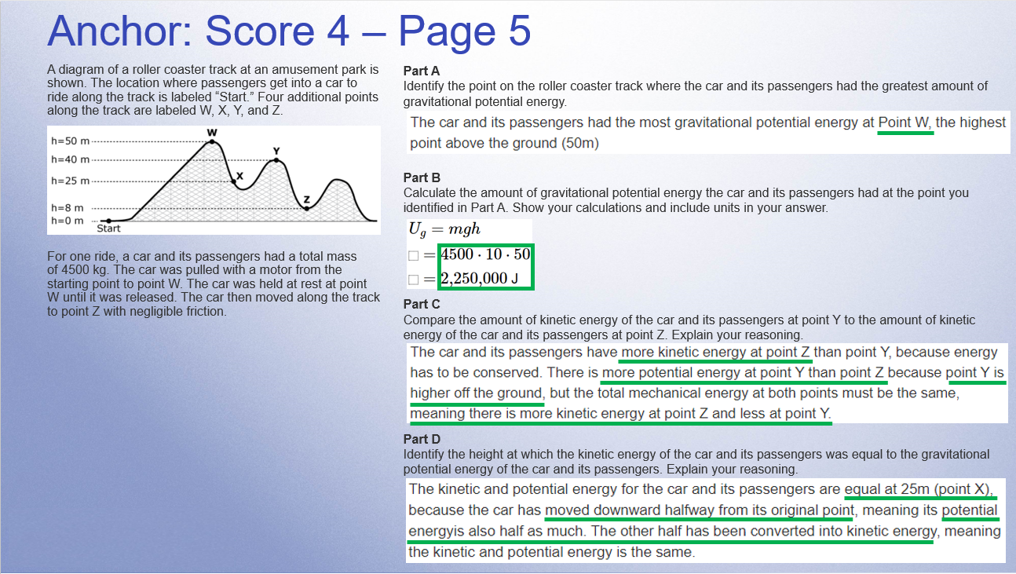
Anchor: Score 4 – Page 5
Notes:
RETURN HERE

Slide 16
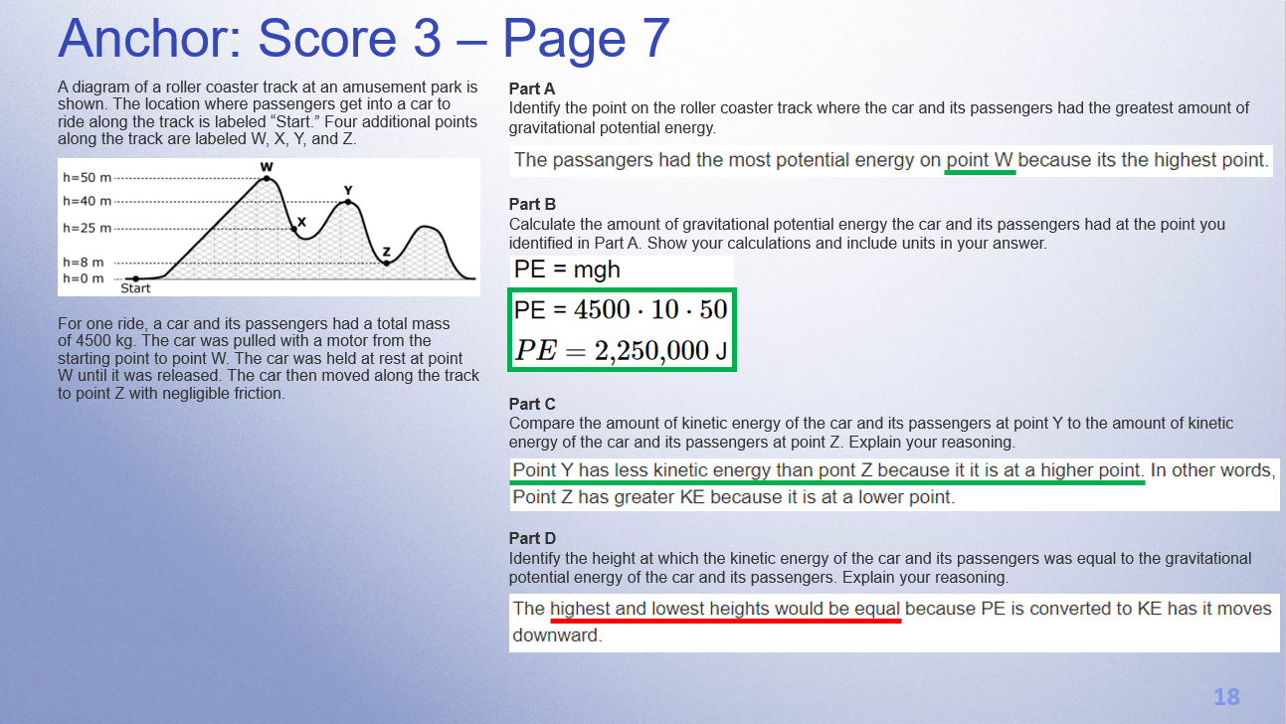
Anchor: Score 3 – Page 7

Slide 17
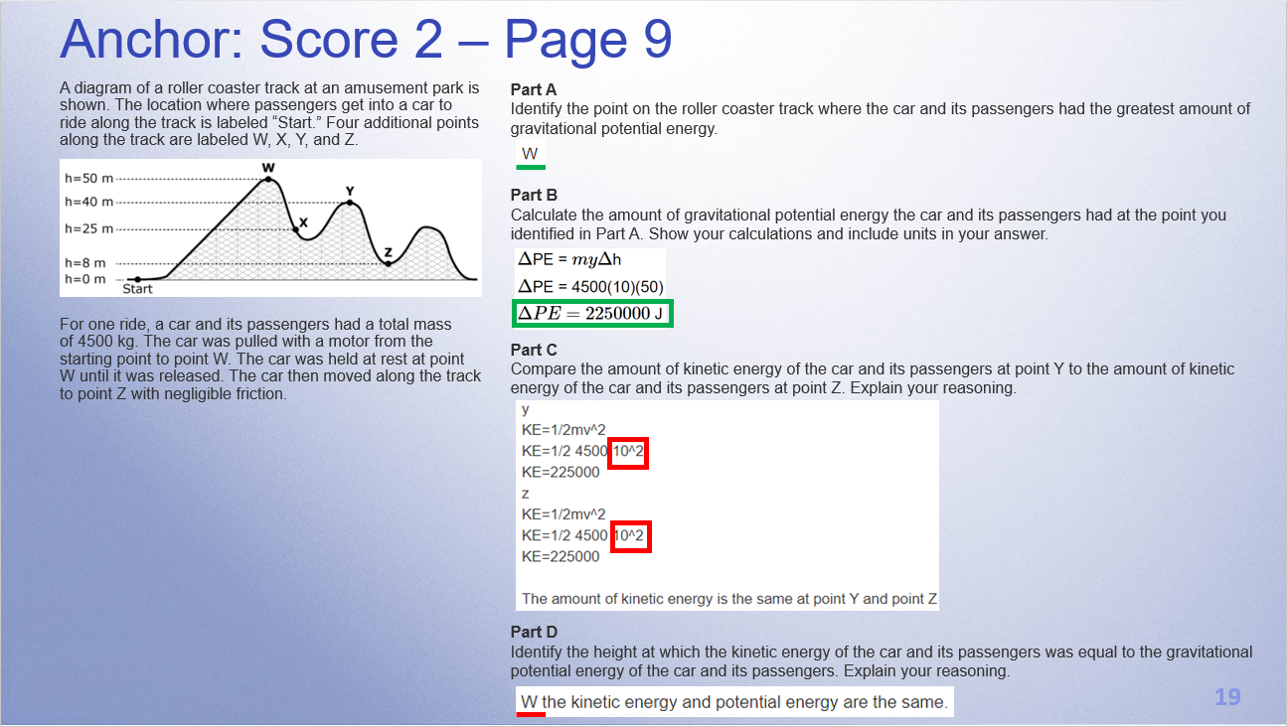
Anchor: Score 2 – Page 9

Slide 18
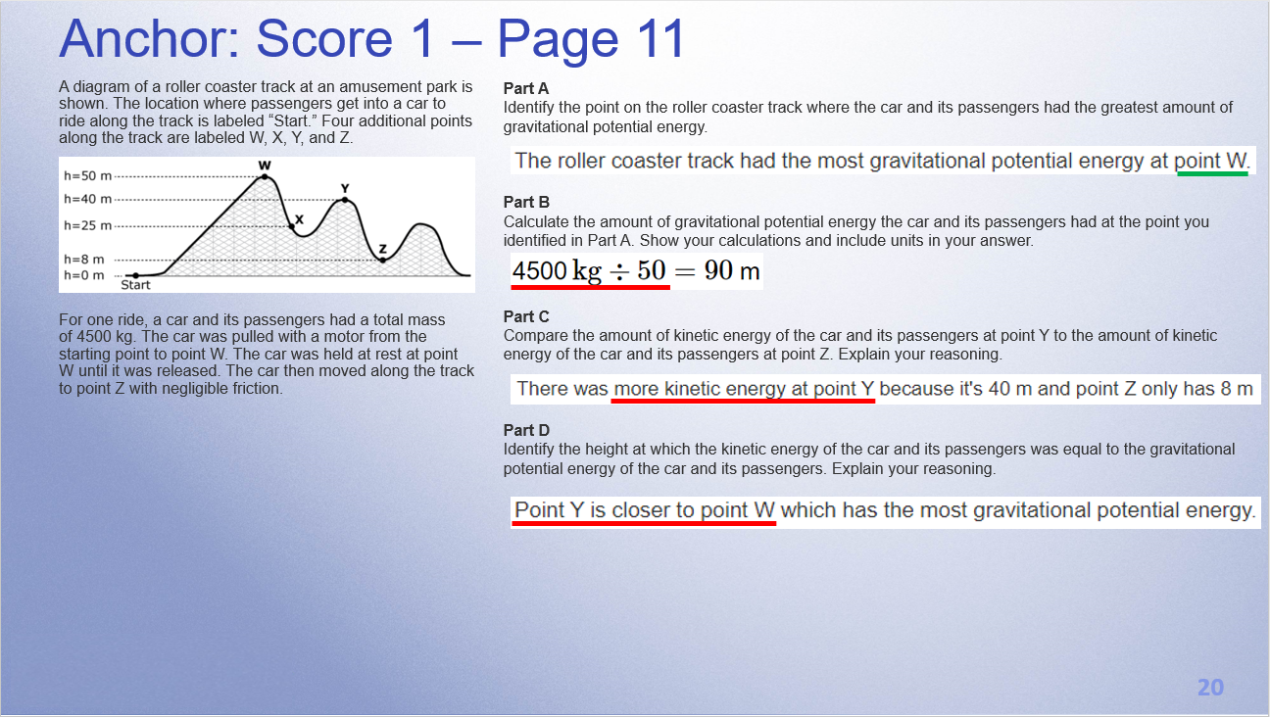
Anchor: Score 1 – Page 11

Slide 19
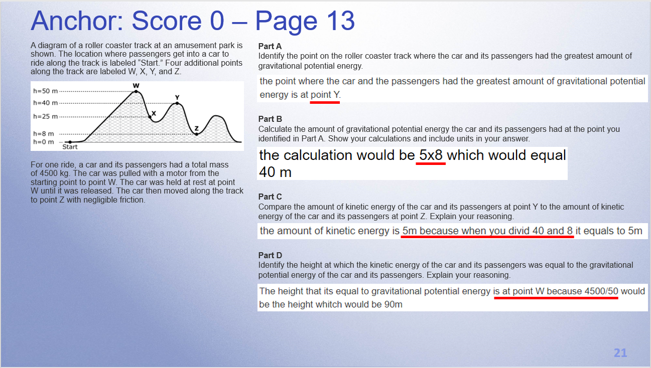
Anchor: Score 0 – Page 13

Slide 20
Individual Scoring of Student Responses
Use scoring notes and anchor papers to score the student responses in the pack that is posted as a resource.
I will then go over how we scored the response.
Responses are from actual students but were retyped

Slide 21
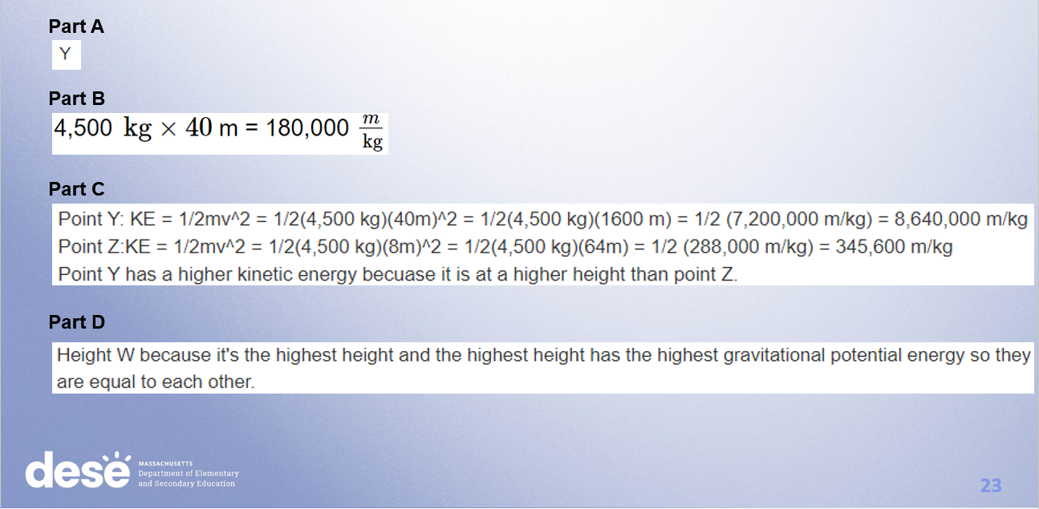
Response A – Page 16

Slide 22
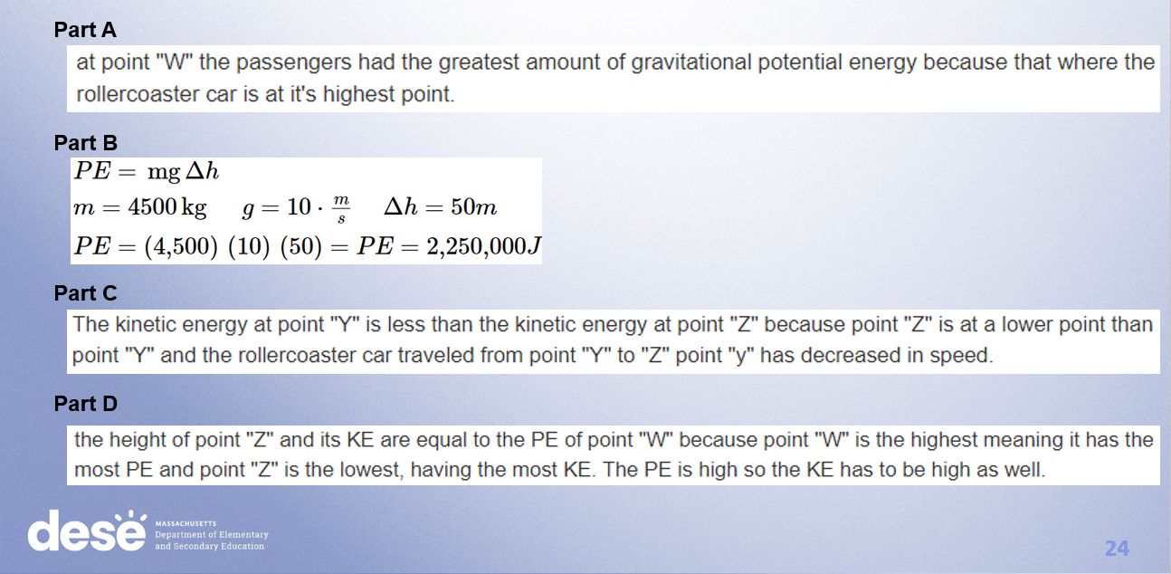
Response B – Page 18

Slide 23
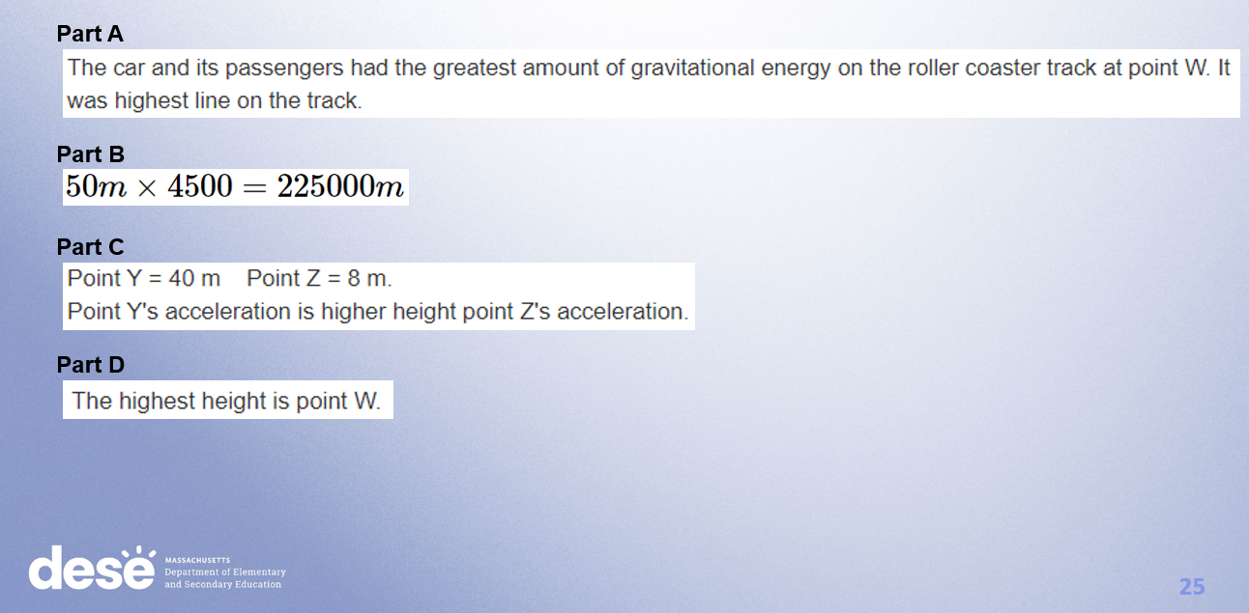
Response C – Page 20

Slide 24
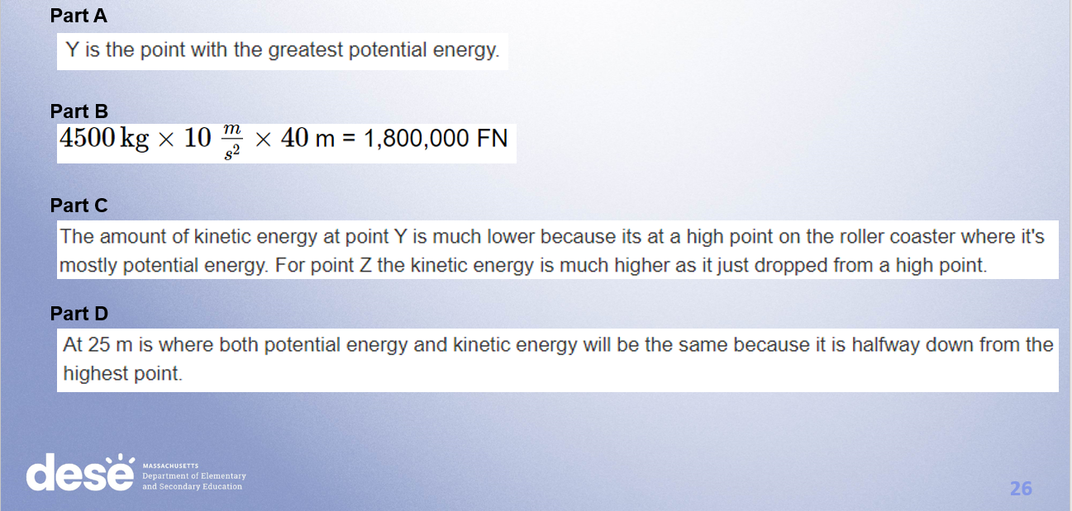
Response D – Page 22

Slide 25
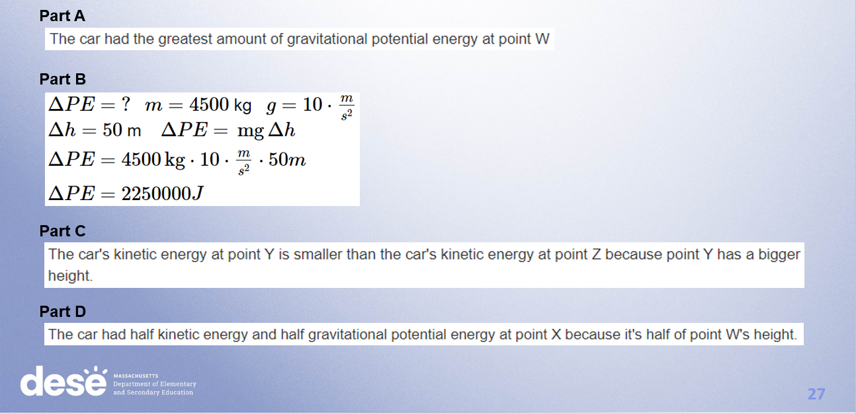
Response E – Page 24

Slide 26
Introductory Physics
Motion, Forces, & Interactions Question
2022
Series Circuit

Slide 27
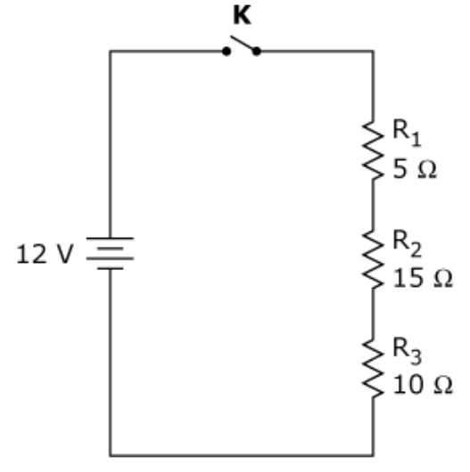
Question – Page 27
The diagram shows a circuit with a 12 V battery, three resistors, and component K.
Part A
Identify component K and explain its main function.
Part B
Component K is replaced with a piece of wire.
Calculate the total resistance of the circuit. Show your calculations and include units in your answer.
Part C
Is the amount of current flowing through R₁ the same as the amount of current flowing through R₂? Explain your reasoning.
Part D
Calculate the voltage drop across R₁. Show your calculations and include units in your answer.

Slide 28
Item Information
Standard Alignment: HS-PS2-9(MA)
  Evaluate simple series and parallel circuits to predict changes to voltage, current, or resistance when simple changes are made to a circuit. Clarification Statements: Predictions of changes can be represented numerically, graphically, or algebraically using Ohm’s law. Simple changes to a circuit may include adding a component, changing the resistance of a load, and adding a parallel path, in circuits with batteries and common loads. Simple circuits can be represented in schematic diagrams. State Assessment Boundary: Use of measurement devices and predictions of changes in power are not expected in state assessment.
Practice Category Alignment: B. Mathematics and Data
  Analyzing and Interpreting Data
  Using Mathematics and Computational Thinking

Slide 29
Scoring Guide – Page 28
Score | Description
4 | The response demonstrates a thorough understanding of series circuits and Ohm's law. The response correctly identifies and clearly explains the main function of component K. The response correctly calculates the total resistance of the circuit, clearly explains whether the amount of current through R₁ and R₂ is the same, and also correctly calculates the voltage drop across the R₁.
3 | The response demonstrates a general understanding of series circuits and Ohm's law.
2 | The response demonstrates a limited understanding of series circuits and Ohm's law.
1 | The response demonstrates a minimal understanding of series circuits and Ohm's law.
0 | The response is incorrect or contains some correct work that is irrelevant to the skill or concept being measured.

Slide 30
Scoring Notes – Page 28
Part A
Component K is a switch and is used to (any one of the following):
  turn the circuit on/off.
  allow/prevent current from flowing in the circuit.
  open/close the circuit.
Part B
Total resistance = 5 Ω + 15 Ω + 10 Ω = 30 Ω
Part C
The current flowing through R₁ is the same as the current flowing through R₂ because (any one of the following):
  the resistors are connected in series.
  there is only one pathway for the current.
  the resistors are connected on the same branch.
  Circuit current: I = V/R = 12 V / 30 Ω = 0.4 A
Part D
Voltage drop across R₁ = IR = (0.4 A) (5 Ω) = 2 V
OR There is 1/6 of the total resistance, so it’s 1/6 the total voltage = 2 V
Each part is worth 1 point.
To receive a score of 4, all calculations and units must be included and be correct.

Slide 31
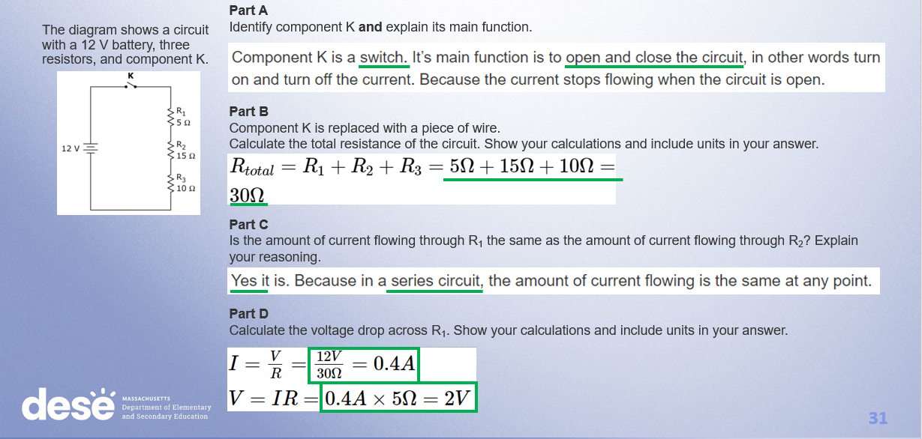
Anchor: Score 4 – Page 30

Slide 32
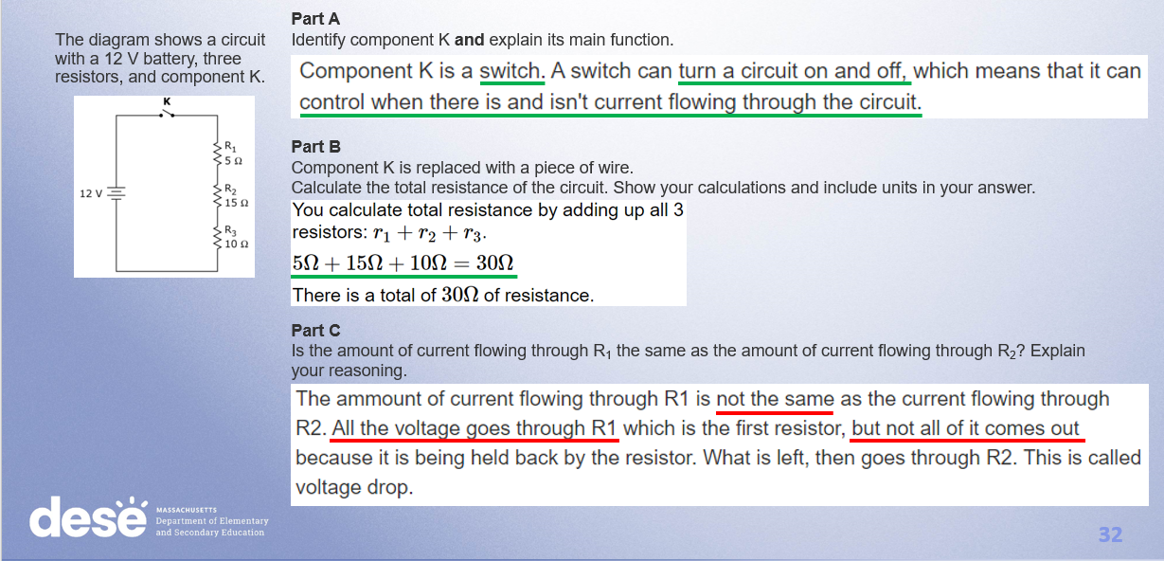
Anchor: Score 3 – Page 32

Slide 33
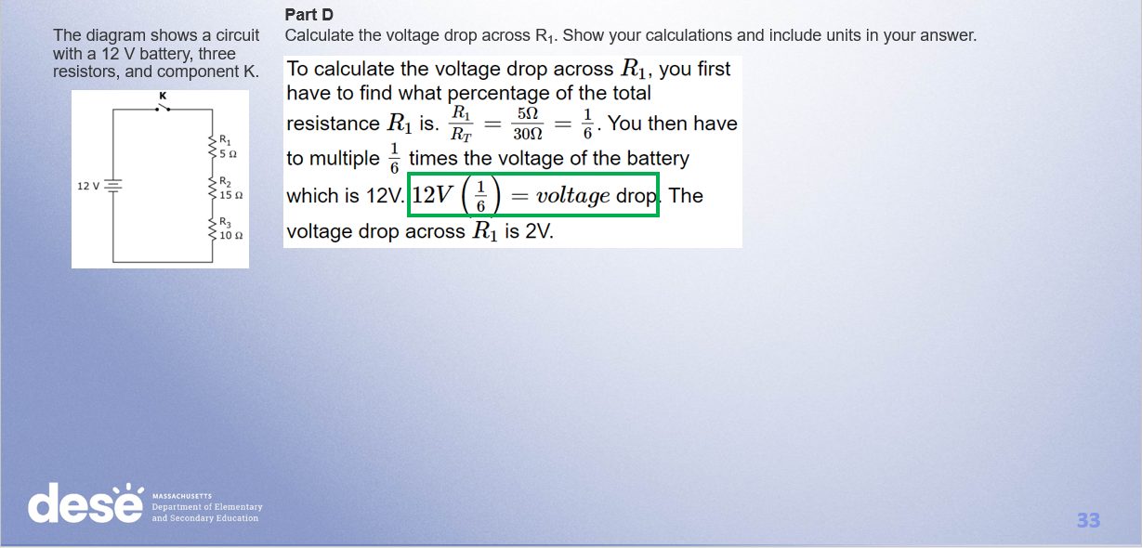
Anchor: Score 3 (cont.)

Slide 34
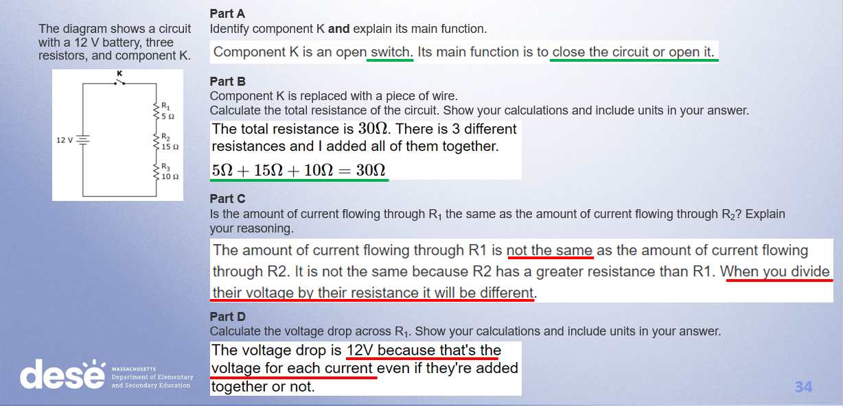
Anchor: Score 2 – Page 34

Slide 35
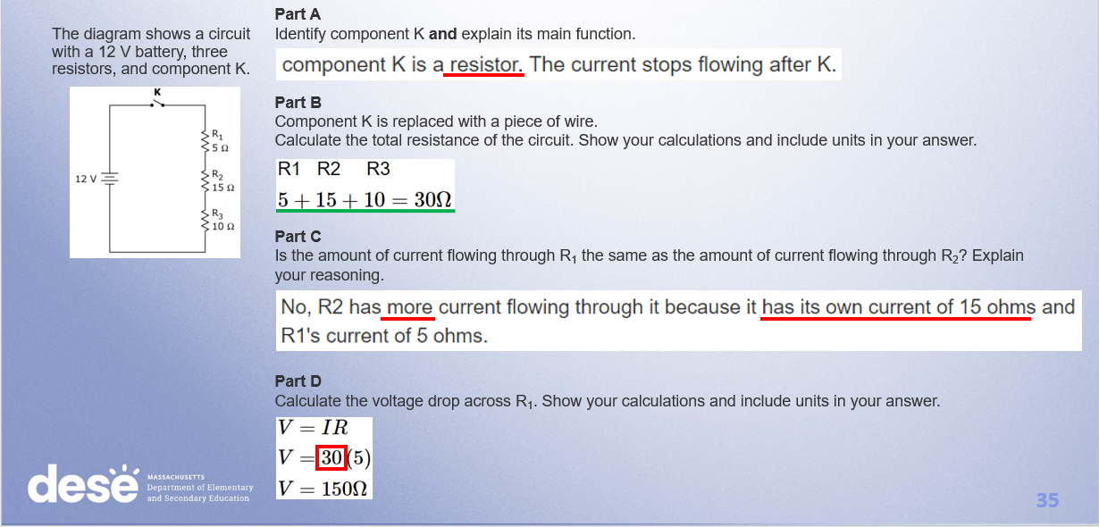
Anchor: Score 1 – Page 36

Slide 36
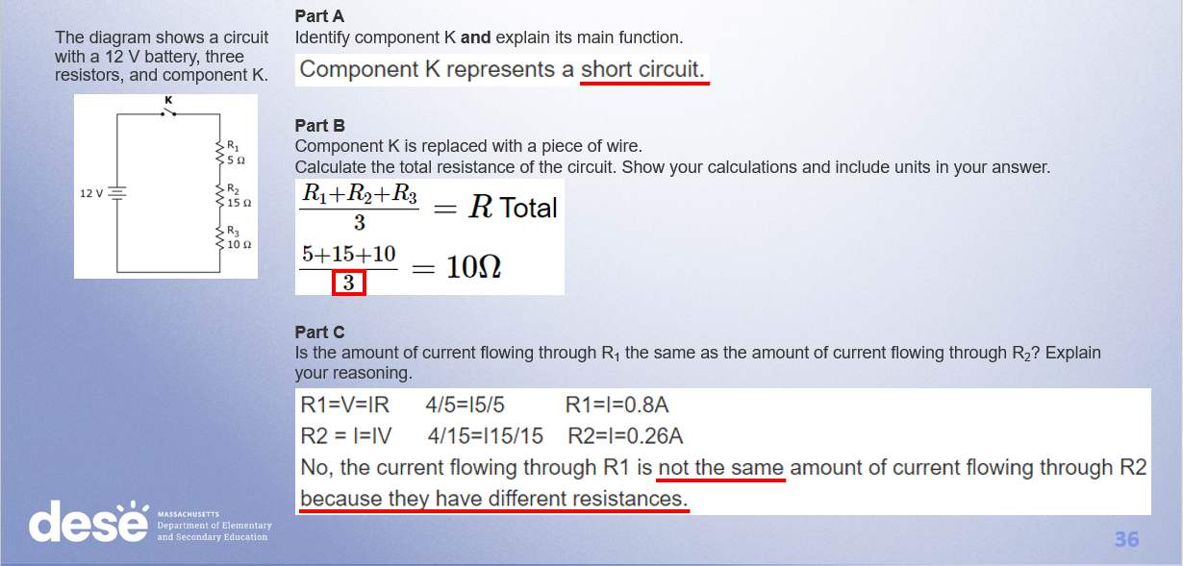
Anchor: Score 0 – Page 38

Slide 37
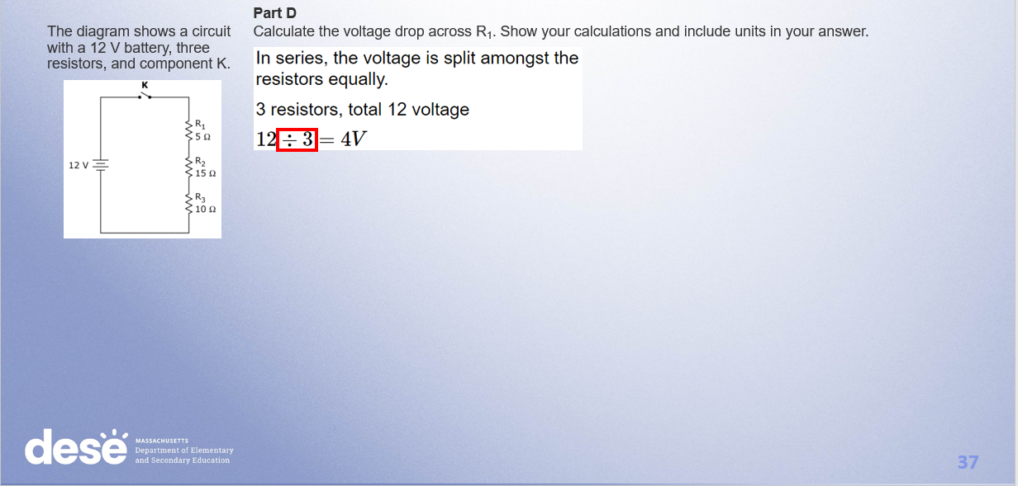
Anchor: Score 0 (cont.)

Slide 38
Individual Scoring of Student Responses
Use scoring notes and anchor papers to score the student responses in the pack that is posted as a resource.
I will then go over how we scored the response.
Responses are from actual students but were retyped

Slide 39
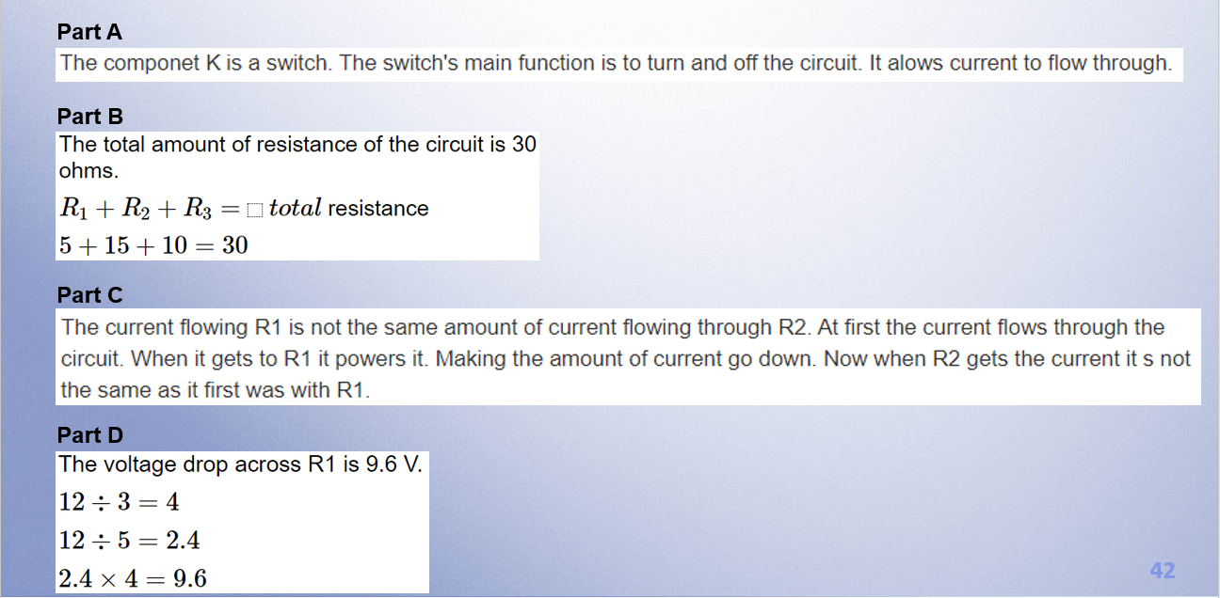
Response A – Page 41

Slide 40
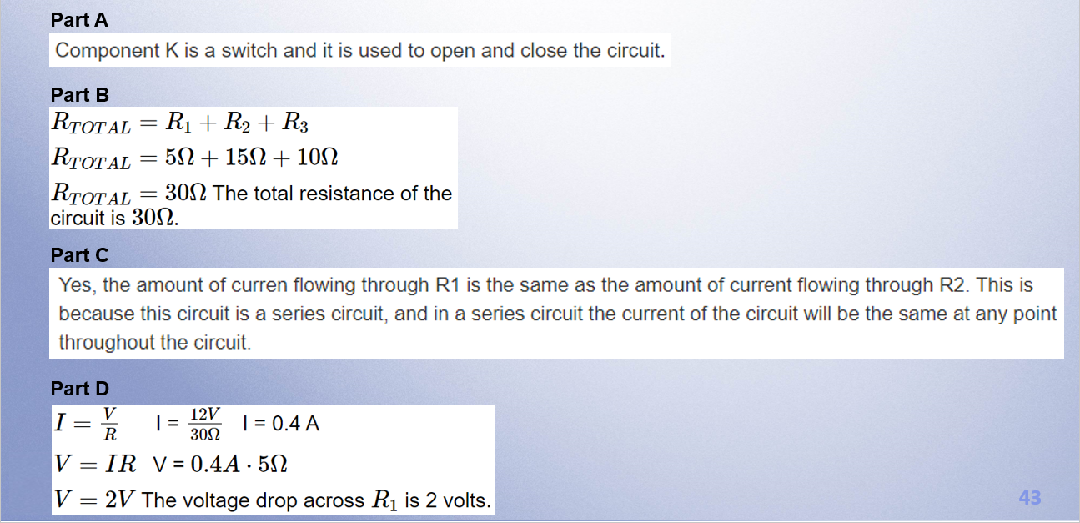
Response B – Page 43

Slide 41
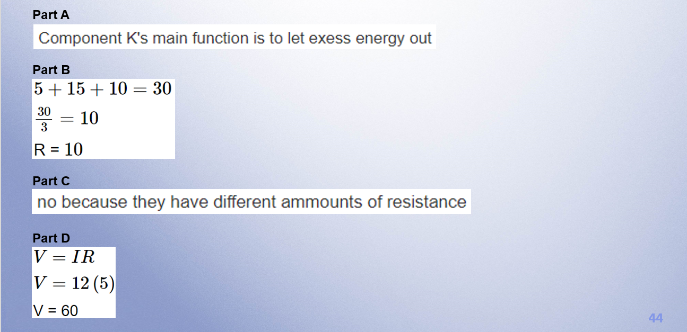
Response C – Page 45

Slide 42
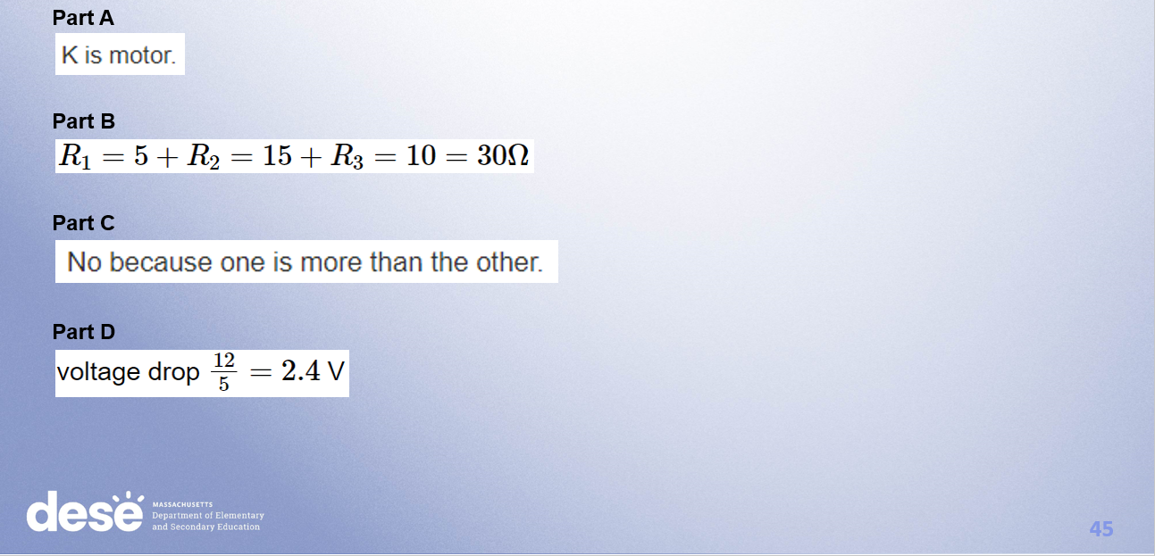
Response D –Page 47

Slide 43
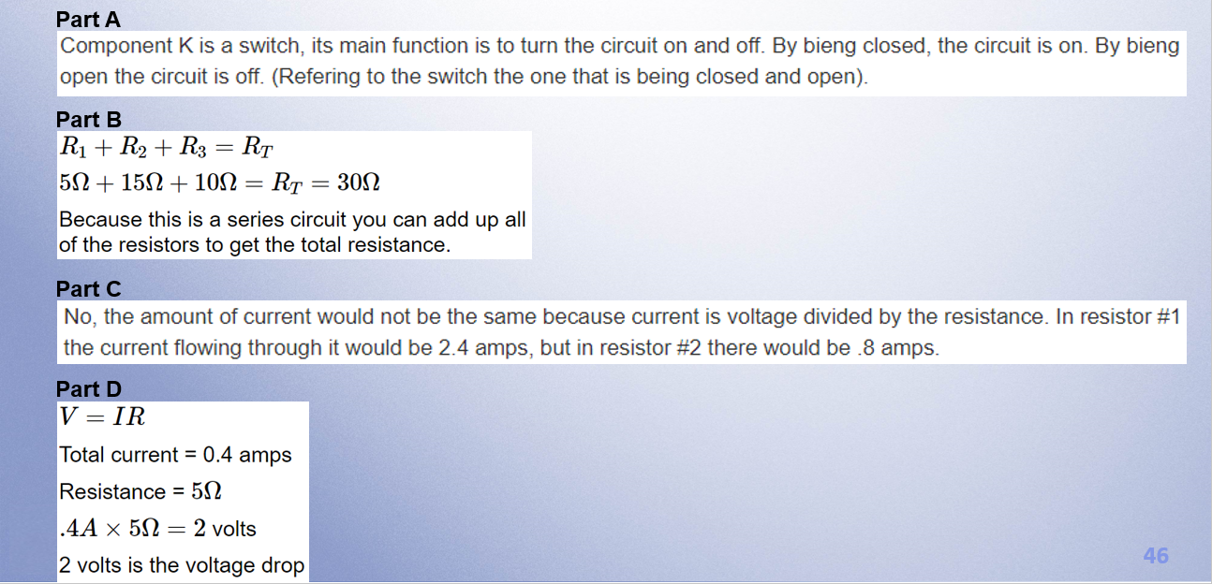
Response E – Page 49

Slide 44
Resources on DESE Website
Resource | Link
MCAS headlines and links | https://www.doe.mass.edu/mcas/
STE Test Development & Design | https://www.doe.mass.edu/mcas/tdd/sci.html
Student Work Samples | https://www.doe.mass.edu/mcas/student/default.html
Released Questions | http://mcas.pearsonsupport.com/released-items/science/
Practice Tests and Tutorial | http://mcas.pearsonsupport.com/student/
MCAS Training Page | https://www.doe.mass.edu/mcas/training.html

Slide 45
Contact Information
DESE Office of Student Assessment for policy questions (e.g., test designs, accommodations)
Web: www.doe.mass.edu/mcas
Email: mcas@mass.gov
Phone: 781-338-3625
MCAS Service Center
Web: http://mcasservicecenter.com/
Phone: 1-800-737-5103

Slide 46

THANK YOU

