Slide 1
MCAS Scoring of
Science & Technology/Engineering
Constructed-Response Items
Grade 8
2024

Slide 2

Today’s Agenda
Overview of MCAS test development and scoring process
Grade 8 Science constructed-response (CR) scoring
  Physical Science CR
  Life Science CR
Review resources available on the Department’s website

Slide 3
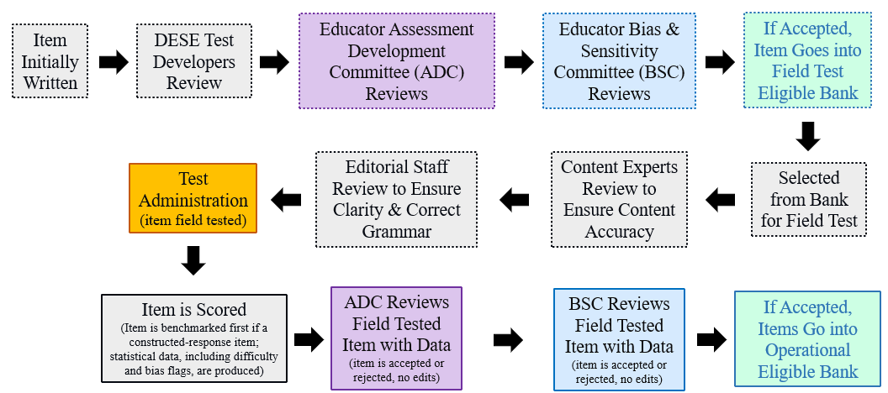
Life Cycle of Science and Technology/Engineering (STE) Item

Slide 4
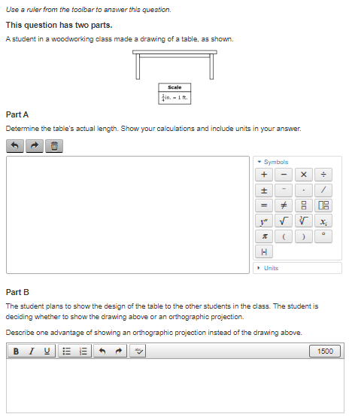
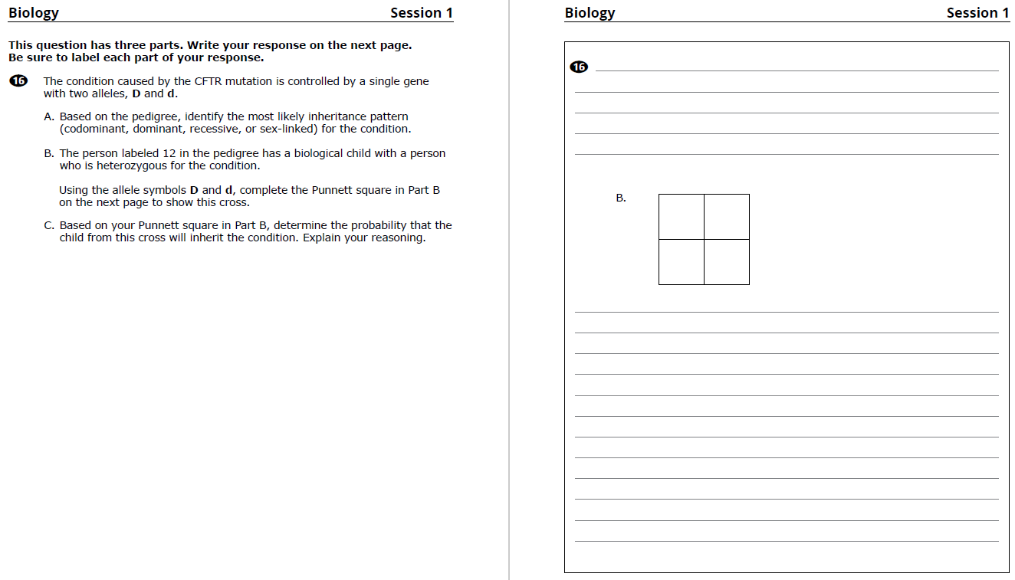
Constructed-Response (CR) Questions
Students write a response to a multi-part question
Scored holistically with partial credit
Often ask students to explain their reasoning, use evidence from data, or show their work
CBT
PBT

Slide 5

Things Not Scored on Science Tests
Spelling, grammar, and punctuation
Above grade-level misconceptions
Extra or irrelevant information (though caution against this)
Using an incorrect calculation from a previous part of an item (typically)

Slide 6

Full Credit
Students who earn full credit:
Answer all parts
Apply correct content knowledge and practices
Follow instructions, such as:
    Explaining reasoning
    Analyzing and drawing conclusions based on graphs or data tables
    Creating or completing scientific models

Slide 7

Scoring Overview: Benchmarking
Review and discuss the scoring of student responses
Adjust detailed scoring notes, which include:
  Correct responses with associated reasoning/calculations
  How points are assigned
  Scoring rules for holistic scoring
Training packs are put together, which include:
  3 “anchor” papers for each score level
  1+ practice papers for each score level

Slide 8
Scoring Overview: How Responses are Scored
Scoring leaders/scorers have content expertise, including college-level courses for the assigned test
Before scoring each question, every scorer must:
  Participate in a detailed training on how to score the responses
  Satisfactorily score a qualification set made up of actual student responses
Embedded responses and read-behinds by scoring leaders are used to monitor a scorer's performance and ensure scoring accuracy
All high school responses are scored by two scorers
Gr. 5 and 8 Tests: Approximately 25-30% of responses are scored by two scorers

Slide 9
Constructed Response Scoring Training and Practice
Question, score guide, and scoring notes review
Anchor papers
Individual scoring of student responses

Slide 10
Gr. 8 STE
Physical Science Question
Released in 2022
Riding Bicycles

Slide 11
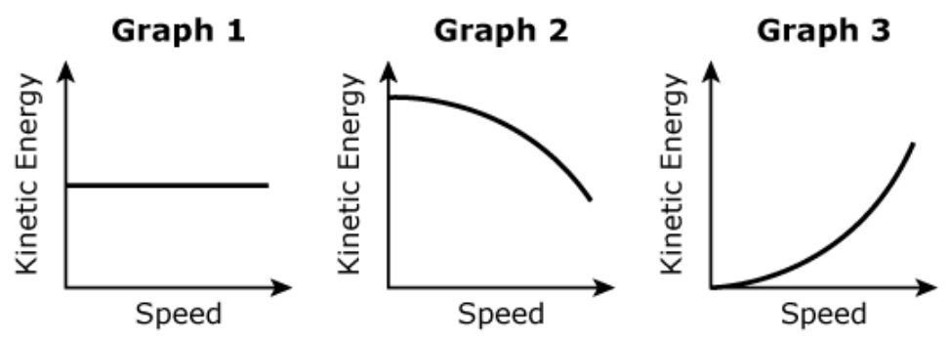
Question
Two students are riding identical bicycles on a level sidewalk. Student R has a mass of 55 kg and student S has a mass of 40 kg.
Part A
Both students are traveling at a speed of 3 m/s.
Determine whether student R has a larger, a smaller, or an equal amount of kinetic energy compared to student S. Explain your reasoning.
Part B
Student R is at rest, begins to ride, and then moves faster and faster.
Identify which graph (1, 2, or 3) best represents the relationship between student R’s speed and kinetic energy. Explain your reasoning.

Slide 12
Item Information
Standard Alignment: 7.MS-PS3-1
  Construct and interpret data and graphs to describe the relationships among kinetic energy, mass, and speed of an object. Clarification Statements: Examples could include riding a bicycle at different speeds and rolling different size rocks downhill. Consider relationships between kinetic energy vs. mass and kinetic energy vs. speed separate from each other; emphasis is on the difference between the linear and exponential relationships. State Assessment Boundary: Calculations or manipulation of the formula for kinetic energy is not expected in state assessment.
Practice Category Alignment: B. Mathematics and Data
  Analyzing and Interpreting Data
  Using Mathematics and Computational Thinking

Slide 13
Scoring Guide (2 points)
Score | Description
2 | The response demonstrates a thorough understanding of the relationship among kinetic energy, mass, and speed of an object. The response correctly compares the kinetic energy of student R with the kinetic energy of student S and clearly explains the reasoning. The response also correctly identifies the graph that best represents the relationship between student R’s speed and kinetic energy and clearly explains the reasoning.
1 | The response demonstrates a partial understanding of the relationship among kinetic energy, mass, and speed of an object.
0 | The response is incorrect or contains some correct work that is irrelevant to the skill or concept being measured.

Slide 14
Scoring Notes
Part A
Student R has a greater amount of kinetic energy, because [the students are riding at the same speed and] (any one of the following):
  student R has more mass.
  student R has a mass of 55 kg while student S has a mass of 40 kg.
  student R's kinetic energy was 247.5 [Joules] while student S's kinetic energy was 180 [Joules].
Part B
Graph 3, because the kinetic energy of an object increases as its speed increases.
Each part is worth 1 point.

Slide 15
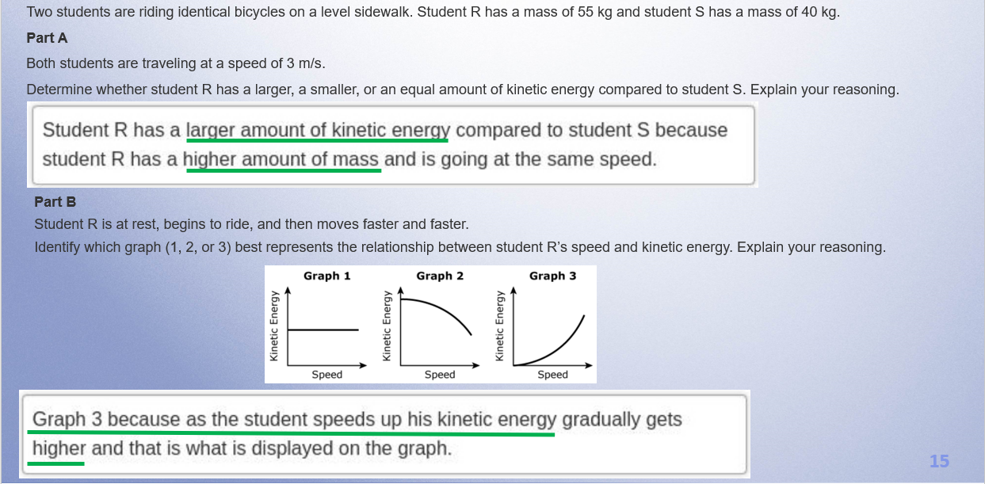
Anchor: Score 2

Slide 16
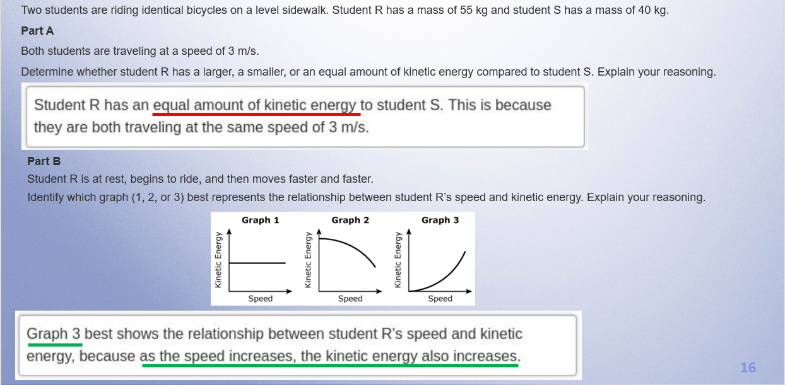
Anchor: Score 1

Slide 17
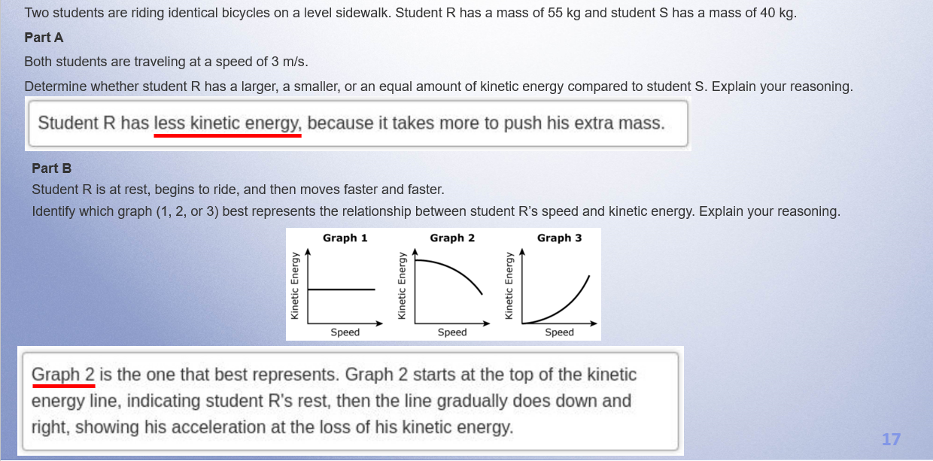
Anchor: Score 0

Slide 18
Individual Scoring of Student Responses
Use scoring notes and anchor papers to score the student responses
Explanation of scores
Responses are from actual students

Slide 19
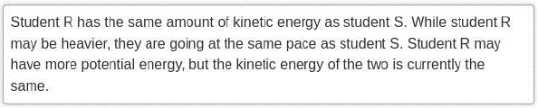

Response A –Page 9
Part A:
Part B:

Slide 20

Response B – Page 10
Part A:
Part B:

Slide 21

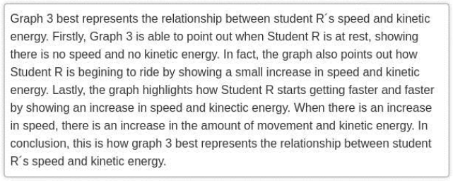

Response C – Page 11
Part A:
Part B:

Slide 22
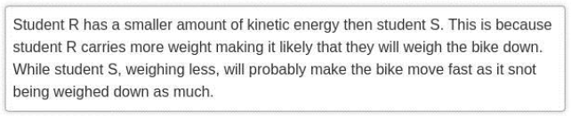
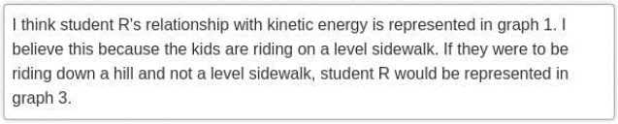
Response D – Page 12
Part A:
Part B:

Slide 23
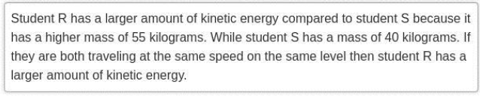
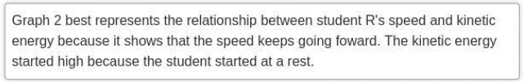
Response E – Page 13
Part A:
Part B:

Slide 24
Gr. 8 STE
Life Science Question
2022
Cownose Rays

Slide 25
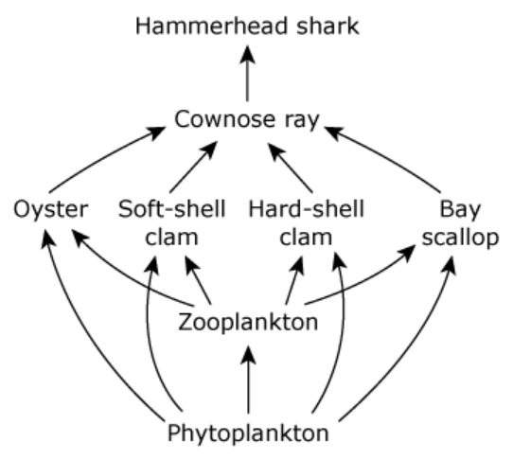
Question
Sharks are large fish that live in the ocean. Hammerhead sharks are a part of a marine ecosystem, as shown in the food web.
Cownose rays are an important part of the marine ecosystem.
Part A
Identify the ecological relationship (competitive, parasitic, or predatory) between cownose rays and oysters in the ecosystem. Explain your reasoning.
Part B
Describe what would most likely happen to the size of the cownose ray population (increase, decrease, or stay the same) if there were a large decrease in the phytoplankton population in the ecosystem. Explain your reasoning.
Part C
Based on the food web, describe what would most likely happen to the hammerhead shark population if the cownose rays were removed from the ecosystem. Explain your reasoning.

Slide 26
Item Information
Standard Alignment: 7.MS-LS2-1.
  Analyze and interpret data to provide evidence for the effects of periods of abundant and scarce resources on the growth of organisms and the size of populations in an ecosystem.
Practice Category Alignment: C. Evidence, Reasoning, & Modeling
  Developing and Using Models
  Constructing Explanations and Designing Solutions

Slide 27

Scoring Guide (3 points)
Score | Description
3 | The response demonstrates a thorough understanding of the effect of scarce resources on the size of populations in an ecosystem. The response correctly identifies the ecological relationship between cownose rays and oysters in this ecosystem and clearly explains the reasoning. The response clearly describes what would happen to the size of the cownose ray population if there were a large decrease in the phytoplankton population and clearly explains the reasoning. The response also clearly describes what would happen to the hammerhead shark population if the cownose rays were removed from the ecosystem and clearly explains the reasoning.
2 | The response demonstrates a partial understanding of the effect of scarce resources on the size of populations in an ecosystem.
1 | The response demonstrates a minimal understanding of the effect of scarce resources on the size of populations in an ecosystem.
0 | The response is incorrect or contains some correct work that is irrelevant to the skill or concept being measured.

Slide 28
Scoring Notes
Part A
The relationship is predatory because: cownose rays eat oysters OR the oysters are prey for the cownose rays.
Part B
The cownose ray population would decrease because (any of the following):
zooplankton eat the phytoplankton, and oysters, clams, and scallops eat the zooplankton, and the rays eat the oysters, clams, and scallops.
ecosystems need producers as a food source for other organisms [and the food web would collapse without producers].
Part C
Any one of the following:
The hammerhead shark population would decrease because the cownose ray is their only/biggest/main food source.
The hammerhead shark population would go extinct/die out because the cownose ray is the only food source for the hammerhead sharks.
Hammerhead sharks would have to migrate/move to a different area [to find food].
Note: For scores going from 0 to 1, responses with 3 correct IDs in Parts A, B, or C, can receive 1 point without explanations.
Each part is worth one point.

Slide 29
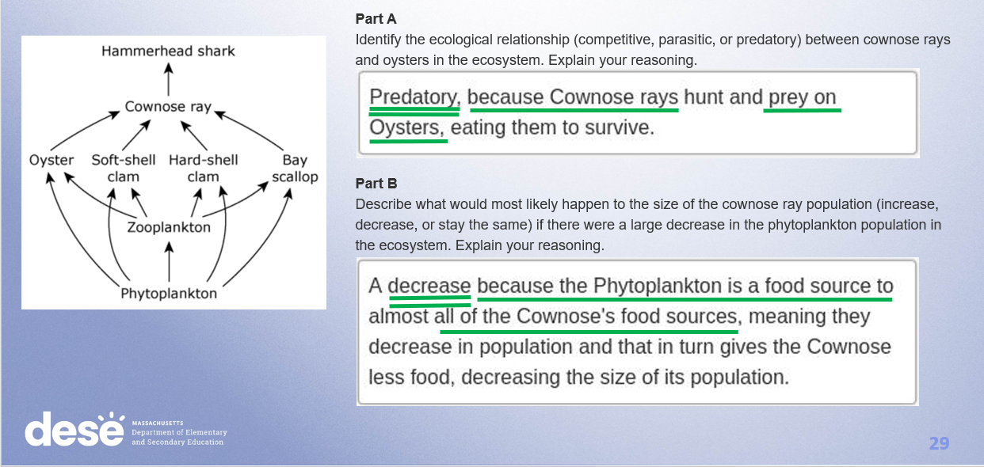
Anchor Score 3

Slide 30
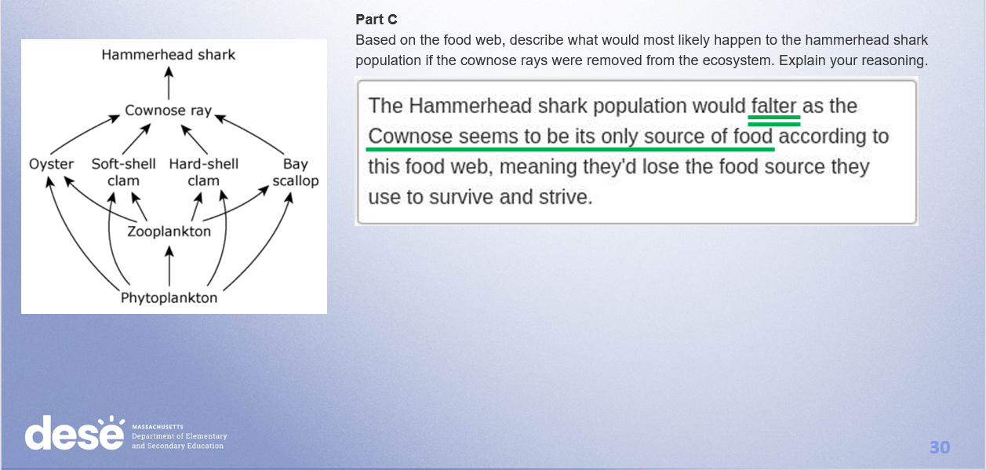
Anchor Score 3 (cont.)

Slide 31
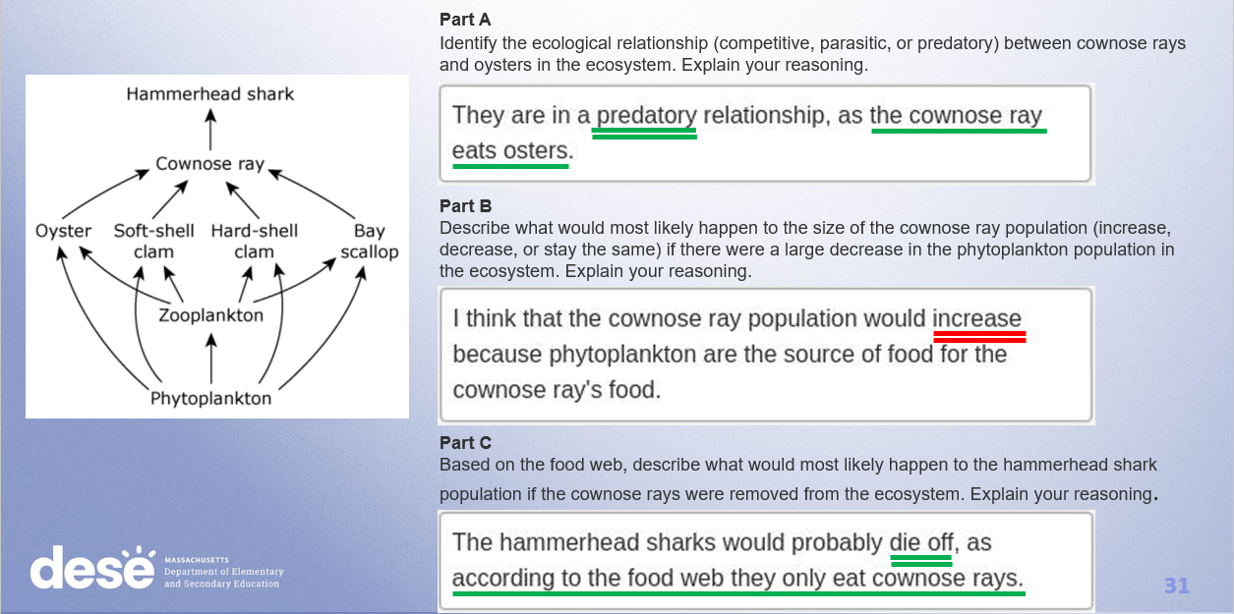
Anchor Score 2

Slide 32
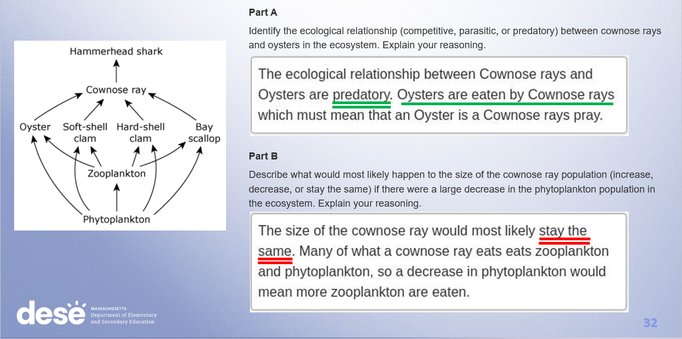
Anchor Score 1

Slide 33
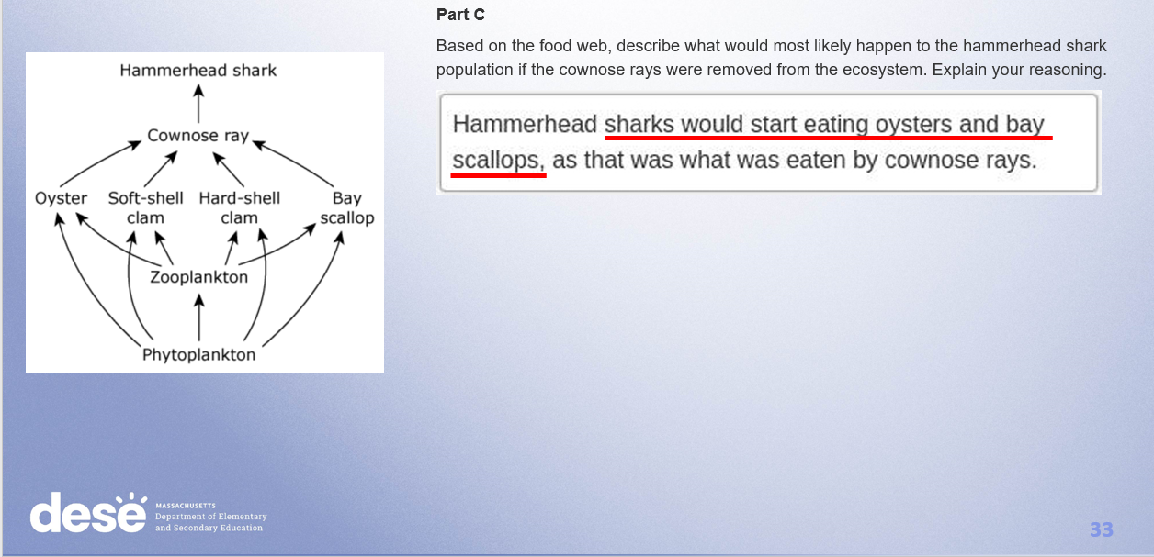
Anchor Score 1 (cont.)

Slide 34
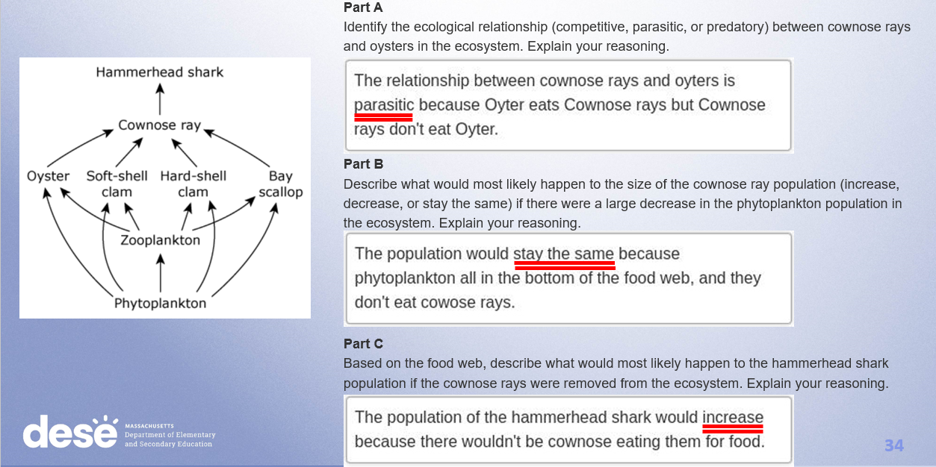
Anchor Score 0

Slide 35
Individual Scoring of Student Responses
Use scoring notes and anchor papers to score the student responses in the PDF emailed to you. We also put the PDF in the chat
Responses are from actual students
Enter the scores you give each response into the poll
Review of poll results and scores

Slide 36
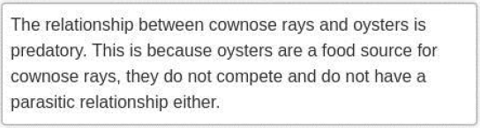
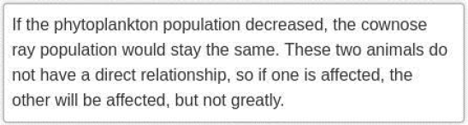
Response A –Page 26
Part A:
Part B:

Slide 37
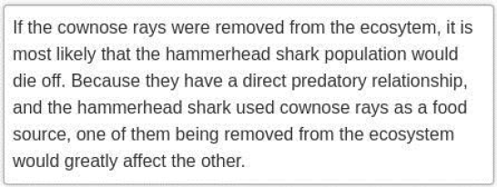
Response A (cont.)
Part C:

Slide 38
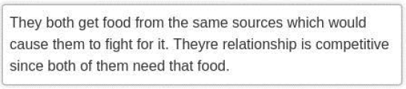
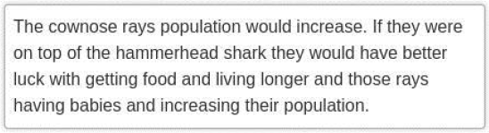

Response B –Page 27
Part A:
Part B:
Part C:

Slide 39



Response C –Page 28
Part A:
Part B:
Part C:

Slide 40
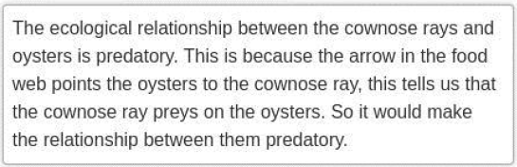
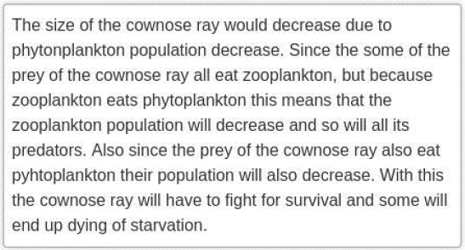
Response D –Page 29
Part A:
Part B:

Slide 41
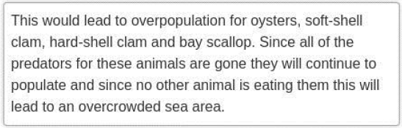
Response D (cont.)
Part C:

Slide 42

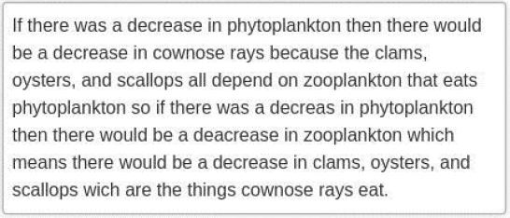
Response E –Page 30
Part A:
Part B:

Slide 43
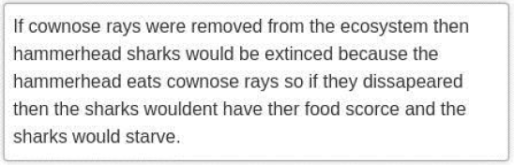
Response E (cont.)
Part C:

Slide 44
Resources on DESE Website
Resource | Link
MCAS headlines and links | https://www.doe.mass.edu/mcas/
STE Test Development & Design | https://www.doe.mass.edu/mcas/tdd/sci.html
Student Work Samples | https://www.doe.mass.edu/mcas/student/default.html
Released Questions | http://mcas.pearsonsupport.com/released-items/science/
Practice Tests and Tutorial | http://mcas.pearsonsupport.com/student/
MCAS Training Page | https://www.doe.mass.edu/mcas/training.html
G5 and G8 STE Assessment Pilot | https://www.doe.mass.edu/mcas/tdd/ste-assess-pilot/default.html

Slide 45
Contact Information
DESE Office of Student Assessment for policy questions (e.g., test designs, accommodations)
Web: www.doe.mass.edu/mcas
Email: mcas@doe.mass.edu
Phone: 781-338-3625
MCAS Service Center
Web: http://mcasservicecenter.com/
Phone: 1-800-737-5103

Slide 46

THANK YOU

