Slide 1
MCAS Scoring of
Science & Technology/Engineering
Constructed-Response Items:
Grade 5
February 2024

Slide 2

Today’s Agenda
Overview of MCAS test development and scoring process
Grade 5 STE constructed-response (CR) scoring
  Lynx Adaptations CR
  Magnets – Toy Boat CR
Review resources available on the Department’s website

Slide 3
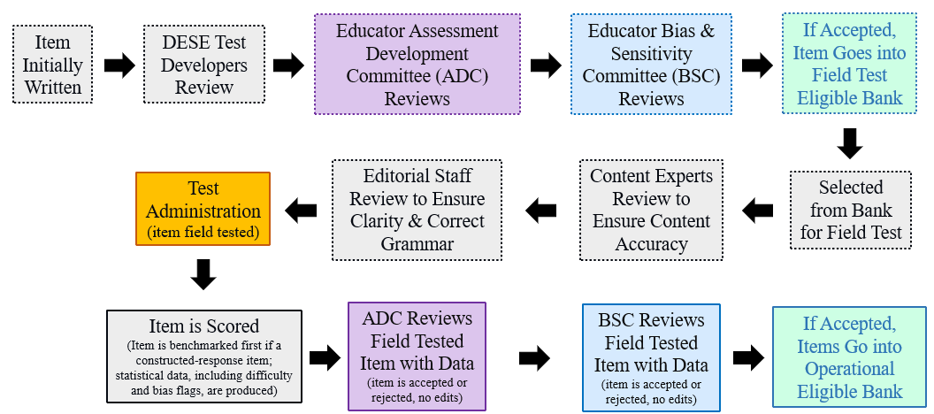
Life Cycle of Science and Technology/Engineering (STE) Item

Slide 4
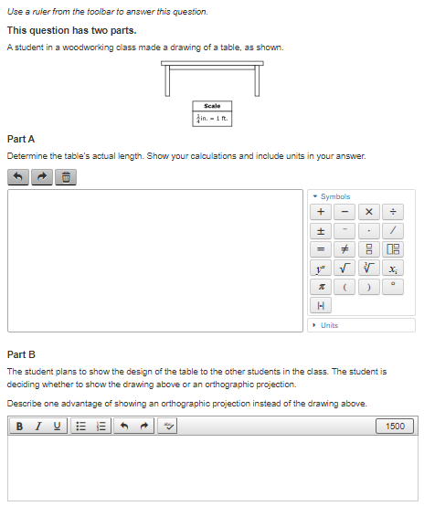
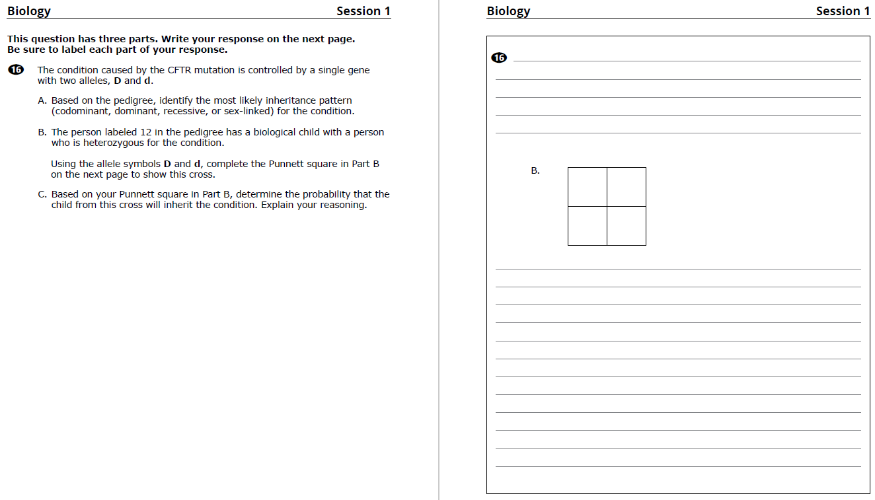
Constructed-Response (CR) Questions
Students write a response to a multi-part question
Scored holistically with partial credit
Often ask students to explain their reasoning, use evidence from data, or show their work
CBT
PBT

Slide 5

Things Not Scored on Science Tests
Spelling, grammar, and punctuation
Above grade-level misconceptions
Extra or irrelevant information (though caution against this)
Using an incorrect calculation from a previous part of an item (typically)

Slide 6

Full Credit
Students who earn full credit:
Answer all parts
Apply correct content knowledge and practices
Follow instructions, such as:
    Explaining reasoning
    Analyzing and drawing conclusions based on graphs or data tables
    Creating or completing scientific models

Slide 7

Scoring Overview: Benchmarking
Review and discuss the scoring of student responses
Adjust detailed scoring notes, which include:
  Correct responses with associated reasoning/calculations
  How points are assigned
  Scoring rules for holistic scoring
Training packs are put together, which include:
  3 “anchor” papers for each score level
  1+ practice papers for each score level

Slide 8
Scoring Overview: How Responses are Scored
Scoring leaders/scorers have content expertise, including college-level courses for the assigned test
Before scoring each question, every scorer must:
  Participate in a detailed training on how to score the responses
  Satisfactorily score a qualification set made up of actual student responses
Embedded responses and read-behinds by scoring leaders are used to monitor a scorer's performance and ensure scoring accuracy
All high school responses are scored by two scorers
Gr. 5 and 8 Tests: Approximately 25-30% of responses are scored by two scorers

Slide 9
Constructed Response Scoring Training and Practice
Question, score guide, and scoring notes review
Anchor papers
Individual scoring of student responses

Slide 10
Gr. 5 STE
Life Science Question
Released in 2019
Lynx Adaptations

Slide 11
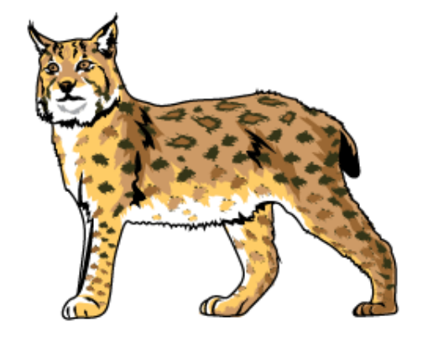
Question
This question has two parts.
The picture shows a lynx.
Lynx are wild cats that have spotted fur, sharp claws, furry ears, and wide paws. Lynx live in forests that are cold many months of the year. They hunt rabbits and other small animals.
Part A
From the information given, identify one trait that provides camouflage for the lynx in its environment. Explain how the trait provides camouflage for the lynx.
Part B
Describe one way the claws of the lynx help it survive in its environment.

Slide 12
Item Information
Standard Alignment: 4-LS1-1
  Construct an argument that animals and plants have internal and external structures that support their survival, growth, behavior, and reproduction. Clarification Statements: Animal structures can include legs, wings, fins, feathers, trunks, claws, horns, antennae, eyes, ears, nose, heart, stomach, lung, brain, and skin. Plant structures can include leaves, roots, stems, bark, branches, flowers, fruit, and seeds. State Assessment Boundary: State assessment will be limited to macroscopic structures.
  Practice Category Alignment: C. Evidence, Reasoning, and Modeling
Constructing explanations and designing solutions
Engaging in argument from evidence

Slide 13
Scoring Guide (2 points)
Score | Description
2 | The response demonstrates a thorough understanding that animals have external structures that support their survival. The response correctly identifies one trait that provides camouflage for the lynx in its environment and clearly explains how the trait provides camouflage for the lynx. The response also clearly describes one way the claws of the lynx help it survive in its environment.
1 | The response demonstrates a partial understanding that animals have external structures that support their survival.
0 | The response is incorrect or contains some correct work that is irrelevant to the skill or concept being measured.

Slide 14
Scoring Notes
Part A
The fur color (brown) and/or pattern (spots) will help the lynx blend in with the trees/forest/environment.
Note: For scores going from 0–1, a creditable explanation without the identification of a trait is acceptable.
Part B
A response many include (any one):
catch/kill prey/get food
defend itself from attack [by predators]
climbing (trees, rocks)
run faster
Each part is worth 1 point.

Slide 15
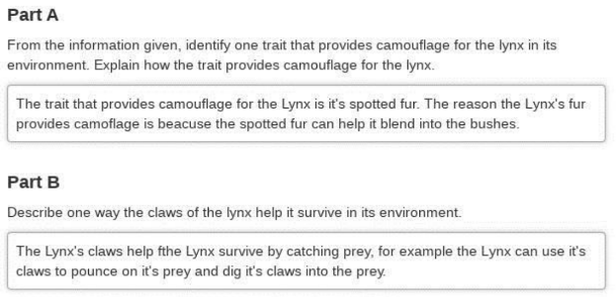
Anchor: Score 2

Slide 16
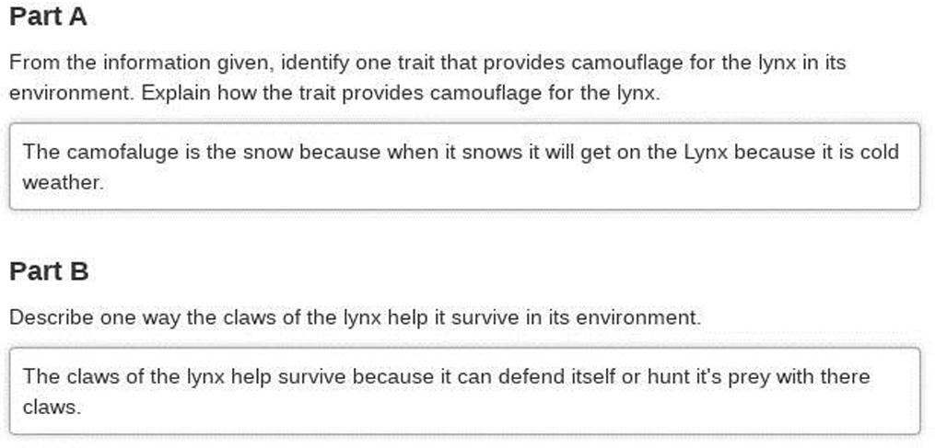
Anchor: Score 1

Slide 17
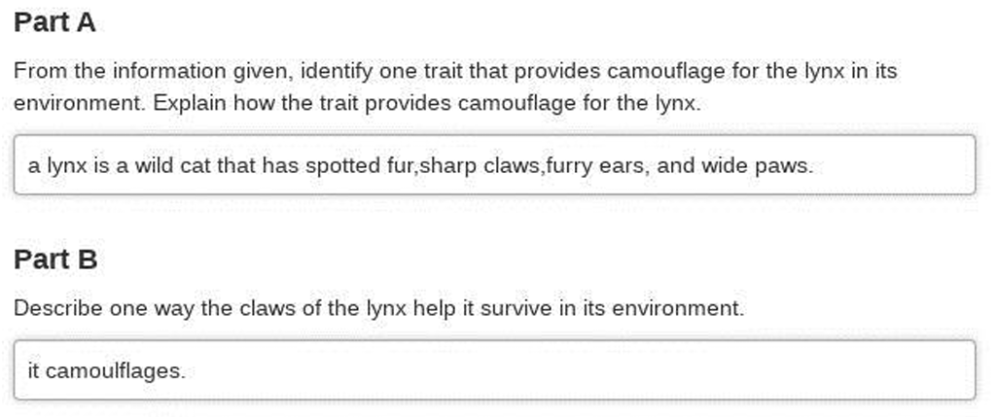
Anchor: Score 0

Slide 18
Individual Scoring of Student Responses
Use scoring notes and anchor papers to score the student responses in the PDF emailed to you. We also put the PDF in the chat
Responses are from actual students
Enter the scores you give each response into the poll
Review of poll results and scores

Slide 19
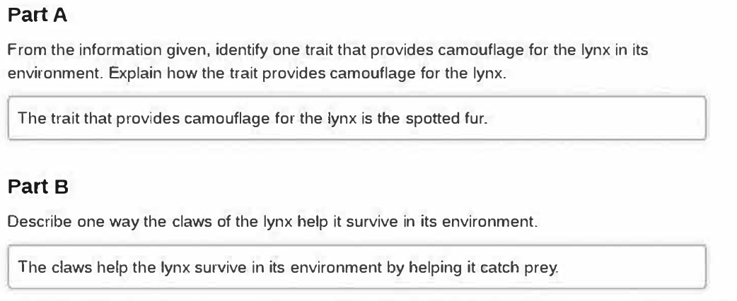
Response A –Page 9

Slide 20
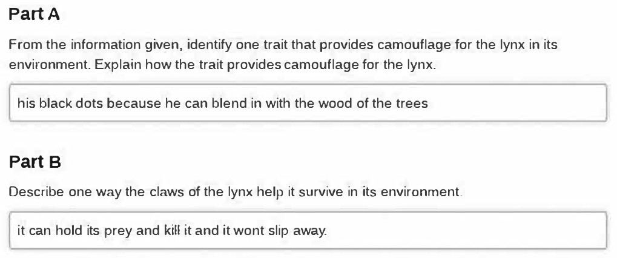
Response B – Page 10

Slide 21
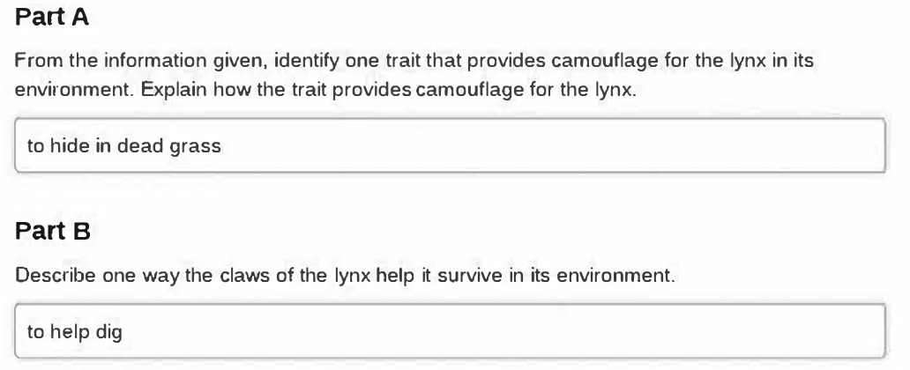
Response C – Page 11

Slide 22
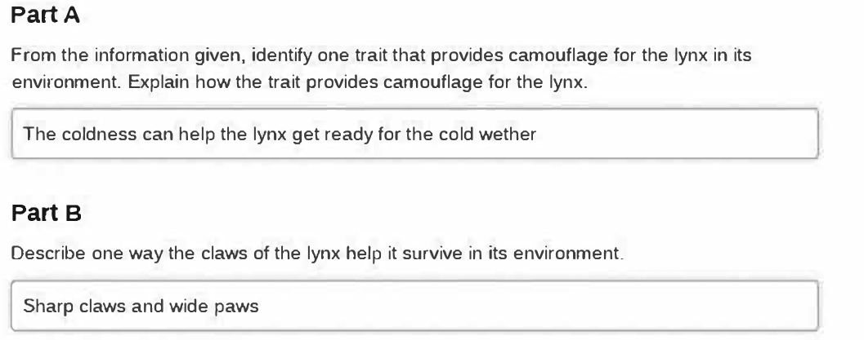
Response D – Page 12

Slide 23
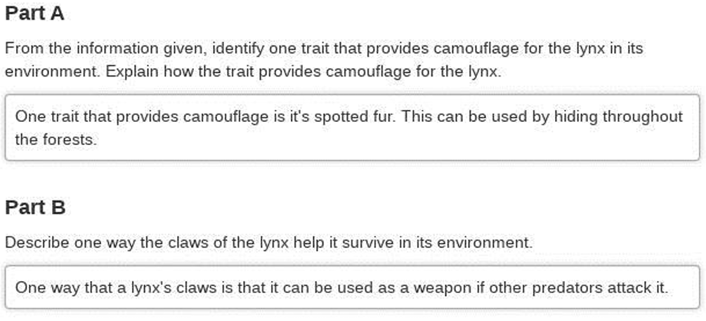
Response E – Page 13

Slide 24
Gr. 5 STE
Physical Science Question
Released in 2022
Magnets – Toy Boat

Slide 25
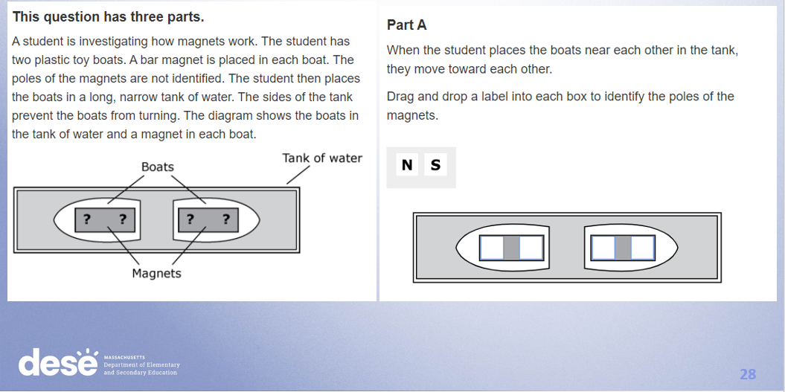
Question

Slide 26
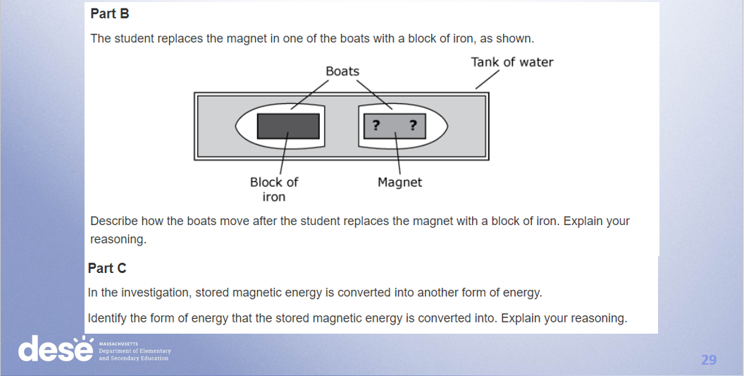
Question

Slide 27
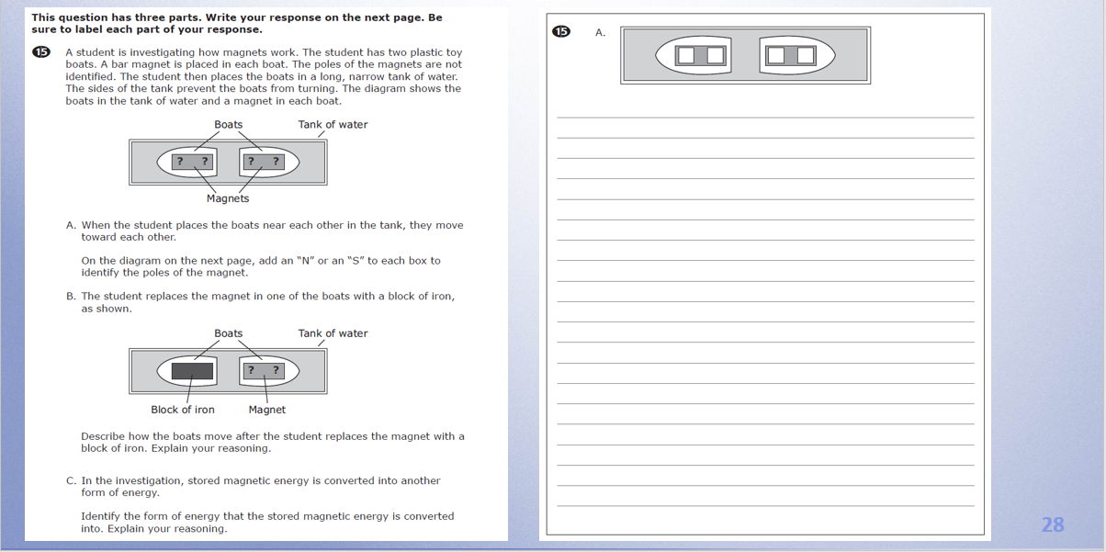
Question

Slide 28
Item Information
Standard Alignment: 3-PS2-3
  Conduct an investigation to determine the nature of the forces between two magnets based on their orientations and distance relative to each other. Clarification Statement: Focus should be on forces produced by magnetic objects that are easily manipulated.
Practice Category Alignment: C. Evidence, Reasoning, & Modeling
  Developing and Using Models
  Constructing Explanations and Designing Solutions

Slide 29

Scoring Guide (3 points)
Score | Description
3 | The response demonstrates a thorough understanding of the forces between two magnets based on their orientations. The response correctly identifies the poles of each magnet. The response clearly describes how the boats will move after one magnet is replaced with a block of iron and clearly explains the reasoning. The response also correctly identifies the form of energy that magnetic energy was converted into and clearly explains the reasoning.
2 | The response demonstrates a partial understanding of the forces between two magnets based on their orientations.
1 | The response demonstrates a minimal understanding of the forces between two magnets based on their orientations.
0 | The response is incorrect or contains some correct work that is irrelevant to the skill or concept being measured.

Slide 30
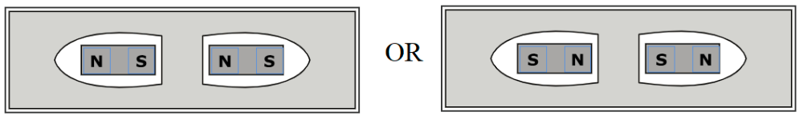
Scoring Notes
Part A
Machine scored: will show opposite poles facing each other
Part B
The boats will move toward each other because (any one of the following):
  a magnet attracts/pulls iron.
  iron attracts/pulls a magnet.
  iron has a magnetic pull/iron is magnetic.
Part C
The stored magnetic energy was converted into kinetic energy/mechanical energy because the boats were moving.
Note: Accept "motion energy" as kinetic energy.
Each part is worth 1 point.
Note: For a score going from 0-1, a correct description in Part B and identification in Part C, without explanations, is creditable.

Slide 31
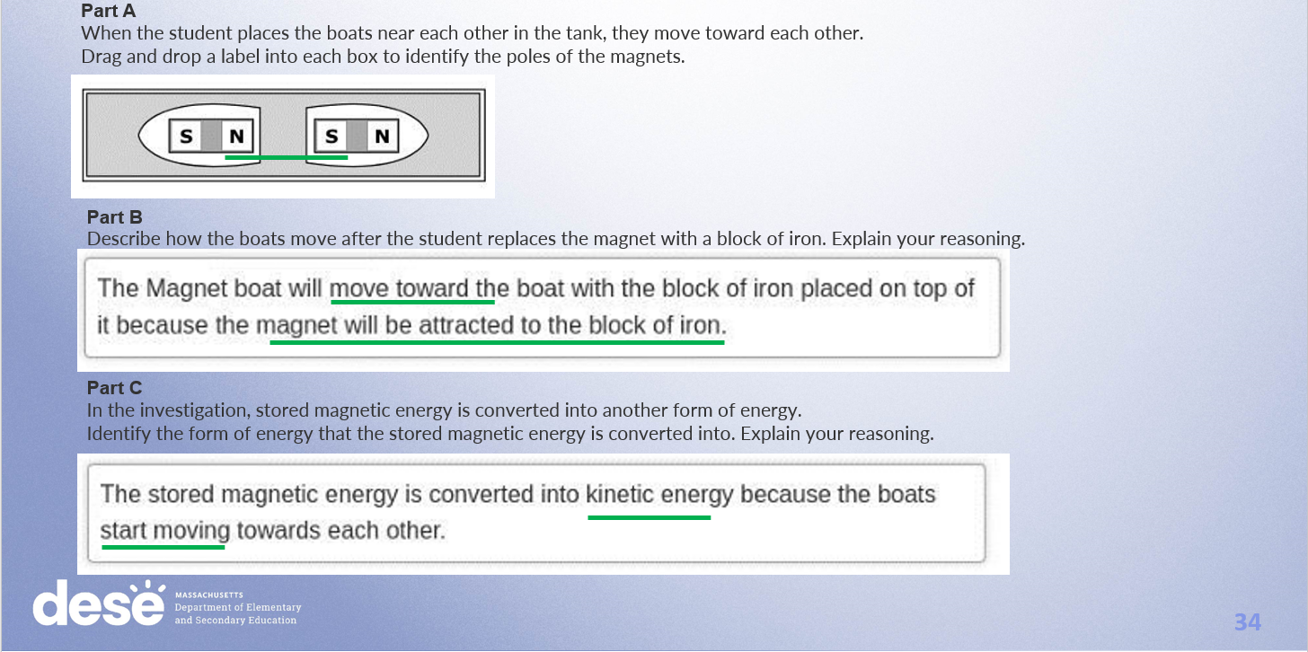
Anchor Score 3

Slide 32
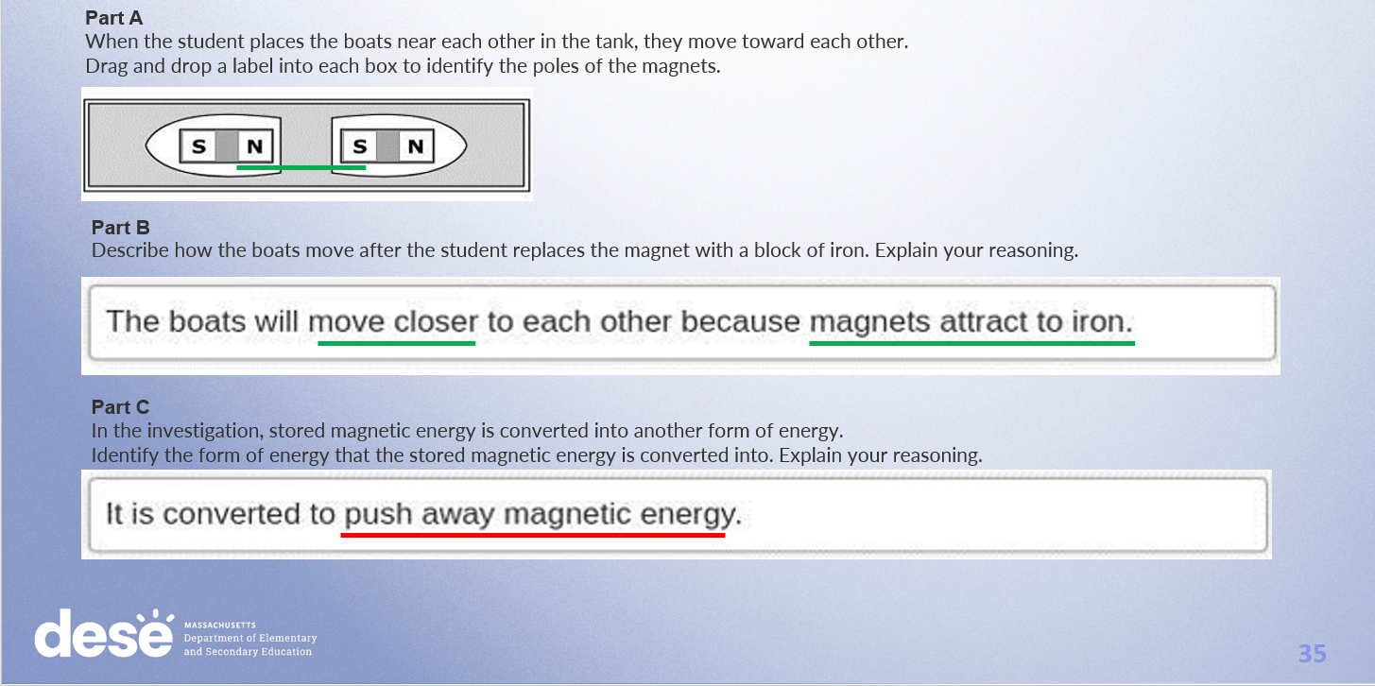
Anchor Score 2

Slide 33
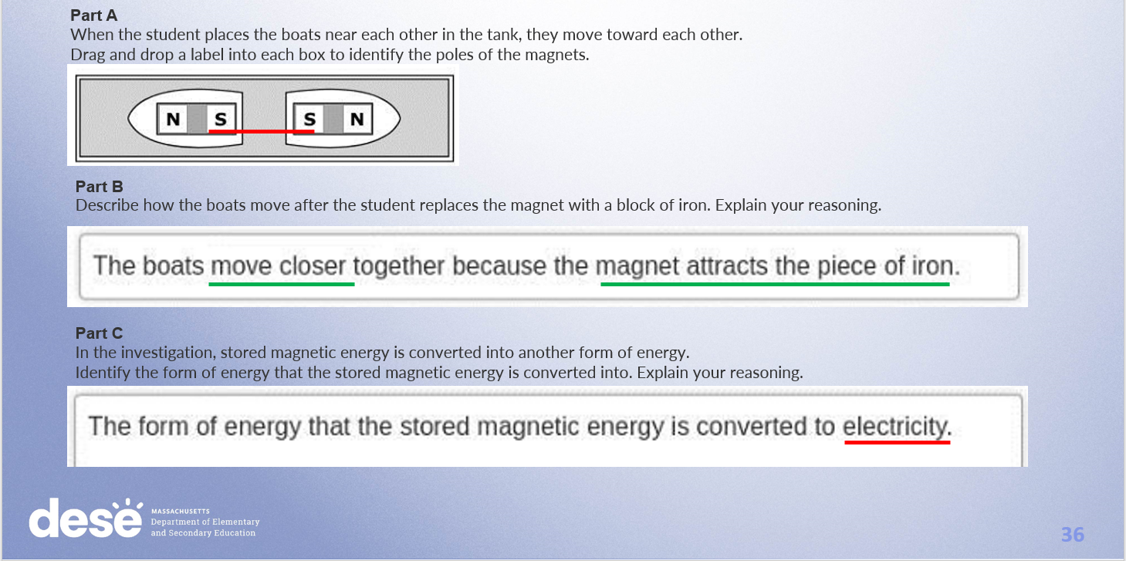
Anchor Score 1

Slide 34
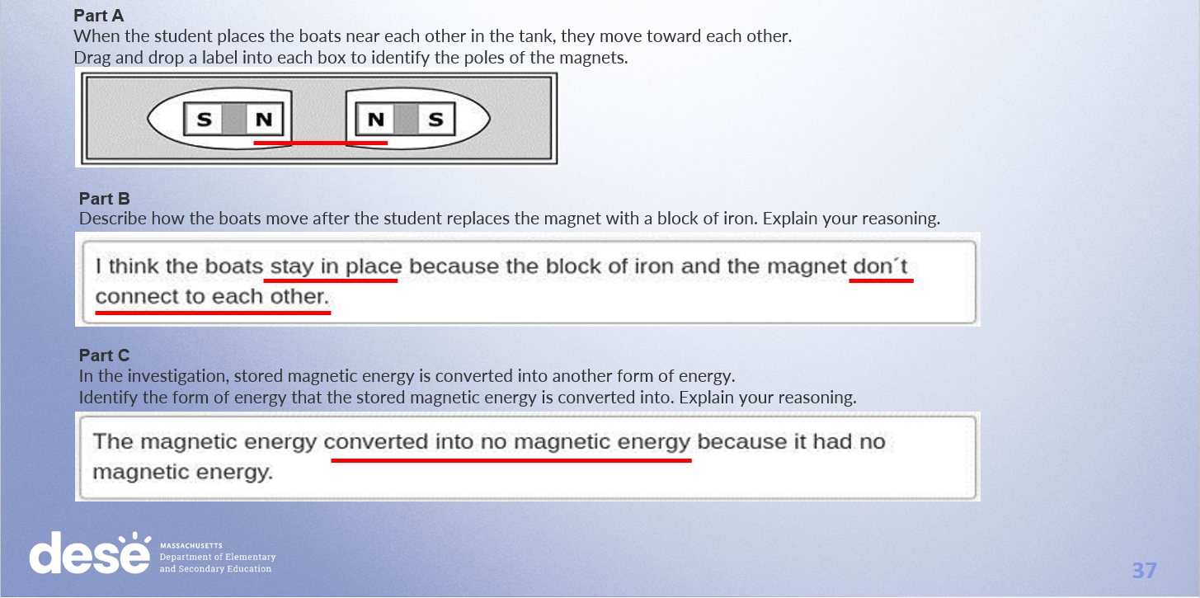
Anchor Score 0

Slide 35
Individual Scoring of Student Responses
Use scoring notes and anchor papers to score the student responses in the PDF emailed to you. We also put the PDF in the chat
Responses are from actual students
Enter the scores you give each response into the poll
Review of poll results and scores

Slide 36
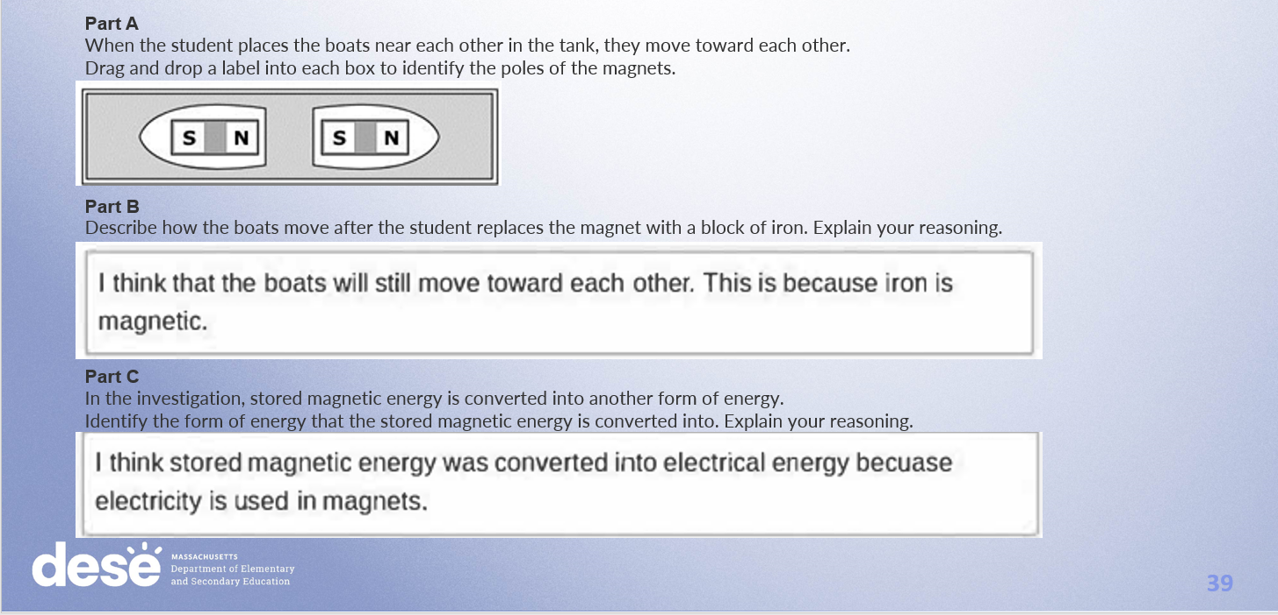
Response A –Page 24

Slide 37
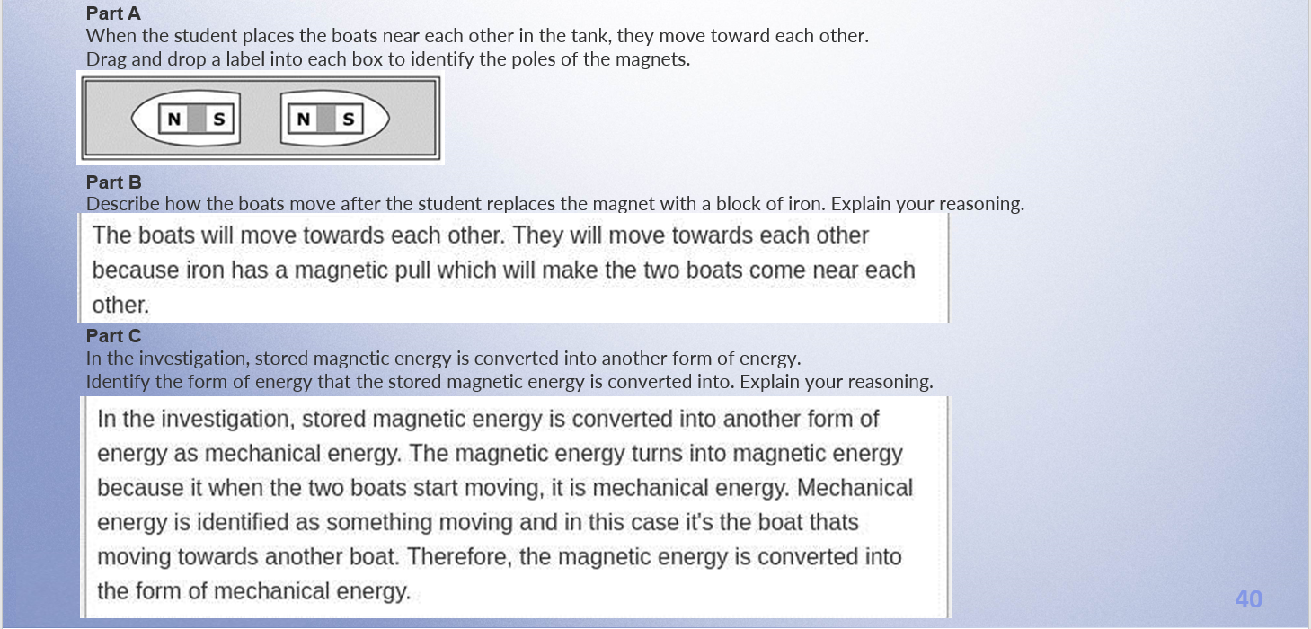
Response B –Page 25

Slide 38
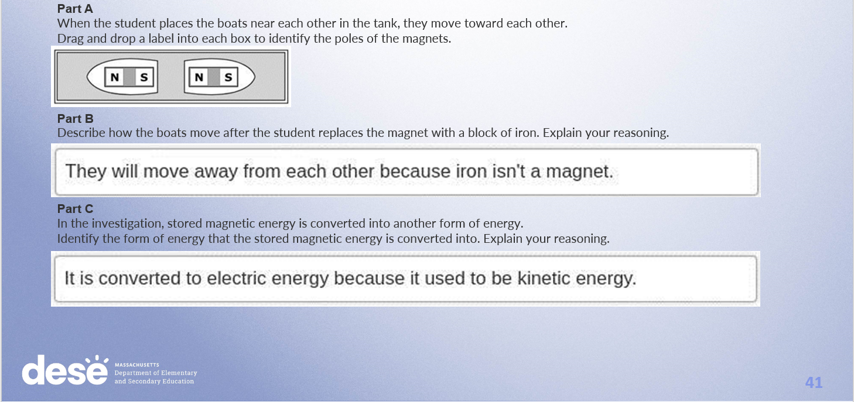
Response C –Page 26

Slide 39
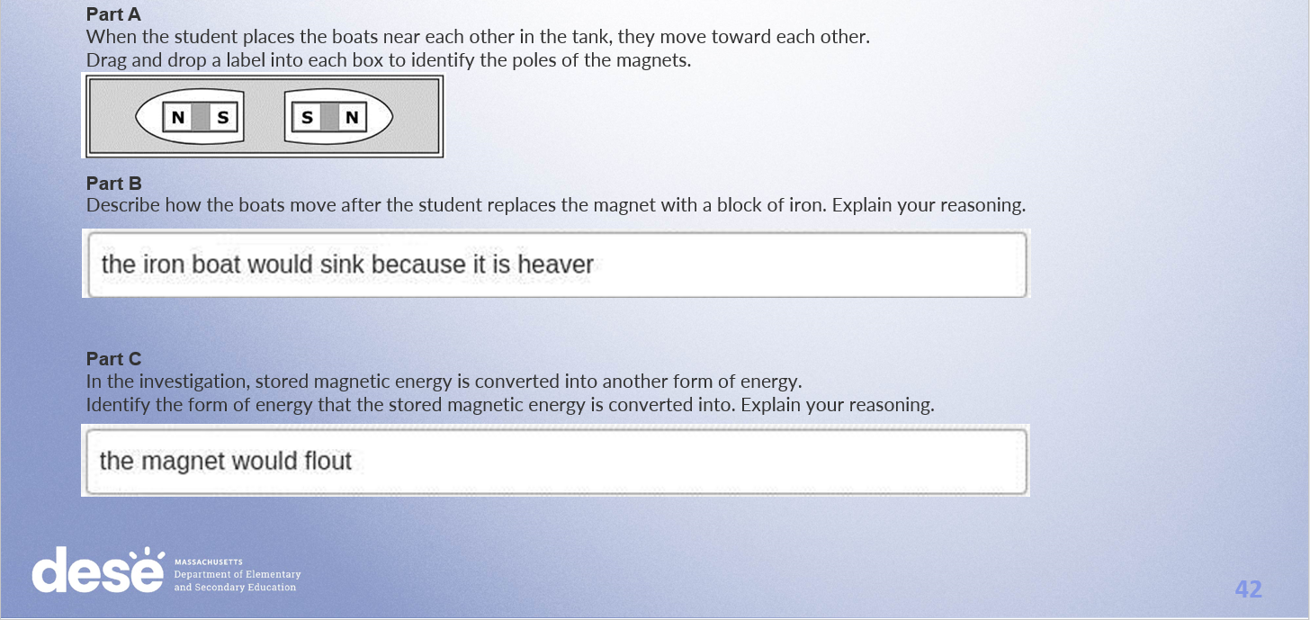
Response D –Page 27

Slide 40
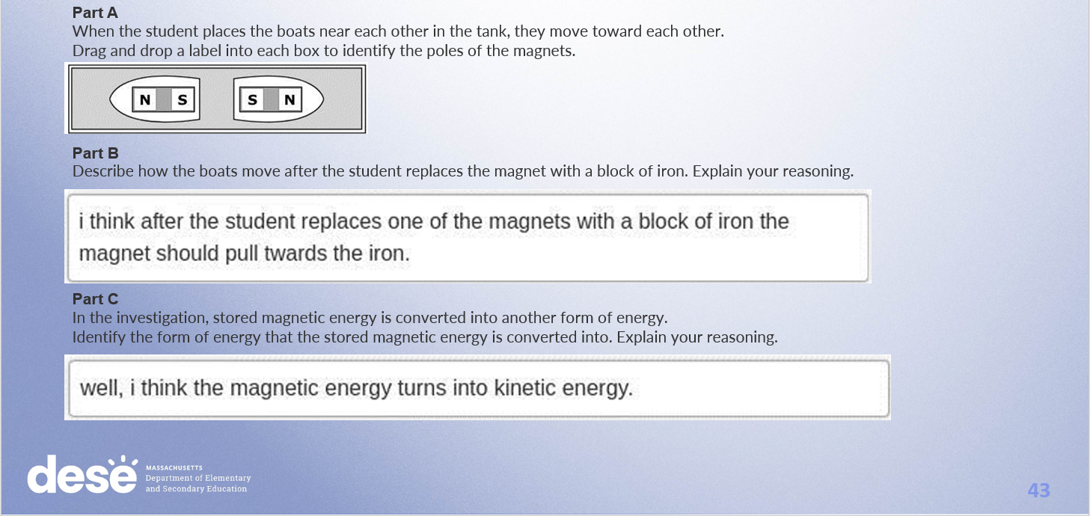
Response E –Page 28

Slide 41
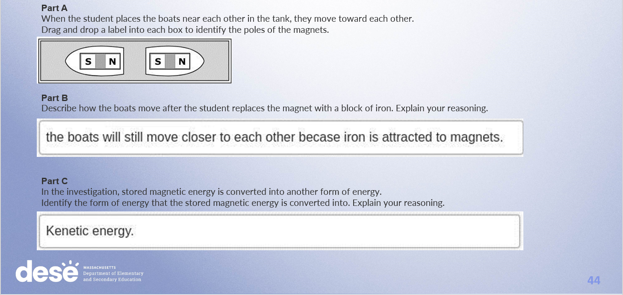
Response F –Page 29

Slide 42
Resources on DESE Website
Resource | Link
MCAS headlines and links | https://www.doe.mass.edu/mcas/
STE Test Development & Design | https://www.doe.mass.edu/mcas/tdd/sci.html
Student Work Samples | https://www.doe.mass.edu/mcas/student/default.html
Released Questions | http://mcas.pearsonsupport.com/released-items/science/
Practice Tests and Tutorial | http://mcas.pearsonsupport.com/student/
MCAS Training Page | https://www.doe.mass.edu/mcas/training.html

Slide 43
Contact Information
DESE Office of Student Assessment for policy questions (e.g., test designs, accommodations)
Web: www.doe.mass.edu/mcas
Email: mcas@doe.mass.edu
Phone: 781-338-3625
MCAS Service Center
Web: http://mcasservicecenter.com/
Phone: 1-800-737-5103

Slide 44

THANK YOU

