Slide 1
MCAS Scoring of
Science & Technology/Engineering
Constructed-Response Items:
Biology
January 2024

Slide 2

Today’s Agenda
Overview of MCAS test development and scoring process
HS Biology constructed-response (CR) scoring
  Chicken Combs, Natural Selection CR
  Plants and Insects Investigation, Photosynthesis & Cellular Respiration CR
Review resources available on the Department’s website
Questions

Slide 3
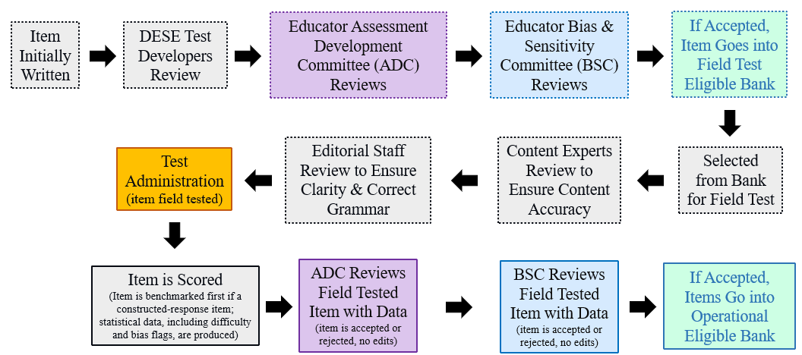
Life Cycle of Science and Technology/Engineering (STE) Item

Slide 4
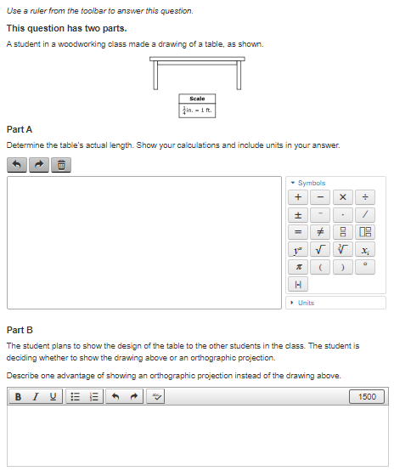
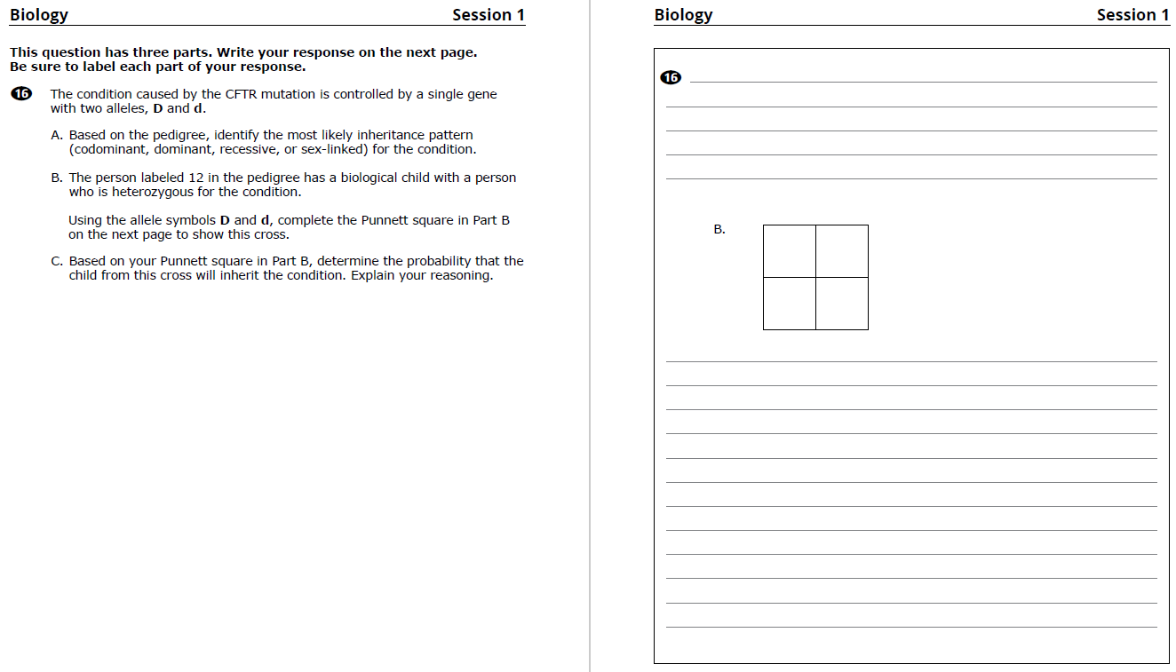
Constructed-Response (CR) Questions
Students write a response to a multi-part question
Scored holistically with partial credit
Often ask students to explain their reasoning, use evidence from data, or show their work
CBT
PBT

Slide 5

Things Not Scored on Science Tests
Spelling, grammar, and punctuation
Above grade-level misconceptions
Extra or irrelevant information (though caution against this)
Using an incorrect calculation from a previous part of an item (typically)

Slide 6

Full Credit
Students who earn full credit:
Answer all parts
Apply correct content knowledge and practices
Follow instructions, such as:
    Explaining reasoning
    Analyzing and drawing conclusions based on graphs or data tables
    Creating or completing scientific models

Slide 7

Scoring Overview: Benchmarking
Review and discuss the scoring of student responses
Adjust detailed scoring notes, which include:
  Correct responses with associated reasoning/calculations
  How points are assigned
  Scoring rules for holistic scoring
Training packs are put together, which include:
  3 “anchor” papers for each score level
  1+ practice papers for each score level

Slide 8
Scoring Overview: How Responses are Scored
Scoring leaders/scorers have content expertise, including college-level courses for the assigned test
Before scoring each question, every scorer must:
  Participate in a detailed training on how to score the responses
  Satisfactorily score a qualification set made up of actual student responses
Embedded responses and read-behinds by scoring leaders are used to monitor a scorer's performance and ensure scoring accuracy
All high school responses are scored by two scorers
Gr. 5 and 8 Tests: Approximately 25-30% of responses are scored by two scorers

Slide 9
Constructed Response Scoring Training and Practice
Question, score guide, and scoring notes review
Anchor papers
Individual scoring of student responses

Slide 10
Biology, Evolution (and Genetics) Question
2023
Chicken Combs

Slide 11

Question (page 2)
The comb on the top of a chicken’s head may be full size, intermediate size, or small size. The small-size comb is called a pea comb. A chicken with a pea comb is shown.
Part A
The allele for a full-size comb (H) and the allele for the pea comb (h) show incomplete dominance.
Using allele symbols, identify the genotype of a chicken with a pea comb.
Part B
Chickens with pea combs have an advantage in cold climates because the pea comb reduces the amount of heat loss the chicken experiences.
Describe how the frequencies of the H allele and the h allele are expected to compare in a wild chicken population that lives in a cold climate.
Part C
Explain how the allele frequencies you described in Part B could be produced as a result of natural selection.

Slide 12
Item Information
Standard Alignment: HS.LS.4.2
Construct an explanation based on evidence that Darwin’s theory of evolution by natural selection occurs in a population when the following conditions are met: (a) more offspring are produced than can be supported by the environment, (b) there is heritable variation among individuals, and (c) some of these variations lead to differential fitness among individuals as some individuals are better able to compete for limited resources than others.
Practice Category: Evidence, Reasoning, and Modeling
  Obtaining, Evaluating, and Communicating information
  Constructing Explanations

Slide 13
Scoring Guide
Score | Description
4 | The response demonstrates a thorough understanding of inheritance patterns. The response correctly identifies the genotype of a chicken with a pea comb, clearly describes the expected frequencies of the alleles in a chicken population that lives in a cold climate, and clearly explains how these frequencies would be produced as a result of natural selection.
3 | The response demonstrates a general understanding of inheritance patterns.
2 | The response demonstrates a limited understanding of inheritance patterns.
1 | The response demonstrates a minimal understanding of inheritance patterns.
0 | The response is incorrect or contains some correct work that is irrelevant to the skill or concept being measured.

Slide 14
Scoring Notes (page 4)
Part A (1 point)
hh
Part B (1 point)
The frequency of the h allele should be higher [than the frequency of the H allele].
Part C (2 points)
Because chickens with a pea comb (hh) have an advantage/lose less heat in cold environments, they would survive, reproduce, and pass on their genes/traits more frequently than chickens with intermediate or full-size combs.
OR
Because chickens with intermediate and full size combs (Hh and HH) have a disadvantage/lose more heat in cold environments, they would survive, reproduce, and pass on their genes/traits less frequently than chickens with pea combs.
Notes: To receive full credit for Part C response must address (1) the chickens with a pea comb have a survival advantage, and (2) the chickens with pea combs reproduce and pass on their genes/traits to their offspring.
For scores of 4, response must explicitly address passing on of genes/traits. At scores of 3 and below, response can simply mention increased rates of survival and reproduction.

Slide 15
Anchor: Score 4 (page 6)
Part A
hh
Part B
Most likely, the h allele will become more frequent in the chicken population because chickens with pea combs have an advantage in cold environments.
Part C
Since the chickens with pea combs have an advantage over chickens with full size combs, the chickens with pea combs are more likely to survive long enough to reproduce and send their genes onto the next generation. This process is called natural selection, and the end result would be a higher frequency of the h allele.

Slide 16
Anchor: Score 3 (page 7)
Part A
hh
Part B
The h allele will have greater frequency than the H allele in a wild chicken population that lives in a cold climate.
Part C
The frequency of the h allele would be greater than the frequency of H because h, the allele for the pea comb, is the most favorable in cold climates. Pea combs (hh) reduces the most heat loss compared to the intermediate-sized comb (Hh) and the full-sized comb (HH). Those chickens with the h allele would be better suited to the cold environment and survive compared to those chickens with the H allele.

Slide 17
Anchor: Score 2 (page 8)
Part A
hh
Part B
In a cold climate the frequency of the h allele would be much higher than the H allele, because the h allele gives off less heat & keeps the chicken warmer
Part C
The frequency of the h allele being more could be produced as a result from natural selection because it keeps the bird warmer and uses less energy, so over time the h allele became more popular through natural selection.

Slide 18
Anchor: Score 1 (page 9)
Part A
hh
Part B
In a cold climate wild chickens will have a pea comb. this helps reduce the amount of heat loss.
Part C
The chickens in a cold climate would have pea combs because it helps them reduce the amount of heat loss. This is natural selection because the chickens know their pea comb will protect them.

Slide 19
Anchor: Score 0 (page 10)
Part A
Hh, hh
Part B
The chickens without pea combs will decrease because they will get cold, get sick and die.
Part C
It’s because the population will change in the chickens.

Slide 20
Individual Scoring of Student Responses
Use scoring notes and anchor papers to score the student responses in the pack emailed to you. We are also putting a link in the chat.
Responses are from actual students but were retyped to be able to more easily see the responses
Enter the scores you give each response into the poll.
We will discuss the scores as a group.

Slide 21
Response A (page 12)
Part A
hh
Part B
The “h” allele is going to be more frequent than the “H” allele. This is because many of the chicken will adjust to the pea comb and produce offspring with the pea comb so as to prevent loss of heat during the cold climate.
Part C
The “h” allele will be more frequent than the “H” allele as a result of natural selection. This is because due to the cold climate the chicken will adjust by developing a pea comb so as to reduce loss of heat.

Slide 22
Response B (page 13)
Part A
hh
Part B
The frequency of the H allele will be far less than the frequency of the h allele in a chicken population that lives in a cold climate.
Part C
This would occur because the pea combed chicken with the h allele would have an advantage over the full sized comb chickens with an H allele. Pea combed chickens wouldn’t use as much energy as long combed chickens, allowing for a much higher rate of survival. Natural selection dictates that pea combed chickens would live on and produce more offspring, passing on their genes.

Slide 23
Response C (page 14)
Part A
hh
Part B
There will be more pea combed chickens, because of the reduced heat loss.
Part C
It could be part of natural selection because the weather would be the one controlling the pea comb and full size comb populations.

Slide 24
Response D (page 15)
Part A
hh
Part B
The frequency of the H allele would be less than the frequency of the h allele in a wild chicken population that lives in a cold climate.
Part C
The h allele would be more frequent because the chickens with the H allele would be less likely to survive because of the great amount of heat loss. The chickens with the h allele would be more likely to survive. Over time the wild chickens would have the h allele because of natural selection.

Slide 25
Response E (page 16)
Part A
hh
Part B
The h allele is more expected to be frequent because this allele helps the chicken more form the cold weather that the H allele would.
Part C
This allele could be produced as a result of natural selection because over time the chicken would want to adapt to their environment and the h allele is more helpful than the H allele.

Slide 26
Biology, Molecules to Organisms Question
2023
Plants and Insects Investigation

Slide 27
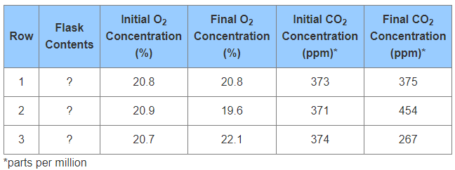
Question (page 18)
A student is studying how flowering plants and insects affect oxygen (O₂) and carbon dioxide (CO₂) concentrations in the air.
Part A
Identify the cellular process performed only by the flowering plants that affects the concentration of O₂ and CO₂ in the air.
Part B
Identify the cellular process performed by both the flowering plants and the insects that affects the concentration of O₂ and CO₂ in the air.
Part C
During an experiment, the student measured the initial concentrations of O₂ and CO₂ in three flasks, added organisms to some of the flasks, sealed the flasks, and placed them under a light. After 12 hours, the student measured the concentrations of O₂ and CO₂ in the flasks. The results for each flask are shown in the table.
During the experiment, the student had forgotten to identify the contents
of each flask. Each of the three flasks contained one of the following:
two plants and one insect; one insect; or no organisms.
Identify the contents of each flask based on the data in rows 1, 2, and 3.
Explain your reasoning using data from the table and the processes you
identified in Parts A and B. Include the row numbers in your response.

Slide 28
Item Information
Standard Alignment: HS.LS.1.5
Use a model to illustrate how photosynthesis uses light energy to transform water and carbon dioxide into oxygen and chemical energy stored in the bonds of sugars and other carbohydrates.
Practice Category: Mathematics and Data
  Analyzing and Interpreting Data
  Using Mathematical and Computational Thinking

Slide 29
Scoring Guide
Score | Description
4 | The response demonstrates a thorough understanding of photosynthesis and cellular respiration. The response correctly identifies the cellular process only the flowering plants perform and also correctly identifies the cellular process that both the flowering plants and insects perform. The response correctly identifies the contents of each flask and clearly explains the reasoning.
3 | The response demonstrates a general understanding of photosynthesis and cellular respiration.
2 | The response demonstrates a limited understanding of photosynthesis and cellular respiration.
1 | The response demonstrates a minimal understanding of photosynthesis and cellular respiration.
0 | The response is incorrect or contains some correct work that is irrelevant to the skill or concept being measured.

Slide 30
Scoring Notes (page 19)
Part A (1 point) photosynthesis
Part B (1 point) cellular respiration/respiration
Part C (3 points) 1 pt. for each ID & explanation pair
Row | Contents | Explanation
1 | no organisms | little/no change in gas concentrations
2 | one insect | insect performs [cellular] respiration, so O₂ decreased and CO₂ increased
3 | two plants and one insect | plants perform photosynthesis, so O₂ increased and CO₂ decreased
Notes:
5 pts = 4 score; 4 pts = 3 score; 2-3 pts = 2 score; 1 pt = 1 score
For a score of 4, must use data from the table and include cellular processes in response.
At scores of 3 and below, if Parts A and B are correct, accept response to Part C that does not include processes in the explanation.
At scores of 2 and below, 3 IDs in Part C with no explanation is acceptable.

Slide 31
Anchor: Score 4 (page 21)
Part A
The flowering plants use photosynthesis which affects the CO2 and O2 concentrations.
Part B
Cellular respiration affects the CO2 and O2 concentration levels
Part C
Row 1 had no organisms in the flask because the O2 and CO2 levels had little change in concentration. Row 2 had one insect because the oxygen levels decreased but the CO2 levels increased due to cellular respiration. Row 3 had two plants and one insect because the O2 levels increased as there was more oxygen being made than used and the CO2 levels decreased due to photosynthesis.

Slide 32
Anchor: Score 3 (page 22)
Part A
The process of the flowering plants that affects the levels of O2 and CO2 in the air is photosynthesis.
Part B
The process performed by both the flowering plants and insects that affects the concentration of O2 and CO2 in the air is cellular respiration.
Part C
The contents of flask one was no organisms because the oxygen levels did not change at all. The contents of flask two was one insects because the oxygen levels went down and the carbon dioxide levels went up considerably. The contents of flask three was two plants and one insect because the oxygen levels went up slightly and the carbon dioxide levels went down significantly.

Slide 33
Anchor: Score 2 (page 23)
Part A
The cellular process performed only by the flowering plants that affects the concentrations of O2 and CO2 in the air is called photosynthesis.
Part B
The cellular process performed by both the flowering plants and insects is called cellular respiration.
Part C
There were two plants and one insect in each flask. The data table shows that there is oxygen and carbon dioxide being produced. The plants produce the oxygen and the insect produces carbon dioxide. If there was one insect or no organisms in each then there would be little to none carbon dioxide and oxygen.

Slide 34
Anchor: Score 1 (page 24)
Part A
The cellular process performed would be photosynthesis
Part B
The cellular process performed would also be photosynthesis
Part C
Row one = one insect because the final concentration is not the highest
Row two = two plants and one insect because the final concentration is the highest on the chart
Row three = no organisms because it has the lowest final concentration

Slide 35
Anchor: Score 0 (page 25)
Part A
cellular respiration
Part B
photosynthesis
Part C
Row one - one insect
Row two - two plants and one insect
Row three - no organisms

Slide 36
Individual Scoring of Student Responses
Use scoring notes and anchor papers to score the student responses in the pack emailed to you. We are also putting a link in the chat.
Responses are from actual students but were retyped to be able to more easily see the responses
Enter the scores you give each response into the poll.
We will discuss the scores as a group.

Slide 37
Response A (page 27)
Part A
The cellular process performed only be the flowering plants that affects the concentrations of O2 and CO2 in the air is photosynthesis.
Part B
The cellular process performed by both the flowering plants and the insects that affects the concentrations of O2 and CO2 in the air would be cellular respiration.
Part C
Row one - no organisms,
Row two - one insect,
Row three - two plants and one insect.

Slide 38
Response B (page 28)
Part A
Photosynthesis is the cellular process performed only by flowering plants that affects the concentrations of O2 and CO2 in the air.
Part B
Cellular respiration is performed by both the flowering plants and the insects that affects the concentrations of O2 and CO2 in the air.
Part C
In row 1, there are no organisms in the flask because there is no effect to the amount of oxygen in the flask, and CO2 only went up by 2 ppm. In row 2, there is one insect because oxygen levels reduced and CO2 level drastically increased. In row 3, there are two plants and an insect because oxygen levels rose and CO2 levels dropped due to photosynthesis from the plants.

Slide 39
Response C (page 29)
Part A
The cellular process performed only by the flowering plants that affects the concentrations of O2 and CO2 in the air is photosynthesis.
Part B
The cellular process performed by both the flowering plants and the insects that affects the concentrations of O2 and CO2 in the air is cellular respiration.
Part C
In row 1 there is no organisms. I know that because it is showing no oxygen, but organisms need oxygen to survive. In row 2 there is only an insect. I know that because there is a drop in oxygen meaning some of it was used. And finally in row 3 is the insect and the two plants. I know that because the CO2 is less and that is what the plant uses.

Slide 40
Response D (page 30)
Part A
Only the flowering plants perform photosynthesis in order to produce food for themselves.
Part B
Both the flowering plants and the insects perform cellular respiration to turn their food into energy (glucose into ATP).
Part C
Flask 1 contains no organisms because the gas levels are stable, Flask 2 contains one insect because the O2 level decreased while the CO2 level increased (cellular respiration), and Flask 3 contains two plants and one insect because the O2 level increased while the CO2 level decreased (photosynthesis).

Slide 41
Response E (page 31)
Part A
carbon dioxide
Part B
hydrogen oxide
Part C
Row one: no organism
Row two: one insect
Row three: 2 plants 1 insect

Slide 42
Resources on DESE Website
Resource | Link
MCAS headlines and links | https://www.doe.mass.edu/mcas/
STE Test Development & Design | https://www.doe.mass.edu/mcas/tdd/sci.html
Student Work Samples | https://www.doe.mass.edu/mcas/student/default.html
Released Questions | http://mcas.pearsonsupport.com/released-items/science/
Practice Tests and Tutorial | http://mcas.pearsonsupport.com/student/
MCAS Training Page | https://www.doe.mass.edu/mcas/training.html

Slide 43
Contact Information
DESE Office of Student Assessment for policy questions (e.g., test designs, accommodations)
Web: www.doe.mass.edu/mcas
Email: mcas@doe.mass.edu
Phone: 781-338-3625
MCAS Service Center
Web: http://mcasservicecenter.com/
Phone: 1-800-737-5103

Slide 44

THANK YOU

