Slide 1
Scoring of Middle School Mathematics
MCAS
Constructed Response Questions
February 28, 2024

Slide 2
Agenda
Overview of MCAS test development and scoring process
Middle School Constructed Response (CR) scoring
  Question 1: Ratios and Proportional Relationships – 7-RP.A.1
  Question 2: Functions – 8-F.B.4
Practice with scoring student work samples
Review of resources available on the Department’s website

Slide 3
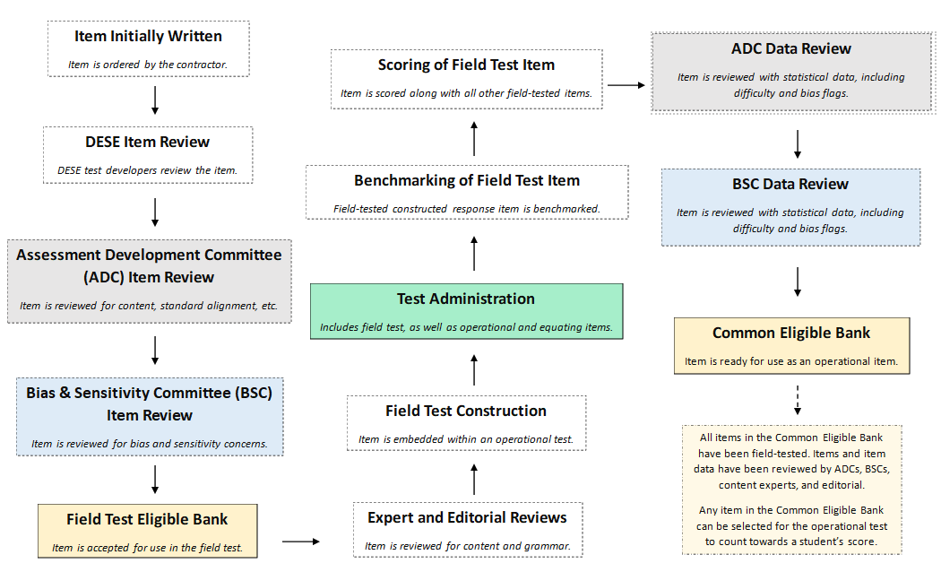
Life Cycle of a MCAS Mathematics Question

Slide 4
Constructed Response (CR) Questions
Students write a response to a multi-part question.
Responses are scored holistically.
Students are often asked to "Show or explain" how they got their answer.
All parts of a CR must be answered for full credit.
Student performance is based on the overall demonstration of understanding.

Slide 5
Things to Know
  Spelling, grammar, and punctuation are not considered in the scoring of a response​.
  A response does not need to be in a complete sentence​.
  Information not related to what is being asked does not detract from the score a response receives​.
  In multi-step problems, the same error is counted only once.
  Only whole score points for overall responses. E.g. A student cannot receive 2.5 points.
  How a student explains their answer/reasoning can often vary. For instance,
    student 1 may show all their calculations and their final answer, and
    student 2 may write an explanation in sentence form explaining a step-by-step process along with their answer.

Slide 6
Scoring Overview: Benchmarking Process
Hundreds of student responses are reviewed for training materials.
Training materials consist of:
  Detailed training notes:
    More detailed than scoring guides
    Include exemplary responses, calculations, and other content information
    Include instructions for scoring different types of responses
    Include how points should be distributed
  Benchmarked student responses: selected anchor papers that show a full range of scores.

Slide 7
Scoring Overview: Scorer Process
Scoring leaders and individual scorers are trained for each question. They must have content expertise.
Each MCAS mathematics constructed response scorer must:
  participate in constructed response specific training
  qualify to score each constructed response question
All leaders/scorers must show accuracy and consistency on practice papers before they are allowed to score “live” papers.
A scorer’s performance is monitored during the scoring process by measures such as read-behinds and embedded responses to ensure accuracy.
Many responses are scored by more than one scorer for score accuracy.

Slide 8
First Scoring Demonstration
Question 1: 7-RP.A.1 (Released 2023)
  Review the following:
    the Question,
    the Sample Response,
    the Scoring Guide, and
    the Scoring Notes.
  Analyze the Training responses

Slide 9
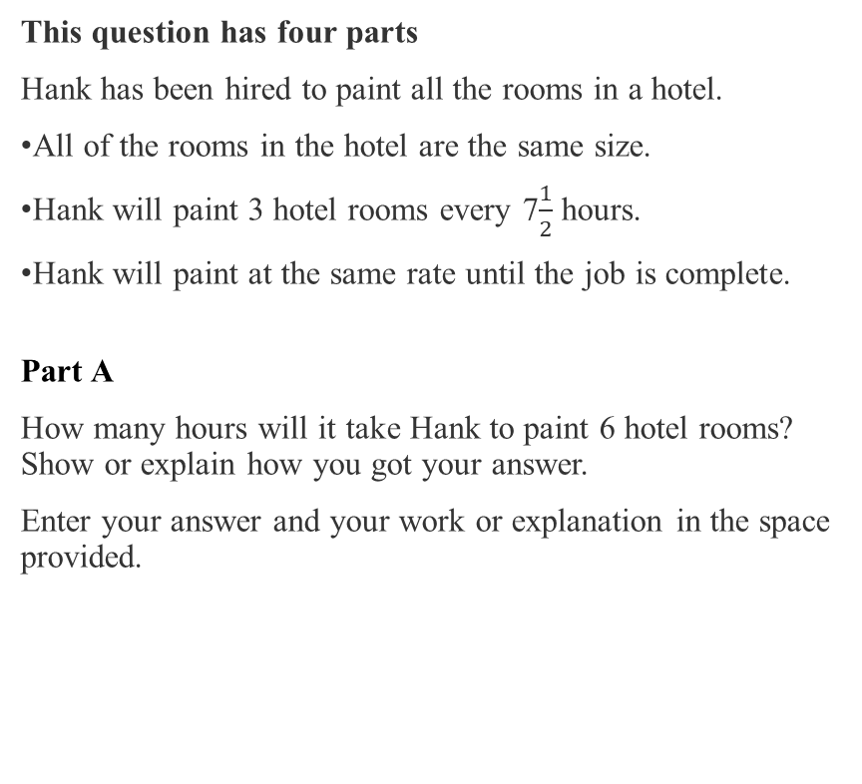
Question 1: Grade 7 – Ratios and Proportional Relationships - Released 2023
On page 2 of your Packet
Part B
How many hours will it take Hank to paint 1 hotel room? Show or explain how you got your answer.
Enter your answer and your work or explanation in the space provided.
Part C
Write an equation that can be used to find ℎ, the number of hours it will take Hank to paint r hotel rooms.
Enter your equation in the space provided.
Part D
It will take Hank 1,200 hours to paint all the hotel rooms. What is the total number of rooms in the hotel? Show or explain how you got your answer.
Enter your answer and your work or explanation in the space provided.
This question has four parts
Hank has been hired to paint all the rooms in a hotel.
All of the rooms in the hotel are the same size.
Hank will paint 3 hotel rooms every 7$\frac{1}{2}$ hours.
Hank will paint at the same rate until the job is complete.
Part A
How many hours will it take Hank to paint 6 hotel rooms? Show or explain how you got your answer.
Enter your answer and your work or explanation in the space provided.

Slide 10
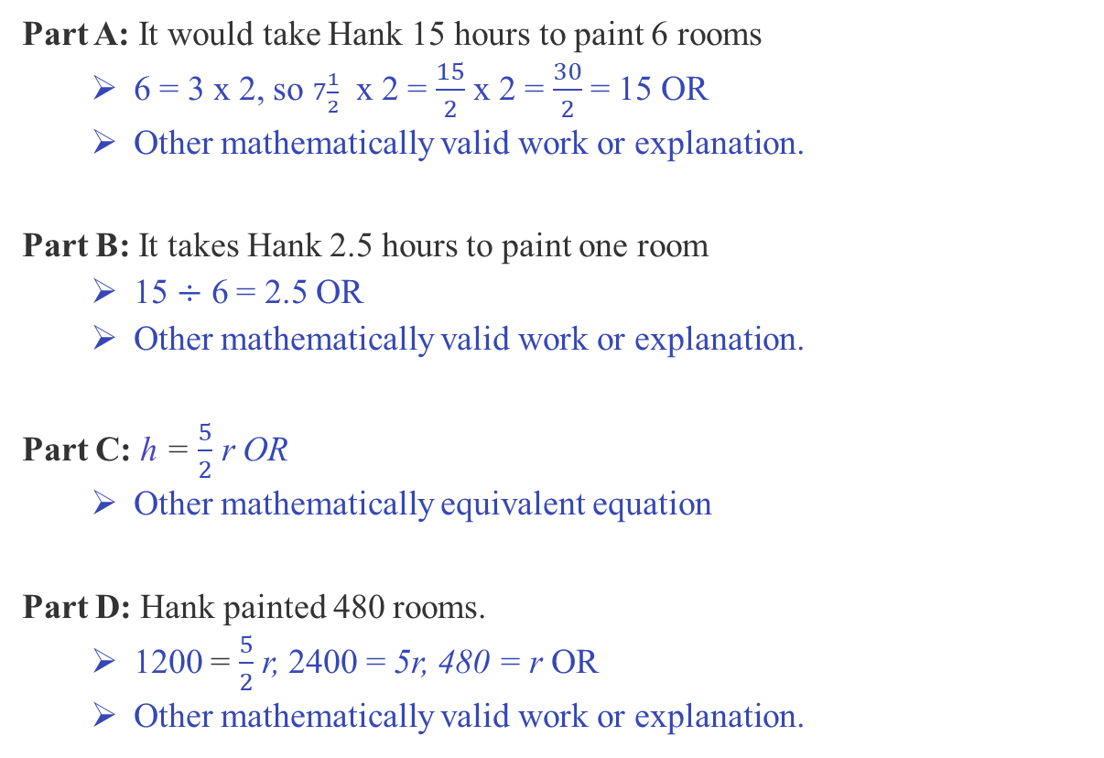
Middle School Question Sample Response
On page 3 of your Packet
Part A: It would take Hank 15 hours to paint 6 rooms
  6 = 3 x 2, so $7\frac{1}{2}$ x 2 = $\frac{15}{2}$ x 2 = $\frac{30}{2}$ = 15 OR
  Other mathematically valid work or explanation.
Part B: It takes Hank 2.5 hours to paint one room
  15 $÷$ 6 = 2.5 OR
  Other mathematically valid work or explanation.
Part C: h = $\frac{5}{2}$ r OR
  Other mathematically equivalent equation
Part D: Hank painted 480 rooms.
  1200 = $\frac{5}{2}$ r, 2400 = 5r, 480 = r OR
  Other mathematically valid work or explanation.

Slide 11
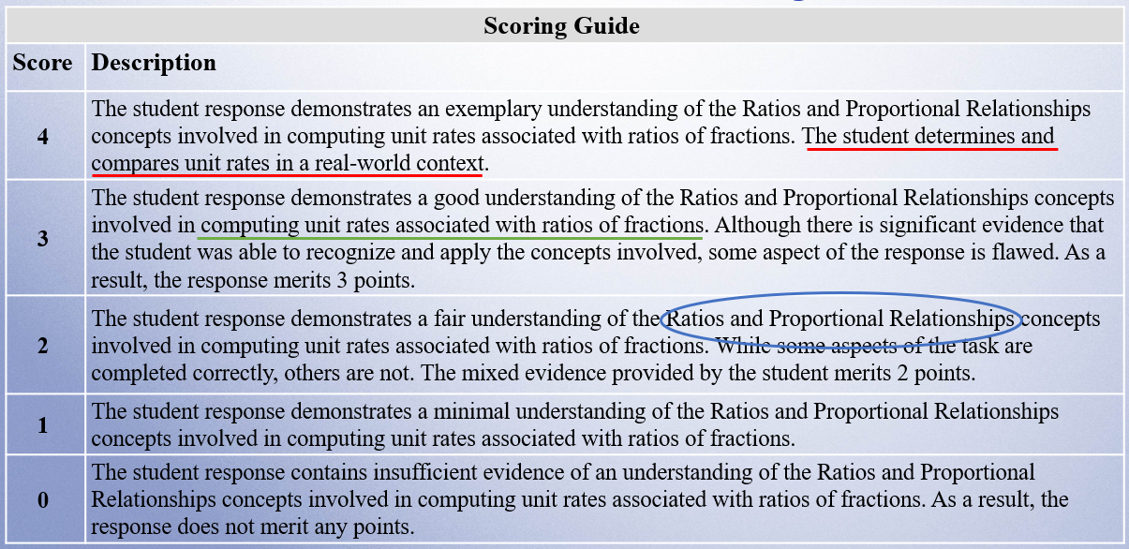
Middle School Question Scoring Guide
On page 4 of your Packet

Slide 12
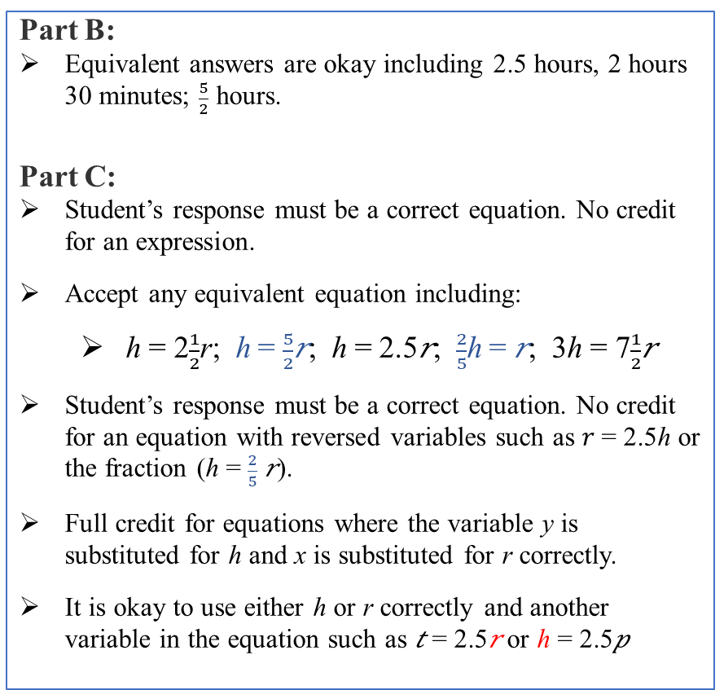
Middle School Question Scoring Notes
On page 5 of your Packet
Part B:
Equivalent answers are okay including 2.5 hours, 2 hours 30 minutes; $\frac{5}{2}$ hours.
Part C:
Student’s response must be a correct equation. No credit for an expression.
Accept any equivalent equation including:
  h = 2$\frac{1}{2}$r; ℎ = $\frac{5}{2}$𝑟; ℎ = 2.5𝑟; $\frac{2}{5}$ℎ = 𝑟; 3ℎ = 7$\frac{1}{2}$𝑟
Student’s response must be a correct equation. No credit for an equation with reversed variables such as 𝑟 = 2.5ℎ or the fraction (ℎ = $\frac{2}{5}$ 𝑟).
Full credit for equations where the variable y is substituted for h and x is substituted for r correctly.
It is okay to use either h or r correctly and another variable in the equation such as 𝑡 = 2.5𝑟 or ℎ = 2.5𝑝
No credit for equations with different variables where the variables are not defined.
Full credit is given for a correct equation based on an incorrect answer in part B.
Part D:
Correct answer with no work or explanation is okay.
Full credit is given for a correct answer based on an incorrect equation in part C.
Answer-only (appears in parts A, B and D):
One or two answer(s)-only = 1 point
One or two answer(s)-only and Part C = 2 points
Three answers-only = 2 points
Three answers-only and Part C = 3 points

Slide 13
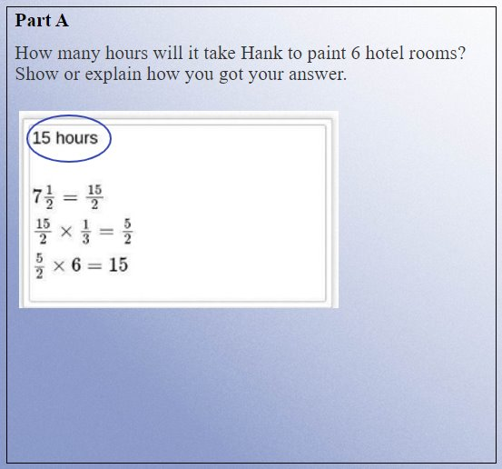
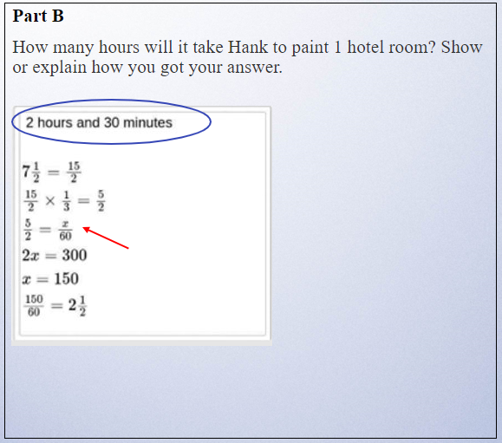
Training Response: Score 4
On page 7 of your Packet
Student converted 1 hour to 60 minutes

Slide 14

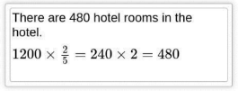
Training Response: Score 4 Cont’d
On page 7 of your Packet
Part C
Write an equation that can be used to find ℎ, the number of hours it will take Hank to paint r hotel rooms.
Part D
It will take Hank 1,200 hours to paint all the hotel rooms. What is the total number of rooms in the hotel? Show or explain how you got your answer.

Slide 15
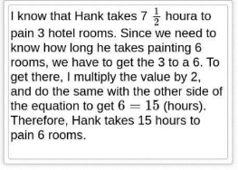
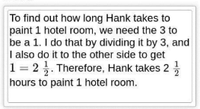

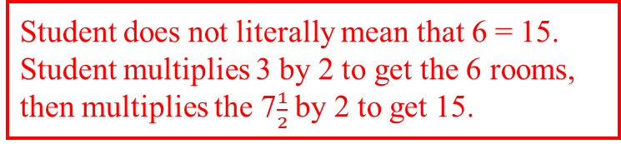
Training Response: Score 3
On page 8 of your Packet
Part A
How many hours will it take Hank to paint 6 hotel rooms? Show or explain how you got your answer.
Part B
How many hours will it take Hank to paint 11 hotel room? Show or explain how you got your answer.
Student does not literally mean that 6 = 15. Student multiplies 3 by 2 to get the 6 rooms, then multiplies the 7$\frac{1}{2}$ by 2 to get 15.
Student divides the given number 3 by 3 to get 1, then divides the given number 7$\frac{1}{2}$ by 3 to get 2 $\frac{1}{2}$.

Slide 16

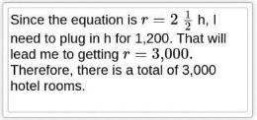
Training Response: Score 3 Cont’d
On page 8 of your Packet
Part C
Write an equation that can be used to find ℎ, the number of hours it will take Hank to paint r hotel rooms.
Part D
It will take Hank 1,200 hours to paint all the hotel rooms. What is the total number of rooms in the hotel? Show or explain how you got your answer.
Per Scoring notes, student swapped the variables, so no credit.
Full credit - Student correctly used incorrect equation from part C to answer part D.

Slide 17
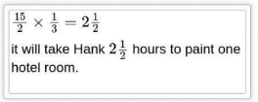
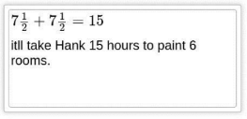
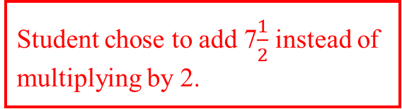
Training Response : Score 2
On page 9 of your Packet
Part A
How many hours will it take Hank to paint 6 hotel rooms? Show or explain how you got your answer.
Part B
How many hours will it take Hank to paint 1 hotel room? Show or explain how you got your answer.
Student chose to add 7$\frac{1}{2}$ instead of multiplying by 2.

Slide 18


Training Response : Score 2 Cont’d
On page 9 of your Packet
Part C
Write an equation that can be used to find ℎ, the number of hours it will take Hank to paint r hotel rooms.
Part D
It will take Hank 1,200 hours to paint all the hotel rooms. What is the total number of rooms in the hotel? Show or explain how you got your answer.

Slide 19
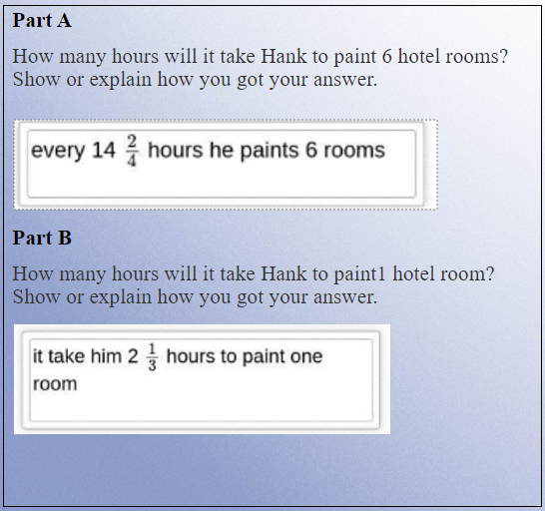
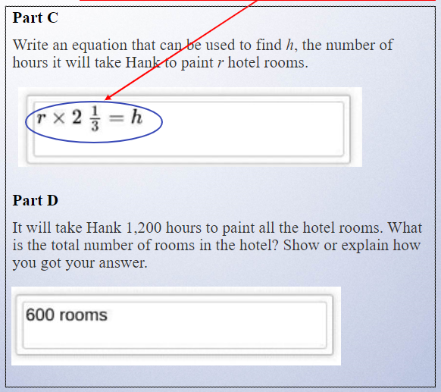
Training Response : Score 1
On page 10 of your Packet
Student correctly used incorrect answer from part B to create a correct equation in part C.

Slide 20
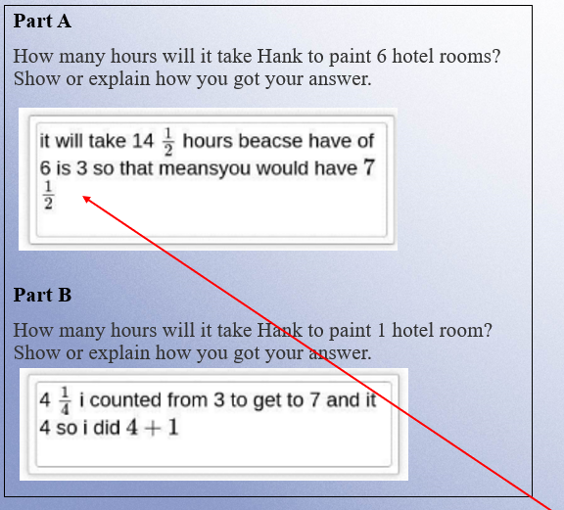
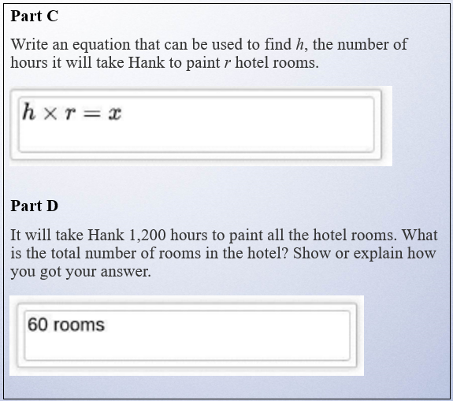
Training Response : Score 0
On page 11 of your Packet
Student had the beginning of the strategy to find “half” of 6 but didn’t follow through correctly. Insufficient.

Slide 21
Individual Practice of Scoring Student Responses
Question 1: 7-RP.A.1 (Released 2023)
  Revisit the following:
    the Question,
    the Sample Response,
    the Scoring Guide, and
    the Scoring Notes.
  Read the Sample Response
  Use the Training Response papers to score the response
  Choose one score that you think best represents the response.

Slide 22
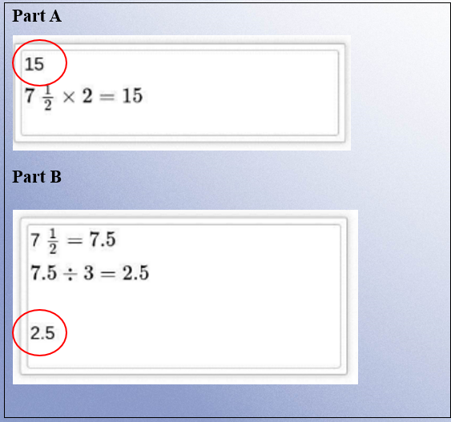
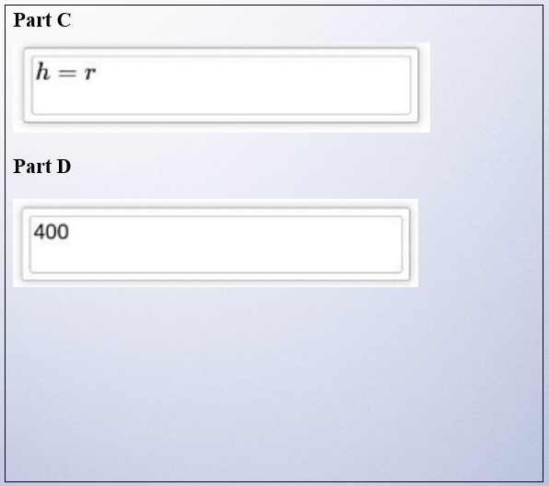
Practice Response A
On page 13 of your Packet
Score: 2
A – Full credit C – No credit
B – Full credit D – No credit

Slide 23
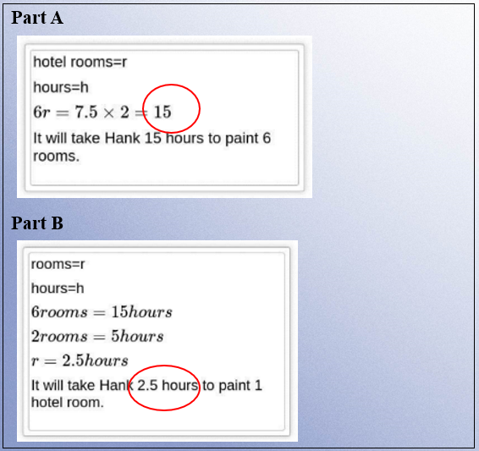
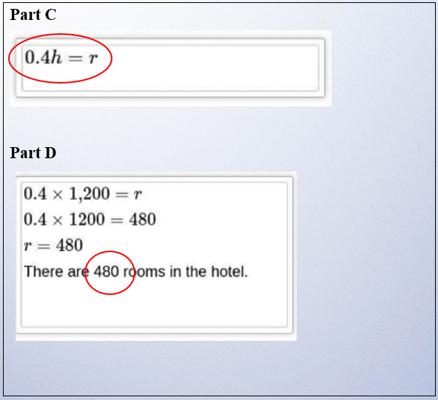
Practice Response B
On page 14 of your Packet
A – Full credit C – Full credit
B – Full credit D – Full credit
Score: 4

Slide 24
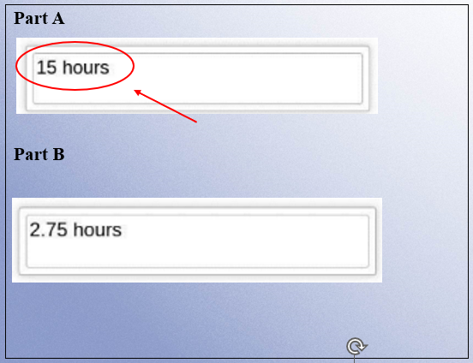
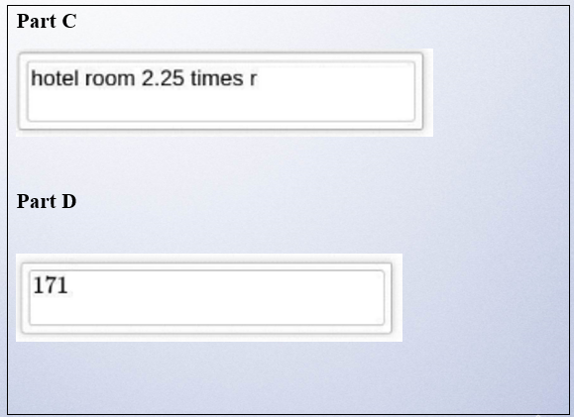
Practice Response C
On page 15 of your Packet
Score: 1
A – Full credit C – No credit
B – No credit D – No credit
Answer-only was given full credit per scoring notes.

Slide 25
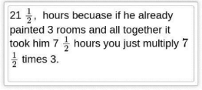



Practice Response D
On page 16 of your Packet
Score: 0
A – No credit C – No credit
B – No credit D – No credit
Part A
Part B
Part C
Part D

Slide 26
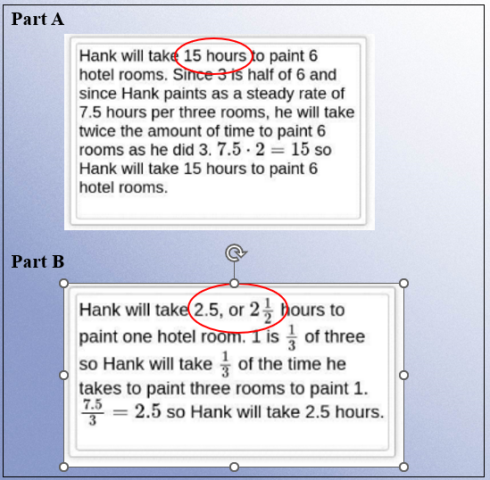
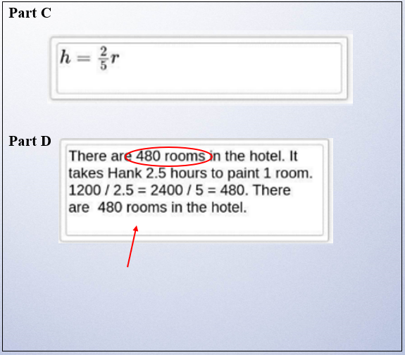
Practice Response E
On page 17 of your Packet
Score: 3
A – Full credit C – No credit
B – Full credit D – Full credit
Student did not use their equation from part C.

Slide 27
Second Scoring Demonstration
Question 2: 8-F.B.4 (Released 2023)
  Review the following:
    the Question,
    the Sample Response,
    the Scoring Guide, and
    the Scoring Notes.
  Analyze the Training responses

Slide 28
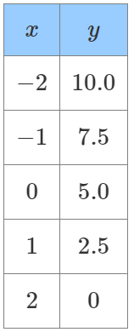
Question 2: Grade 8 – Functions – Released 2023
On page 18 of your Packet
This question has four parts
A student created this table to represent a linear relationship between x and y.
Part A
What is the y-intercept of the line represented by the x and the y values shown in the table? Show or explain how you got your answer.
Enter your answer and your work or explanation in the space provided.
Part B
What is the slope of the line represented by the x and y values shown in the table? Show or explain how you got your answer.
Enter your answer and your work or explanation in the space provided.
Part C
Write an equation of the line represented by the relationship between x and y shown in the table.
Enter your equation in the space provided.
Part D
The student says the point (9, −17.5) lies on the line represented by the relationship between x and y shown in the table.
Is the student correct? Show or explain how you got your answer.
Enter your answer and your work or explanation in the space provided.

Slide 29
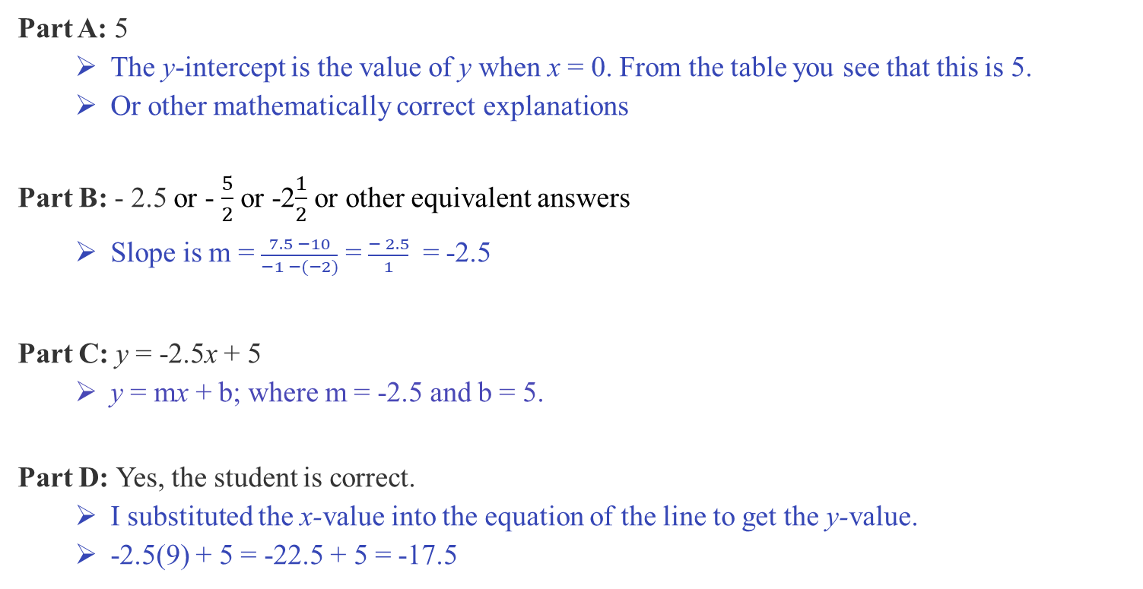
Middle School Question Sample Response
On page 19 of your Packet
Part A: 5
  The y-intercept is the value of y when x = 0. From the table you see that this is 5.
  Or other mathematically correct explanations
Part B: - 2.5 or - $\frac{5}{2}$ or -2$\frac{1}{2}$ or other equivalent answers
  Slope is m = $\frac{7.5 −10}{−1 −(−2)}$ = $\frac{− 2.5}{1}$ = -2.5
Part C: y = -2.5x + 5
  y = mx + b; where m = -2.5 and b = 5.
Part D: Yes, the student is correct.
  I substituted the x-value into the equation of the line to get the y-value.
  -2.5(9) + 5 = -22.5 + 5 = -17.5

Slide 30
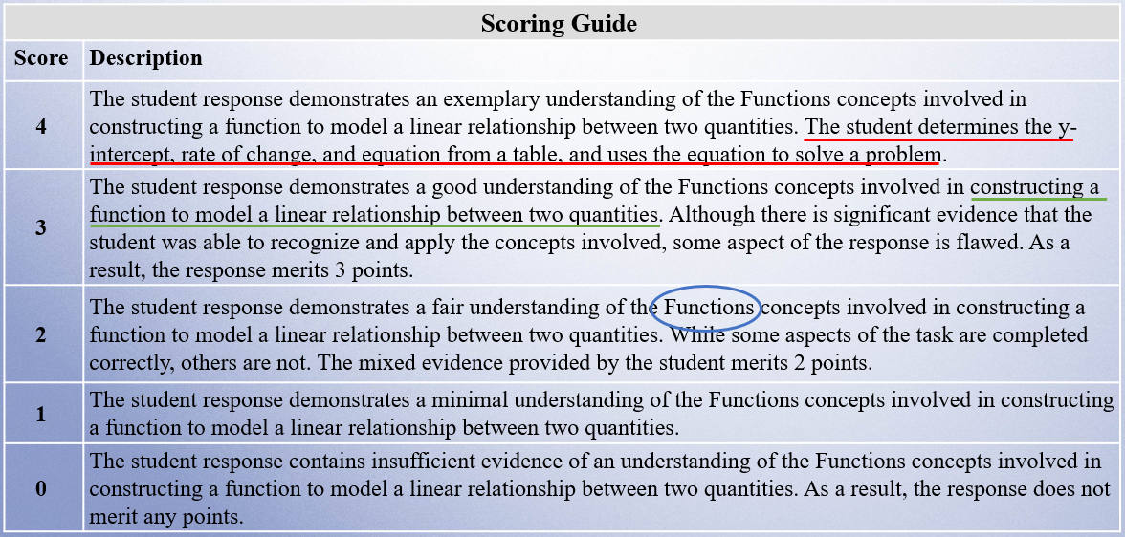
Middle School Question Scoring Guide
On page 20 of your Packet

Slide 31
Middle School Question Scoring Notes
Answer-only (appears in parts A and B only):
1 or 2 answer(s)-only = 1 point
1 or 2 answer(s)-only + C (or D) = 2 points
1 or 2 answer(s)-only + C + D = 3 points
On page 21 of your Packet
Part D:
This question is dichotomous, so no credit for “Yes” only. Student must provide an explanation with the answer of “Yes” to receive full credit.
Correct strategy includes substituting the point (9, -17.5) into their equation and solving, or continuing the table to x = 9 and y = -17.5.
  They can also receive credit if they refer to both the x and y coordinates or the point (9, -17.5) and say that they continued the table.
Full credit is given for a correct answer of “Yes” and explanation based on an incorrect equation in part C.
Part A:
Answers may be written as: 5, 5.0, or the point (0, 5)
Explanations may look like,
  The y-intercept is the value of y when x = 0.
  The y-intercept is where the line crosses the y-axis.
Students can find slope first and then find the y-intercept using the equation of the line and a point from the table.
Part B:
Correct strategy with computation error is noted but okay.
Part C:
Student’s response must be an equation. No credit for an expression.
Full credit is given for a correct equation based on an incorrect answer in part A and/or part B.

Slide 32
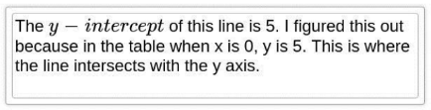
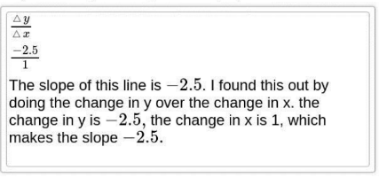
Training Response: Score 4
On page 23 of your Packet
Part A
What is the y-intercept of the line represented by the x and the y values shown in the table? Show or explain how you got your answer.
Part B
What is the slope of the line represented by the x and y values shown in the table? Show or explain how you got your answer.

Slide 33

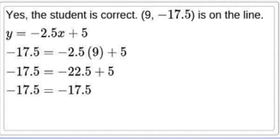
Training Response : Score 4 Cont’d
On page 23 of your Packet
Part C
Write an equation of the line represented by the relationship between x and y shown in the table.
Part D
The student says the point (9,−17.5) lies on the line represented by the relationship between x and y shown in the table.
Is the student correct? Show or explain how you got your answer.

Slide 34

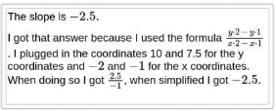
Training Response : Score 3
On page 24 of your Packet
Part A
What is the y-intercept of the line represented by the x and the y values shown in the table? Show or explain how you got your answer.
Part B
What is the slope of the line represented by the x and y values shown in the table? Show or explain how you got your answer.
With the answer for part B being -2.5, it is easy to miss that this is incorrect.

Slide 35
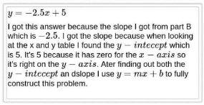
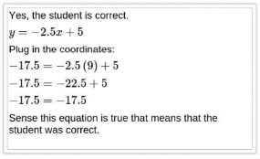
Training Response: Score 3 Cont’d
On page 24 of your Packet
Part C
Write an equation of the line represented by the relationship between x and y shown in the table.
Part D
The student says the point (9,−17.5) lies on the line represented by the relationship between x and y shown in the table. Is the student correct? Show or explain how you got your answer.
Student provided correct explanation. However, an explanation was not needed.

Slide 36


Training Response : Score 2
On page 25 of your Packet
Part A
What is the y-intercept of the line represented by the x and the y values shown in the table? Show or explain how you got your answer.
Part B
What is the slope of the line represented by the x and y values shown in the table? Show or explain how you got your answer.
Answer-only was given full credit per scoring notes.
Answer should be -2.5

Slide 37

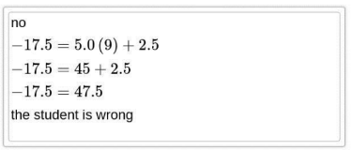
Training Response : Score 2 Cont’d
On page 25 of your Packet
Part C
Write an equation of the line represented by the relationship between x and y shown in the table.
Part D
The student says the point (9,−17.5) lies on the line represented by the relationship between x and y shown in the table.
Is the student correct? Show or explain how you got your answer.
Student reversed y-intercept and slope.
Correct based on incorrect equation from Part C per Scoring notes.

Slide 38


Training Response : Score 1
On page 26 of your Packet
Part A
What is the y-intercept of the line represented by the x and the y values shown in the table? Show or explain how you got your answer.
Part B
What is the slope of the line represented by the x and y values shown in the table? Show or explain how you got your answer.

Slide 39
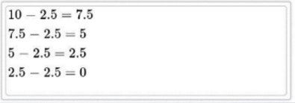
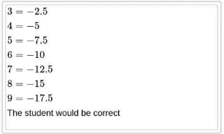
Training Response : Score 1 Cont’d
On page 26 of your Packet
Part C
Write an equation of the line represented by the relationship between x and y shown in the table
Part D
The student says the point (9,−17.5) lies on the line represented by the relationship between x and y shown in the table. Is the student correct? Show or explain how you got your answer.
Student extended the table.

Slide 40


Training Response : Score 0
On page 27 of your Packet
Part A
What is the y-intercept of the line represented by the x and the y values shown in the table? Show or explain how you got your answer.
Part B
What is the slope of the line represented by the x and y values shown in the table? Show or explain how you got your answer.

Slide 41


Training Response : Score 0 Cont’d
On page 27 of your Packet
Part C
Write an equation of the line represented by the relationship between x and y shown in the table.
Part D
The student says the point (9,−17.5) lies on the line represented by the relationship between x and y shown in the table.
Is the student correct? Show or explain how you got your answer.

Slide 42
Individual Practice of Scoring Student Responses
Question 2: 8-F.B.4 (Released 2023)
  Revisit the following:
      the Question,
      the Sample Response,
      the Scoring Guide, and
      the Scoring Notes.
  Read the Sample Response
  Use the Training Response papers to score the response
  Choose one score that you think best represents the response.

Slide 43




Practice Response A
Score: 3
A – Full credit C – Full credit based on Part B
B – No credit D – Full credit
On page 29 of your Packet
Part A
Part B
Part C
Part D

Slide 44


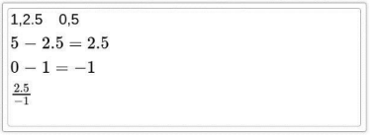

Practice Response B
Score: 1
A – No credit C – No credit
B – Full credit D – No credit
On page 30 of your Packet
Part A
Part B
Part C
Part D

Slide 45


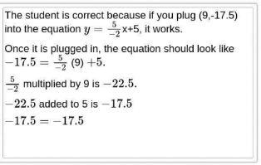
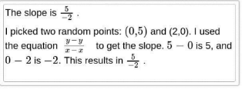
Practice Response C
Score: 4
A – Full credit C – Full credit
B – Full credit D – Full credit
On page 31 of your Packet
Part A
Part B
Part C
Part D
Okay per Scoring notes.

Slide 46




Practice Response D
Score: 0
A – No credit C – No credit
B – No credit D – No credit
On page 32 of your Packet
Part A
Part B
Part C
Part D

Slide 47




Practice Response E
Score: 2
A – Full credit C – No credit
B – No credit D – Full credit
On page 33 of your Packet
Part A
Part B
Part C
Part D
Not based on part B because there is no y-intercept.
Not connected to Parts A, B or C, but correct for full-credit.

Slide 48
Resources on DESE Website
Resource | Link
MCAS headlines and links to MCAS site | https://www.doe.mass.edu/mcas/
Mathematics Test Designs | https://www.doe.mass.edu/mcas/tdd/math.html?section=testdesign
Student Work Samples | https://www.doe.mass.edu/mcas/student/default.html
Released Questions | http://mcas.pearsonsupport.com/released-items/math/
Practice Tests and Tutorial | http://mcas.pearsonsupport.com/student/

Slide 49
Contact Information
DESE Office of Student Assessment for policy questions
(e.g., test designs, accommodations)
Web: www.doe.mass.edu/mcas
Email: mcas@mass.gov (new)
Phone: 781-338-3625
MCAS Service Center
Web: http://mcasservicecenter.com
Phone: 1-800-737-5103

Slide 50

THANK YOU

