Slide 1
Scoring of Elementary School Mathematics
MCAS
Constructed Response Questions
February 27, 2024

Slide 2
Agenda
Overview of MCAS test development and scoring process
Elementary Constructed Response (CR) scoring
  Question 1: Measurement and Data – 5-MD.C.5
  Question 2: Operations and Algebraic Thinking – 4-OA.C.5
Practice with scoring student work samples
Review of resources available on the Department’s website

Slide 3
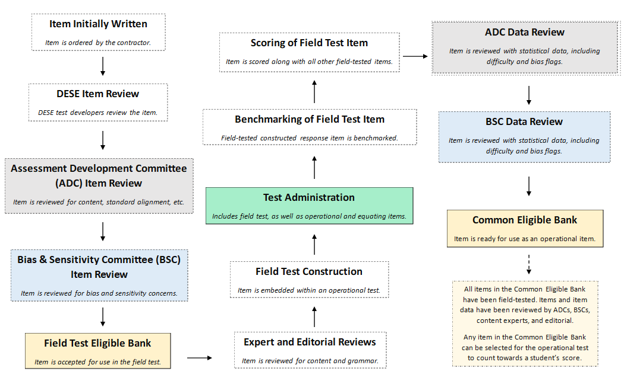
Life Cycle of an MCAS Mathematics Question

Slide 4
Constructed Response (CR) Questions
Students write a response to a multi-part question.
Responses are scored holistically.
Students are often asked to "Show or explain" how they got their answer.
All parts of a CR must be answered for full credit.
Student performance is based on the overall demonstration of understanding.

Slide 5
Things to Know
  Spelling, grammar, and punctuation are not considered in the scoring of a response​.
  A response does not need to be in a complete sentence​.
  Information not related to what is being asked does not detract from the score a response receives​.
  In multi-step problems, the same error is counted only once.
  Only whole score points for overall responses. E.g. A student cannot receive 2.5 points.
  How a student explains their answer/reasoning can often vary. For instance,
    student 1 may show all their calculations and their final answer, and
    student 2 may write an explanation in sentence form explaining a step-by-step process along with their answer.

Slide 6
Scoring Overview: Benchmarking Process
Hundreds of student responses are reviewed for training materials.
Training materials consist of:
  Detailed training notes:
    More detailed than scoring guides
    Include exemplary responses, calculations, and other content information
    Include instructions for scoring different types of responses
    Include how points should be distributed
  Benchmarked student responses: selected anchor papers that show a full range of scores.

Slide 7
Scoring Overview: Scorer Process
Scoring leaders and individual scorers are trained for each question. They must have content expertise.
Each MCAS mathematics constructed response scorer must:
  participate in constructed response specific training
  qualify to score each constructed response question
All leaders/scorers must show accuracy and consistency on practice papers before they are allowed to score “live” papers.
A scorer’s performance is monitored during the scoring process by measures such as read-behinds and embedded responses to ensure accuracy.
Many responses are scored by more than one scorer for score accuracy.

Slide 8
First Scoring Demonstration
Question 1: 5.MD.C.5 (Released 2023)
  Review the following:
    the Question,
    the Sample Response,
    the Scoring Guide, and
    the Scoring Notes.
  Analyze the Training responses

Slide 9

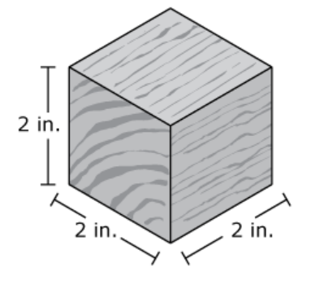
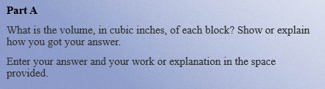
Question 1: Grade 5 – Measurement and Data - Released 2023
On page 2 of your Packet
Part B
The toy company packs the blocks in cartons. Each carton is in the shape of a right rectangular prism and is completely filled, with no gaps or overlaps.
  The carton has a base area of 240 square inches.
  The carton has a height of 12 inches.
What is the volume, in cubic inches, of the carton? Show or explain how you got your answer.
Enter your answer and your work or explanation in the space provided.
Part C
What is the greatest number of blocks that can fit in one carton, with no gaps or overlaps? Show or explain how you got your answer.
Enter your answer and your work or explanation in the space provided.
Part D
The toy company plans to start making a larger carton that holds exactly 1,000 blocks, with no gaps or overlaps.
What could be the measurements, in inches, of the larger carton’s length, width, and height? Show or explain how you got your answers.
Enter your answer and your work or explanation in the space provided.

Slide 10
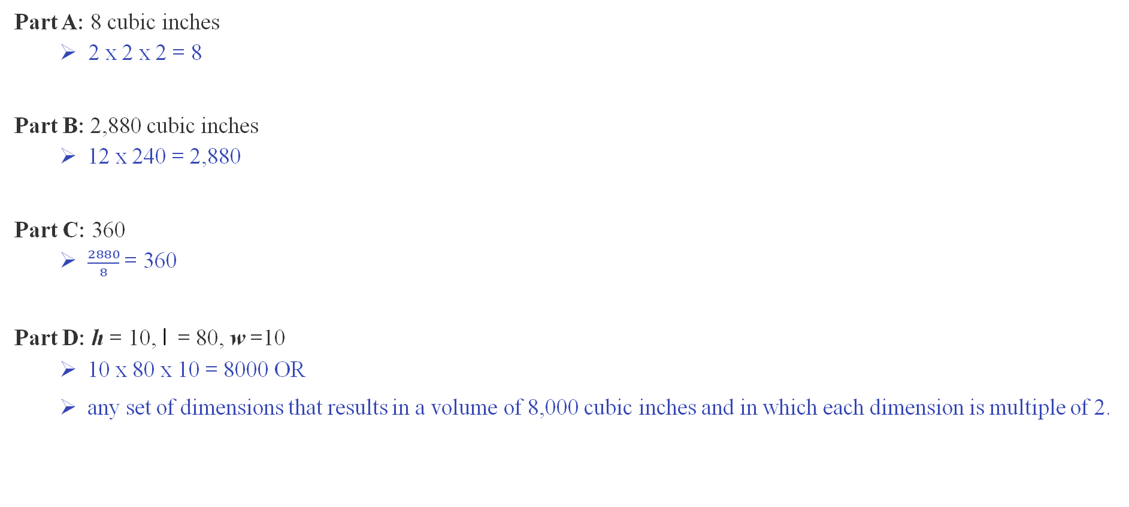
Elementary School Question Sample Response
On page 3 of your Packet
Part A: 8 cubic inches
  2 x 2 x 2 = 8
Part B: 2,880 cubic inches
  12 x 240 = 2,880
Part C: 360
  $\frac{2880}{8}$ = 360
Part D: h = 10, l = 80, w =10
  10 x 80 x 10 = 8000 OR
  any set of dimensions that results in a volume of 8,000 cubic inches and in which each dimension is multiple of 2.

Slide 11
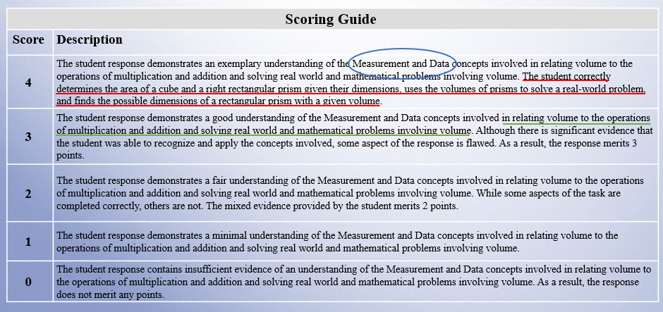
Elementary Question Scoring Guide
On page 4 of your Packet

Slide 12
Elementary Question Scoring Notes
On page 5 of your Packet
Part A:
Must show 2 x 2 x 2 = 8 or 2³ = 8 for full credit.
Students are given the volume formula so, l x w x h = 8 is answer-only.
Part B:
Must show 240 x 12 = 2,880 for full credit.
Students are given the volume formula so, B x h = 2,880 is answer-only.
Correct strategy with computation error is noted but okay.
Part C:
Full credit is given for a correct answer based on an incorrect answer in part A and/or part B.
Correct strategy with computation error is okay.
Part D:
Full credit is given for a correct answer based on an incorrect answer in part A.
Full credit for dimensions and a volume of 8,000 without using an incorrect answer from part A.
Dimensions only is considered answer-only.
Answer-only (possible in all parts):
4 answers-only = 3 points
3 answers-only + 1 part = 3 points
1 or 2 answer(s)-only = 1 point
1 or 2 answer(s)-only + 1 part = 2 points
1 or 2 answer(s)-only + 2 parts = 3 points
1 answer-only + 3 correct parts = 4 points holistically

Slide 13
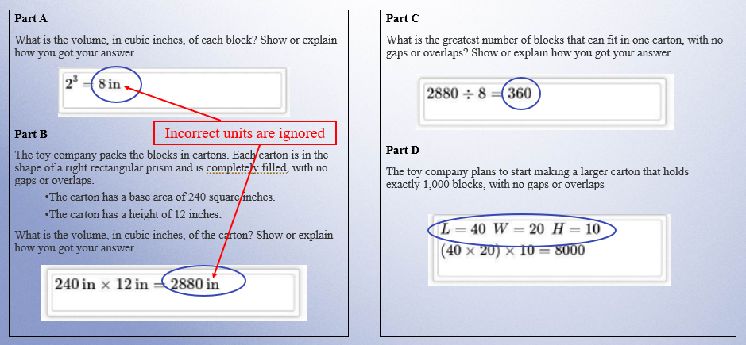
Training Response: Score 4
On page 7 of your Packet

Slide 14
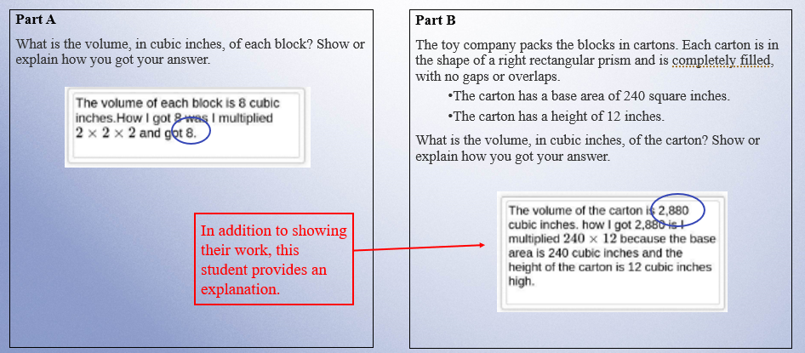
Training Response: Score 3
On page 8 of your Packet

Slide 15
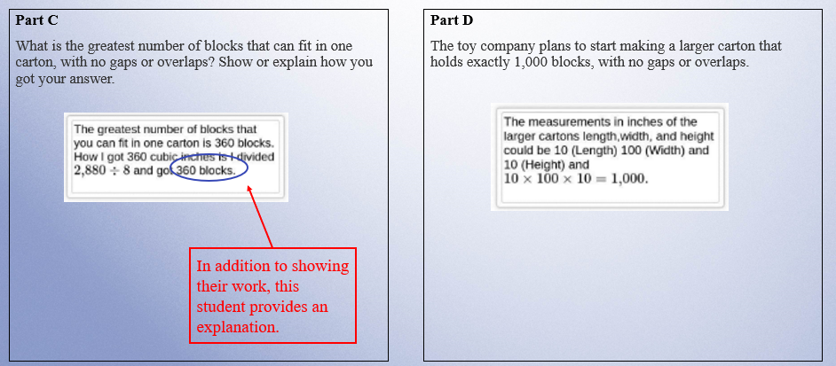
Training Response: Score 3 Cont’d
On page 8 of your Packet

Slide 16
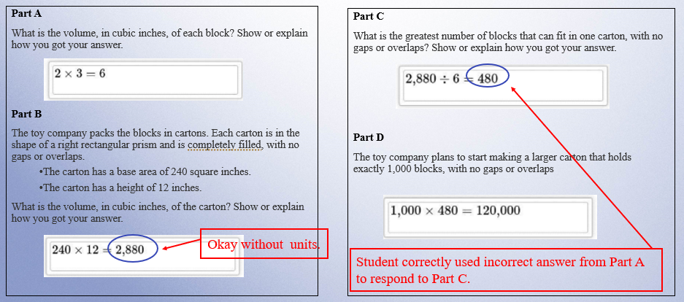
Training Response: Score 2
On page 9 of your Packet

Slide 17
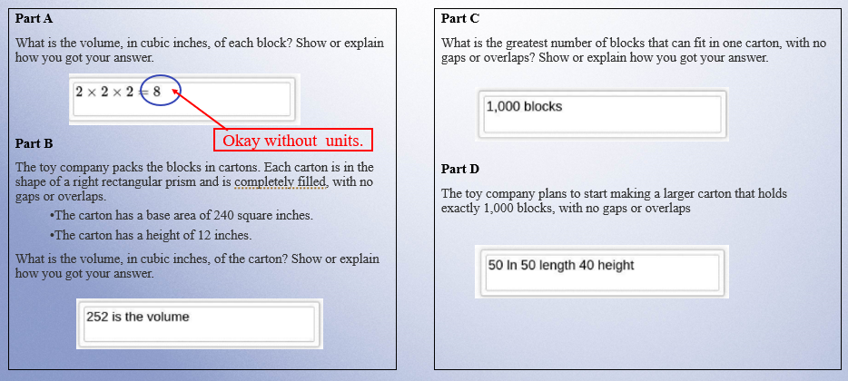
Training Response: Score 1
On page 10 of your Packet

Slide 18
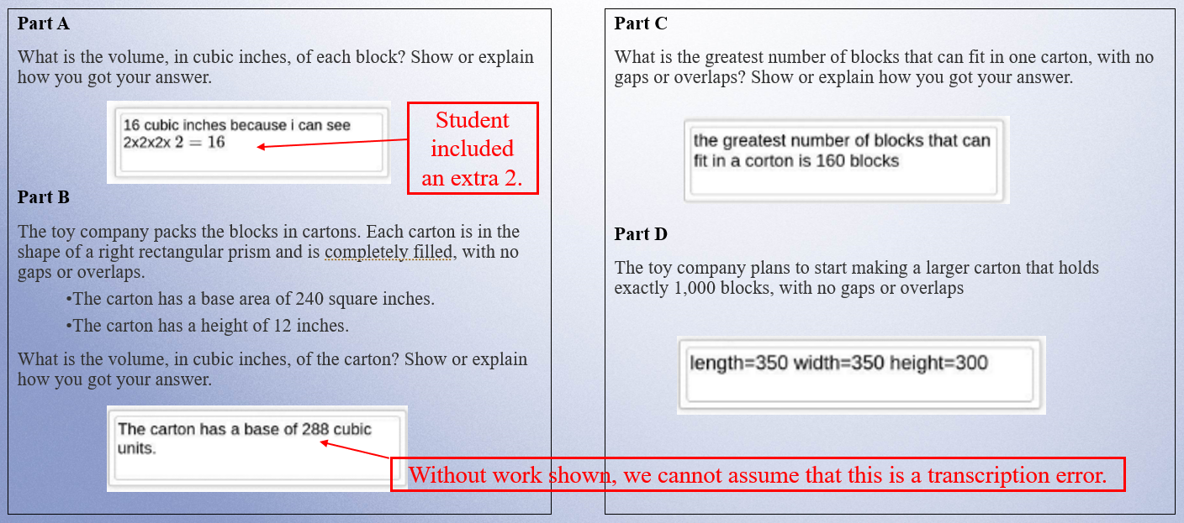
Training Response: Score 0
On page 11 of your Packet

Slide 19
Individual Practice of Scoring Student Responses
Question 1: 5-MD.C.5 (Released 2023)
  Revisit the following:
    the Question,
    the Sample Response,
    the Scoring Guide, and
    the Scoring Notes.
  Read the Sample Response
  Use the Training Response papers to score the response
  Choose one score that you think best represents the response.

Slide 20

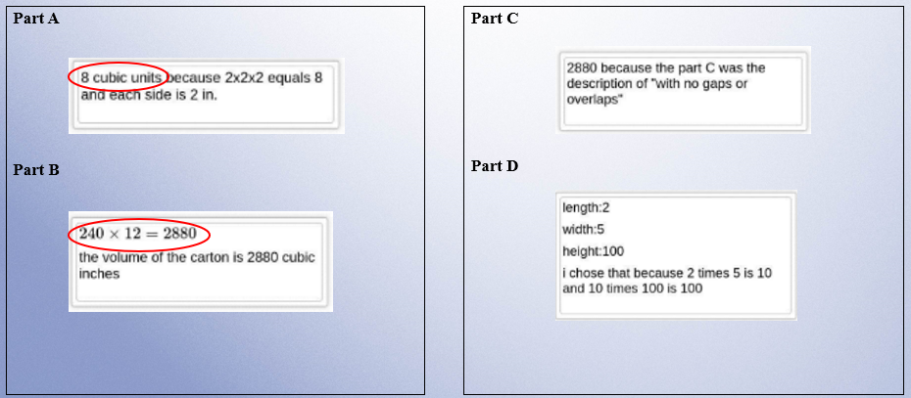
Practice Response A
On page 13 of your Packet

Slide 21

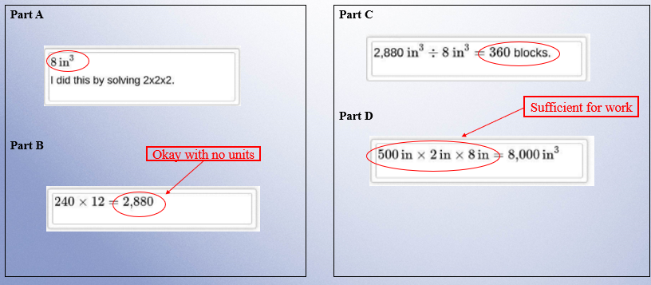
Practice Response B
On page 14 of your Packet

Slide 22

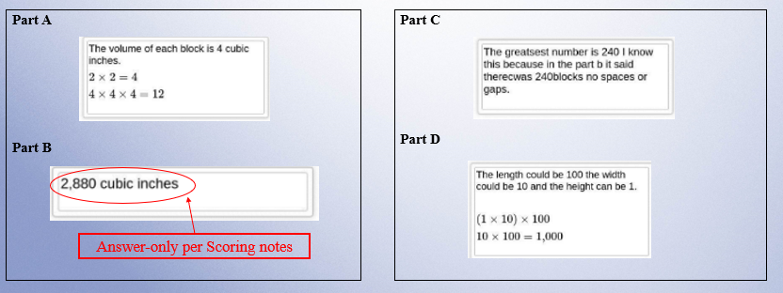
Practice Response C
On page 15 of your Packet

Slide 23

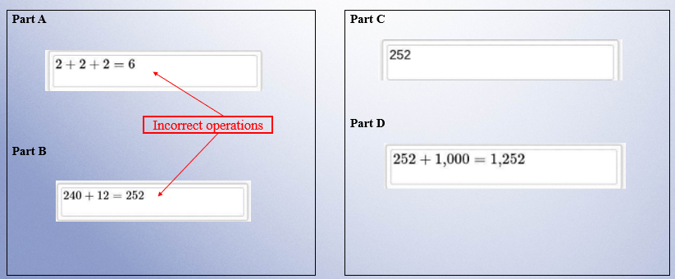
Practice Response D
On page 16 of your Packet

Slide 24

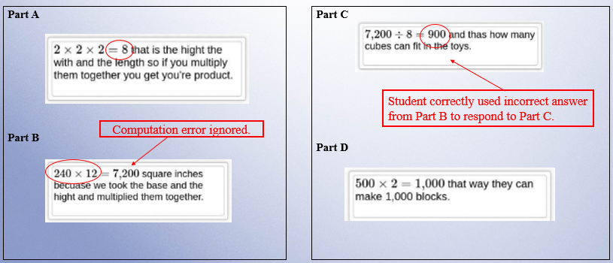
Practice Response E
On page 17 of your Packet

Slide 25
Second Scoring Demonstration
Question 2: 4-OA.C.5 (Released 2023)
  Review the following:
    the Question,
    the Sample Response,
    the Scoring Guide, and
    the Scoring Notes.
  Analyze the Training responses

Slide 26

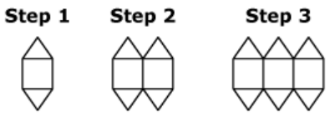
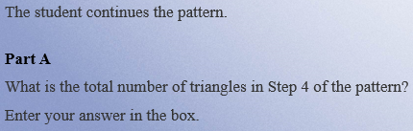
Question 2: Grade 4 – Operations and Algebraic Thinking – Released 2022
On page 18 of your Packet
Part B
What is the total number of squares in Step 6 of the pattern? Explain how you know your answer is correct.
Enter your answer and your work or explanation in the space provided.
Part C
What is the total number of triangles in Step 9 of the pattern? Explain how you can get your answer by using multiplication.
Enter your equation in the space provided.
Part D
One step in the pattern will have a total of 64 triangles.
What is the total number of squares in that step? Show or explain how you got your answer.
Enter your answer and your explanation in the space provided.

Slide 27
Elementary School Question Sample Response
On page 19 of your Packet
Part A: 8 (triangles)
Part B: 6 (squares)
  The number of squares is the same as the step number in the pattern.
Part C: 18 (triangles)
  The number of triangles is always twice as many as the step number in the pattern. So, multiply the step number by 2 to find the number of triangles.
  2 x 9 = 18 OR
  other valid explanation
Part D: 32 (squares)
  The number of triangles is always twice the number of squares.
  64 ÷ 2 = 32 OR
  other valid explanation

Slide 28
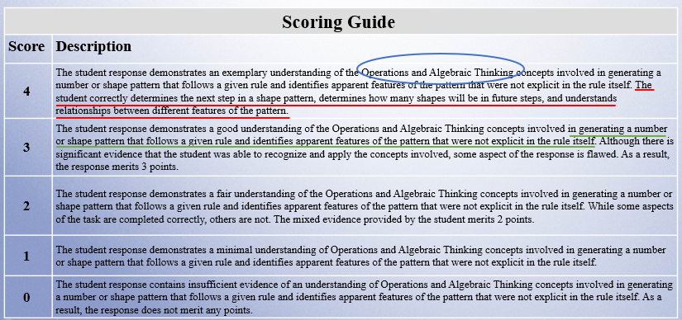
Elementary Question Scoring Guide
On page 20 of your Packet

Slide 29
Elementary Question Scoring Notes
On page 21 of your Packet
Part B:
Full credit for finding the total number of squares in steps 1 through 6 if they show the 6 squares in the 6th step in their work/explanation (1 + 2 + 3 + 4 + 5 + 6 = 21).
Part C:
Does not have to use multiplication to receive full credit (9 + 9 = 18).
Full credit for finding the total number of triangles in steps 1 through 9 if they show the 18 triangles in the 9th step in their work/explanation (2 + 4 + 6 + 8 + …18 = 90).
Part D:
Can use multiplication (2 x 32 = 64).
Can say that the number of triangles is 2 times the step number.
Answer-only (possible in Parts B, C and D):
3 answers-only + part A = 3 points
3 answers-only = 2 points
1 or 2 answer(s)-only + part A = 2 points
1 or 2 answer(s)-only = 1 point

Slide 30
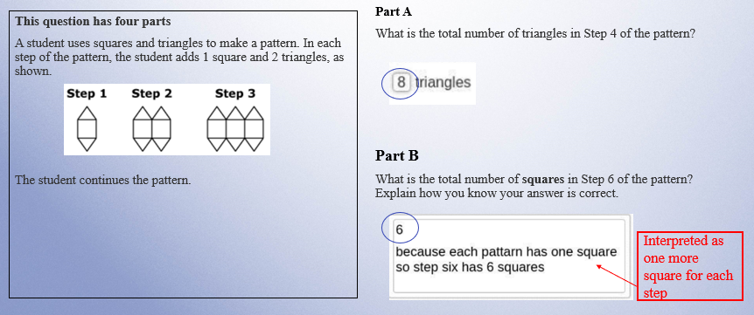
Training Response: Score 4
On page 23 of your Packet

Slide 31
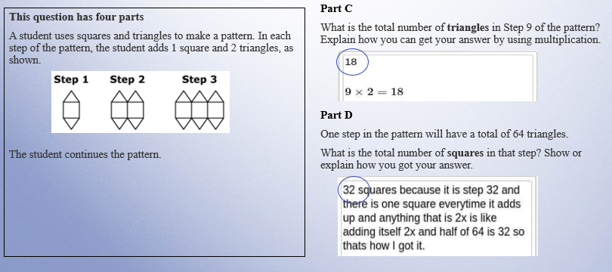
Training Response: Score 4 Cont’d
On page 23 of your Packet

Slide 32
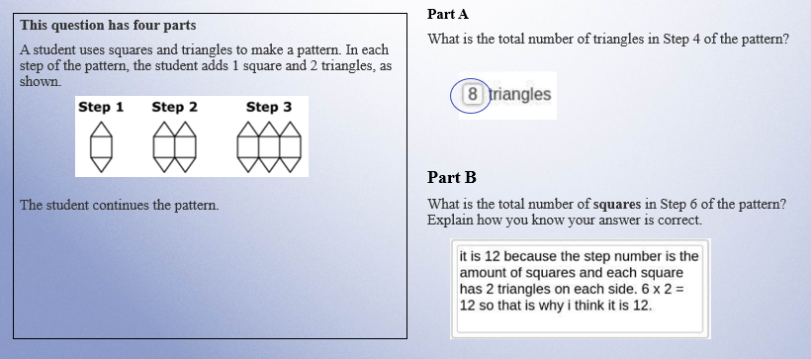
Training Response: Score 3
On page 24 of your Packet

Slide 33
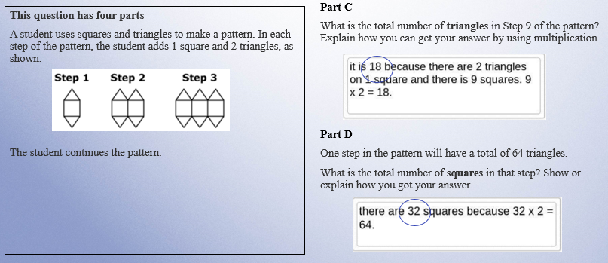
Training Response: Score 3 Cont’d
On page 24 of your Packet

Slide 34
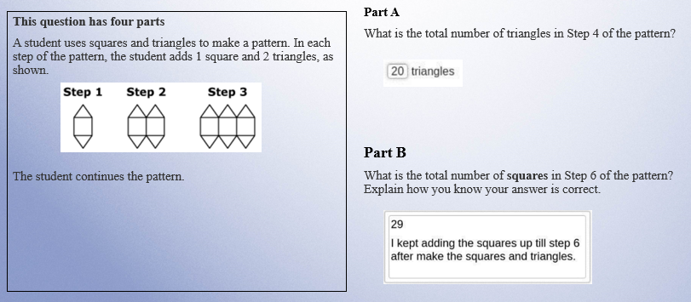
Training Response: Score 2
On page 25 of your Packet

Slide 35
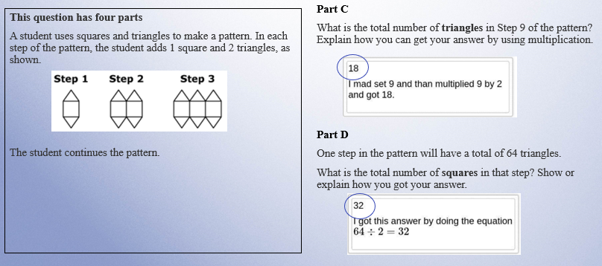
Training Response: Score 2 Cont’d
On page 25 of your Packet

Slide 36
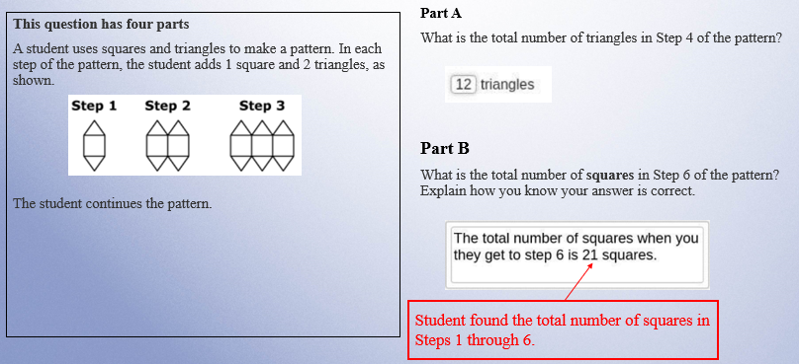
Training Response: Score 1
On page 26 of your Packet

Slide 37
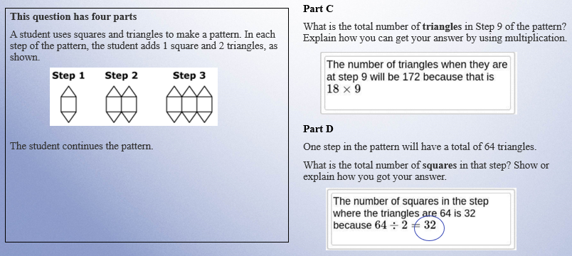
Training Response: Score 1 Cont’d
On page 26 of your Packet

Slide 38
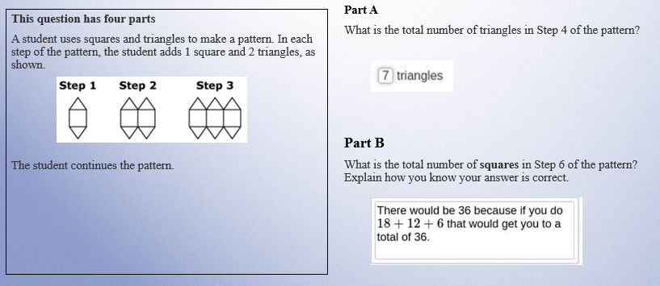
Training Response: Score 0
On page 27 of your Packet

Slide 39
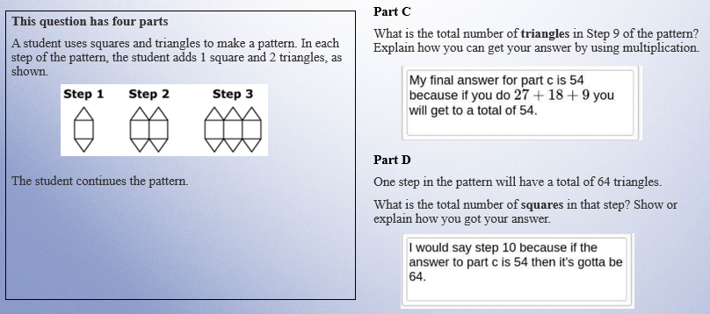
Training Response: Score 0 Cont’d
On page 27 of your Packet

Slide 40
Individual Practice of Scoring Student Responses
Question 2: 4-OA.C.5 (Released 2022)
  Revisit the following:
      the Question,
      the Sample Response,
      the Scoring Guide, and
      the Scoring Notes.
  Read the Sample Response
  Use the Training Response papers to score the response
  Choose one score that you think best represents the response.

Slide 41

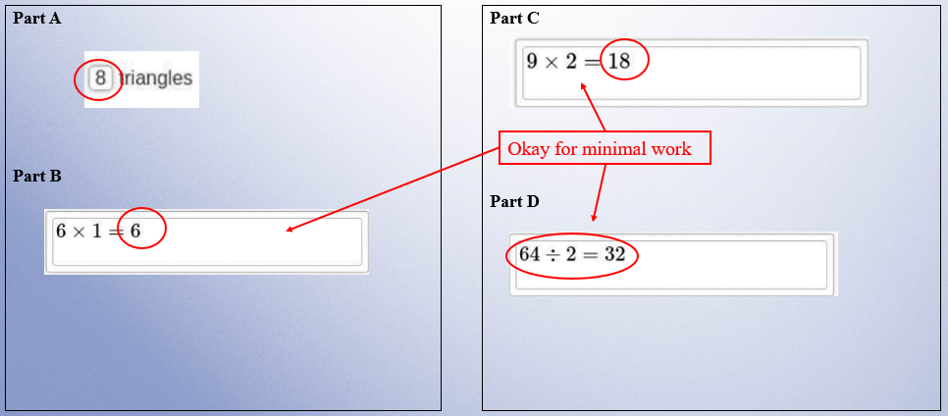
Practice Response A
On page 29 of your Packet

Slide 42

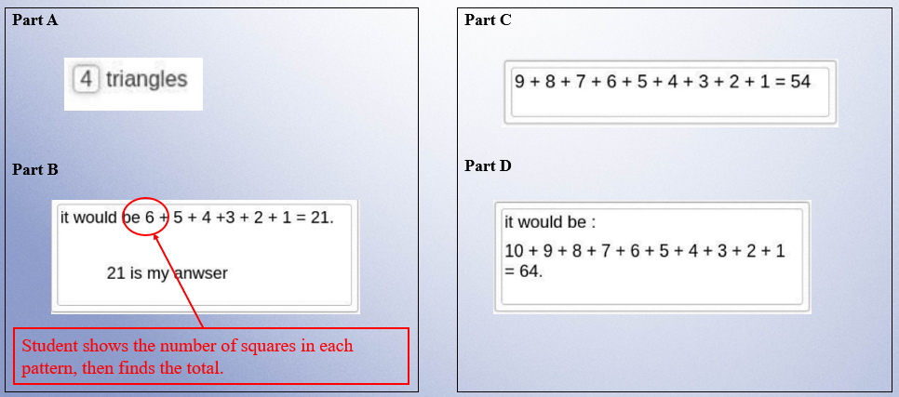
Practice Response B
On page 30 of your Packet

Slide 43

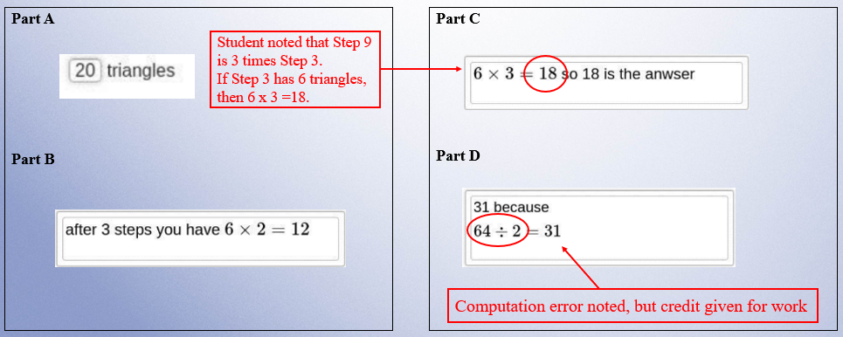
Practice Response C
On page 31 of your Packet

Slide 44

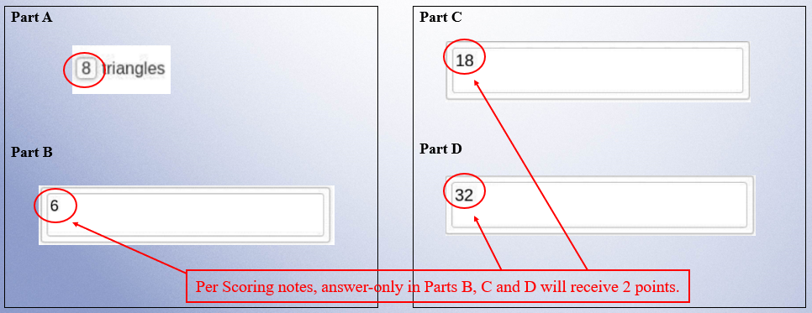
Practice Response D
On page 32 of your Packet

Slide 45

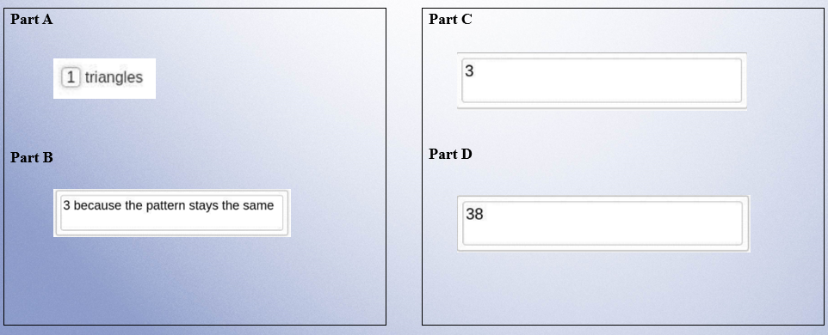
Practice Response E
On page 33 of your Packet

Slide 46
Resources on DESE Website
Resource | Link
MCAS headlines and links to MCAS site | https://www.doe.mass.edu/mcas/
Mathematics Test Designs | https://www.doe.mass.edu/mcas/tdd/math.html?section=testdesign
Student Work Samples | https://www.doe.mass.edu/mcas/student/default.html
Released Questions | http://mcas.pearsonsupport.com/released-items/math/
Practice Tests and Tutorial | http://mcas.pearsonsupport.com/student/

Slide 47
Contact Information
DESE Office of Student Assessment for policy questions
(e.g., test designs, accommodations)
Web: www.doe.mass.edu/mcas
Email: mcas@mass.gov (new)
Phone: 781-338-3625
MCAS Service Center
Web: http://mcasservicecenter.com
Phone: 1-800-737-5103

Slide 48

THANK YOU

