Slide 1

MCAS ELA Elementary Session:
Grades 3$–$4
Constructed Responses
2024

Slide 2
Today’s agenda
Overview of MCAS test development and scoring process
Analysis of a grade 4 Constructed Response (CR) question with student responses
Practice with scoring student responses
Review of resources available on the Department’s website

Slide 3
DESE's Strategic Objectives
DESE partners with districts, schools, and programs to:
Strategic Objective 2 - "Deeper Learning"
Strategic Objective 3 - "Diverse and Effective Workforce"
Develop and sustain a workforce that is diverse, culturally responsive, well-prepared, and committed to continuous improvement, so that all students have equitable access to effective educators.
Promote deeper learning so that all students engage in grade-level work that is real-world, relevant, and interactive.
Cultivate systems to support the whole student and foster joyful, healthy, and supportive learning environments so that all students feel valued, connected, nourished, and ready to learn.
Strategic Objective 1 - "Whole Student"

Slide 4
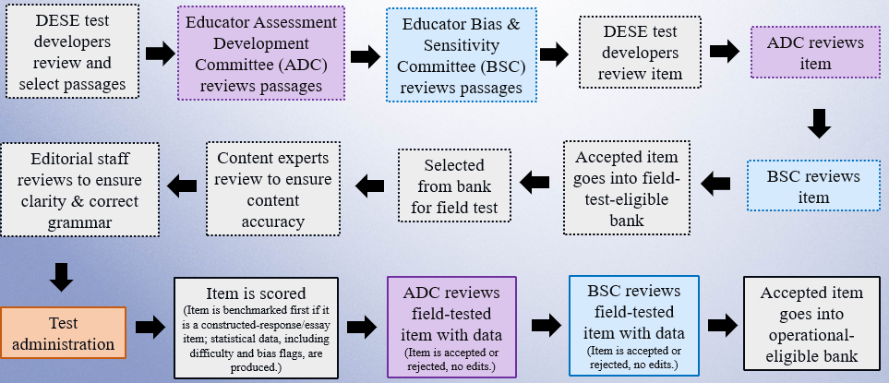
Life Cycle of an English Language Arts (ELA) Item

Slide 5
Scoring Materials
Scoring Guide (Rubric)
  Includes specific descriptions of expectation at each score point
Anchor Papers
  Range of real student responses based on the scoring guide (rubric) and scoring notes (educator committees assist with the development of these notes)
Annotations
  A brief explanation of the expectations at the score point based on the language of the rubric

Slide 6
Constructed Response Scoring Guide
Score Point | Description
3 | Demonstrates full understanding of the reading material Includes important and specific evidence/details for support
2 | Demonstrates partial understanding of the reading material Includes some important evidence/details for support
1 | Demonstrates minimal understanding of the reading material Includes little or no evidence/details for support
0 | Demonstrates no understanding of the reading material Includes insufficient evidence/details for support
CR rubric can be found at : https://www.doe.mass.edu/mcas/tdd/ela.html?section=other

Slide 7
MCAS Student CR Expectations
Based only on the passage(s) presented
Outside information does not count towards the student score
Length of CR should be about a paragraph

Slide 8
Scoring Overview: Scorer process
For each MCAS constructed response, scorers:
participate in constructed response--specific training
qualify to score each question
use the passage, question, scoring notes, scoring guide, anchor papers and annotations
are monitored by measures such as read-behinds and embedded responses to ensure accuracy

Slide 9
Today’s Process for Grade 4 CR question
Review passage, question and direction lines
Revisit the scoring guide
Read and analyze anchor paper(s) at each score point

Slide 10

2022 Grade 4 Released Question
Passage: Home Address: ISS International Space Station
Passage and question can be found at http://mcas.pearsonsupport.com/released-items/ela/

Slide 11
Constructed Response Scoring Guide
Score Point | Description
3 | Demonstrates full understanding of the reading material Includes important and specific evidence/details for support
2 | Demonstrates partial understanding of the reading material Includes some important evidence/details for support
1 | Demonstrates minimal understanding of the reading material Includes little or no evidence/details for support
0 | Demonstrates no understanding of the reading material Includes insufficient evidence/details for support

Slide 12
Constructed Response Scoring Guide
Score Point | Description
3 | Demonstrates full understanding of the reading material Includes important and specific evidence/details for support
2 | Demonstrates partial understanding of the reading material Includes some important evidence/details for support
1 | Demonstrates minimal understanding of the reading material Includes little or no evidence/details for support
0 | Demonstrates no understanding of the reading material Includes insufficient evidence/details for support

Slide 13
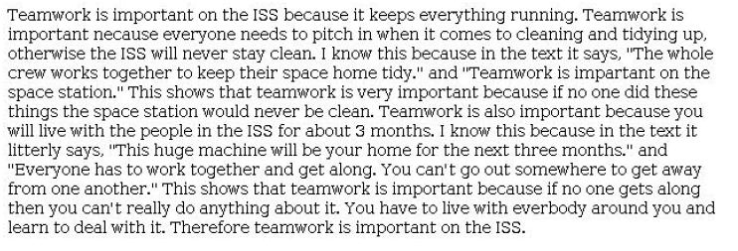
Score: 3

Slide 14
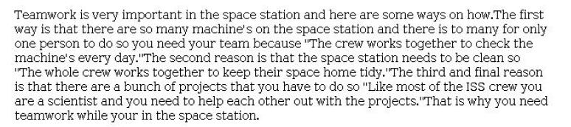
Score: 3

Slide 15
Constructed Response Scoring Guide
Score Point | Description
3 | Demonstrates full understanding of the reading material Includes important and specific evidence/details for support
2 | Demonstrates partial understanding of the reading material Includes some important evidence/details for support
1 | Demonstrates minimal understanding of the reading material Includes little or no evidence/details for support
0 | Demonstrates no understanding of the reading material Includes insufficient evidence/details for support

Slide 16

Score: 2

Slide 17
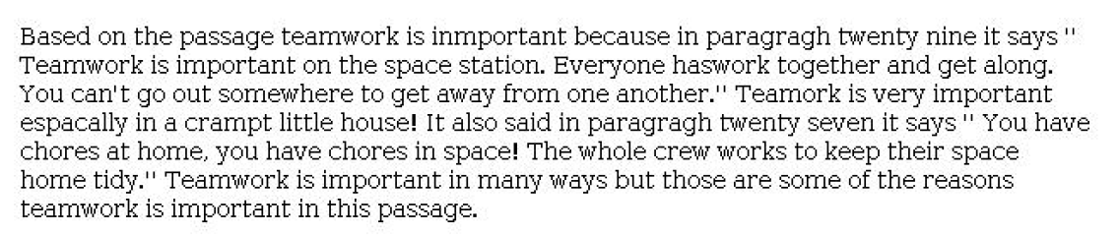
Score: 2

Slide 18
Constructed Response Scoring Guide
Score Point | Description
3 | Demonstrates full understanding of the reading material Includes important and specific evidence/details for support
2 | Demonstrates partial understanding of the reading material Includes some important evidence/details for support
1 | Demonstrates minimal understanding of the reading material Includes little or no evidence/details for support
0 | Demonstrates no understanding of the reading material Includes insufficient evidence/details for support

Slide 19
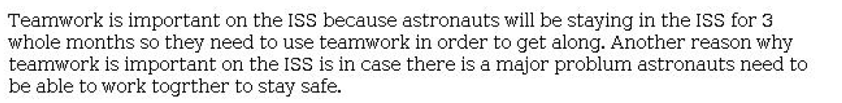
Score: 1

Slide 20
Score: 1

Slide 21
Constructed Response Scoring Guide
Score Point | Description
3 | Demonstrates full understanding of the reading material Includes important and specific evidence/details for support
2 | Demonstrates partial understanding of the reading material Includes some important evidence/details for support
1 | Demonstrates minimal understanding of the reading material Includes little or no evidence/details for support
0 | Demonstrates no understanding of the reading material Includes insufficient evidence/details for support

Slide 22

Score: 0

Slide 23
Practice of Grade 4 CR Question
Revisit the question and passage.
Read the response.
Use the anchor papers and scoring guide to score the response.
Choose one score that you think best represents the response.

Slide 24
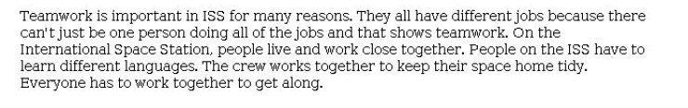
Response A

Slide 25
Response A
Score: 2

Slide 26
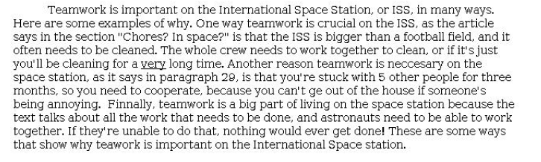
Response B

Slide 27
Response B
Score: 3

Slide 28

Response C

Slide 29
Response C
Score: 0

Slide 30

Response D

Slide 31
Response D
Score: 1

Slide 32
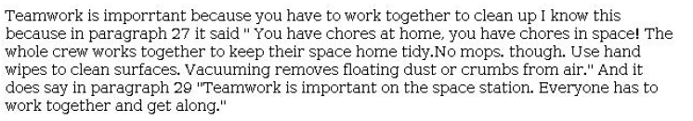
Response E

Slide 33
Response E
Score: 2

Slide 34
MCAS ELA Resources on DESE Website
MCAS Resource | Link
ELA Rubrics | https://www.doe.mass.edu/mcas/tdd/ela.html?section=rubrics
Student Work Samples and Annotations | https://www.doe.mass.edu/mcas/student/default.html
Released Questions | http://mcas.pearsonsupport.com/released-items/ela/
ELA Test Designs | https://www.doe.mass.edu/mcas/tdd/ela.html?section=testdesign
Information about MCAS ELA Essay Scoring | https://www.doe.mass.edu/mcas/tdd/ela.html?section=other

Slide 35
Contact Information
DESE Office of Student Assessment for policy questions (e.g., test designs, accommodations)
Web: www.doe.mass.edu/mcas
Email: mcas@mass.gov
Phone: 781-338-3625
MCAS Service Center
Web: http://mcasservicecenter.com/
Phone: 1-800-737-5103

Slide 36


