Slide 1
MCAS ELA High School Session:
Grade 10
Essays
2024

Slide 2
Today’s agenda
Overview of MCAS test development and scoring process
Analysis of a HS Essay (ES) question with student responses
Practice with scoring student responses
Review of resources available on the Department’s website

Slide 3
DESE's Strategic Objectives
DESE partners with districts, schools, and programs to:
Strategic Objective 2 - "Deeper Learning"
Strategic Objective 3 - "Diverse and Effective Workforce"
Develop and sustain a workforce that is diverse, culturally responsive, well-prepared, and committed to continuous improvement, so that all students have equitable access to effective educators.
Promote deeper learning so that all students engage in grade-level work that is real-world, relevant, and interactive.
Cultivate systems to support the whole student and foster joyful, healthy, and supportive learning environments so that all students feel valued, connected, nourished, and ready to learn.
Strategic Objective 1 - "Whole Student"

Slide 4
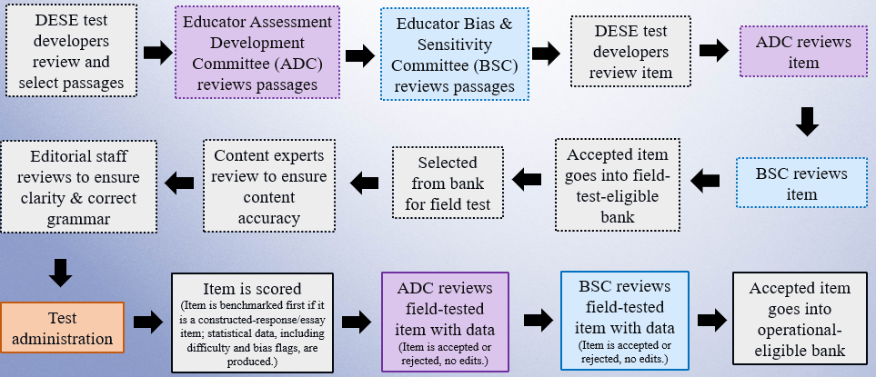
Life Cycle of an English Language Arts (ELA) Item

Slide 5
Types of Essays
Explanatory and Argument
Responses should be based on the passage(s) and not include outside information or personal knowledge on the topic.
Responses should include a central idea/thesis with evidence/details from the passage.
Narrative
Responses should include narrative elements addressing characters, dialogue, plot, and setting that logically extend the passage.

Slide 6
MCAS Essay Scoring
Summaries of passage(s) will receive a zero for Idea Development but may receive up to 3 points for Conventions.
Writing in the wrong mode will receive a zero for Idea Development but may receive up to 3 points for Conventions.
Direct copy from the prompt or passage with no original words from the student will result in a zero score.

Slide 7
MCAS Student Essay Expectations
Essay must address the question and writing mode.
Essay must be based on information from the passage(s).
Essay should include multiple paragraphs to receive higher scores.

Slide 8
Scoring Overview: Scorer Process
For each MCAS essay, scorers
participate in essay-specific training
qualify to score each essay question
use the passage, question, scoring notes, scoring guide, anchor papers and annotations
are monitored by measures such as read-behinds and embedded responses to ensure accuracy

Slide 9
Scoring Materials
Scoring Guide (Rubric)
  Includes specific descriptions of expectation at each score point
Anchor Papers
  Show a range of real student responses based on the scoring guide (rubric) and scoring notes (educator committees assist with the development of these notes)
Annotations
  Present a brief explanation of the expectations at the score point based on the language of the rubric

Slide 10
Today’s Process for Grade 10 ES question
Review scoring guide
Review excerpts, direction lines and question
Review and analyze anchor papers at each score point

Slide 11
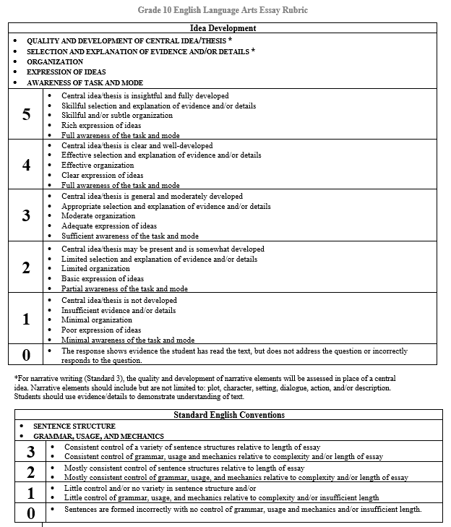
Essay Scoring Guide (Rubric)
Essay rubrics can be found at https://www.doe.mass.edu/mcas/tdd/ela.html?section=rubrics

Slide 12
General Language of Essay Scoring Guide (Rubric)
Idea Development (Writing) | Conventions (Language)
quality and development of central idea/thesis * selection and explanation of evidence and/or details * organization expression of ideas awareness of task and mode | sentence structure grammar, usage, and mechanics
* For narrative writing, the quality and development of narrative elements will be assessed in place of a central idea. Narrative elements should include, but are not limited to: plot, character, setting, dialogue, action, and/or description. Students should use evidence/details to demonstrate understanding of text.

Slide 13
Direction Lines and Questions
Are standardized for each writing mode
Include expectations for what to include in each essay
Questions (prompts) also remind students to use details/information from the passage

Slide 14
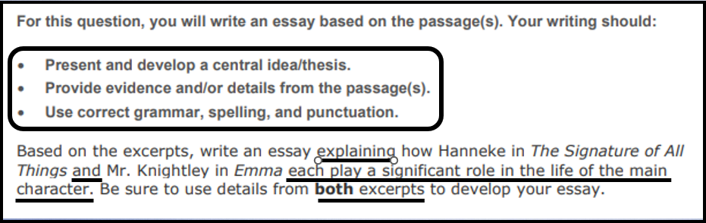
Grade 10 Question (Explanatory)

Slide 15
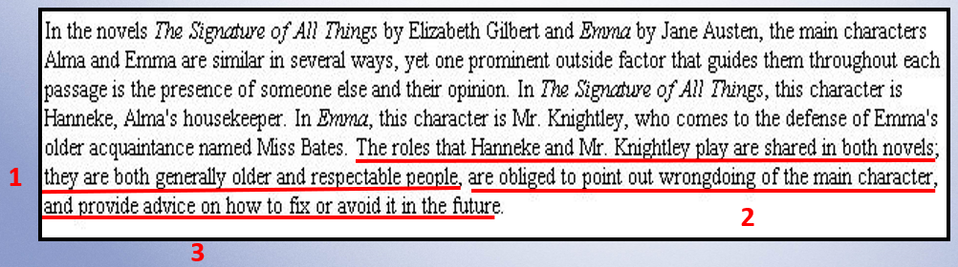
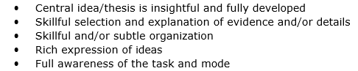
Score: 5/3
Introduction

Slide 16
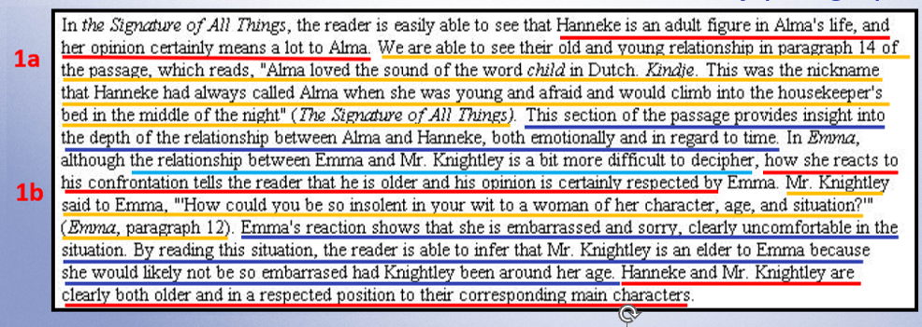

Score: 5/3
1st body paragraph

Slide 17
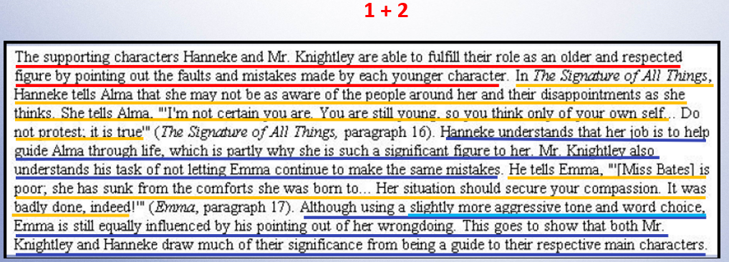
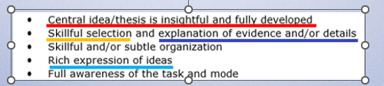
Score: 5/3
2nd body paragraph

Slide 18
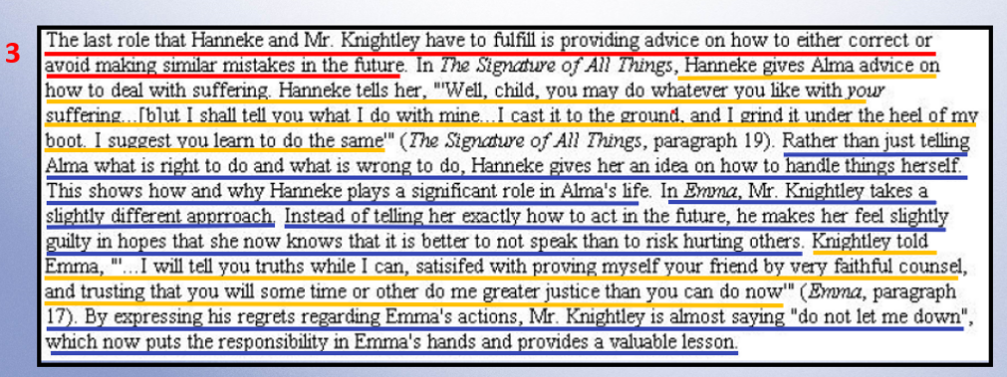
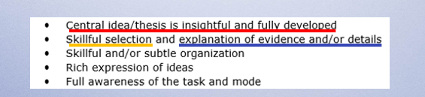
Score: 5/3
3rd body paragraph

Slide 19
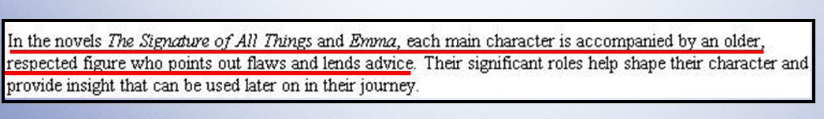
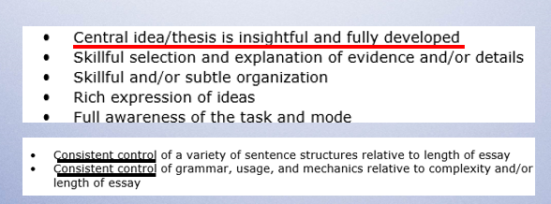
Score: 5/3
Conclusion

Slide 20
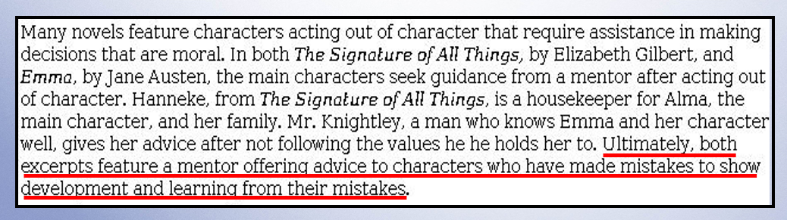
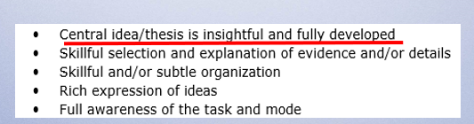
Score: 5/3
Introduction

Slide 21
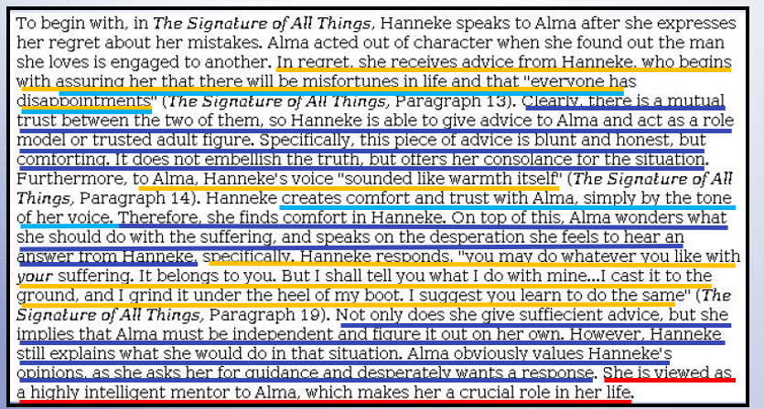
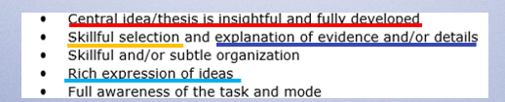
Score: 5/3
1st body paragraph

Slide 22
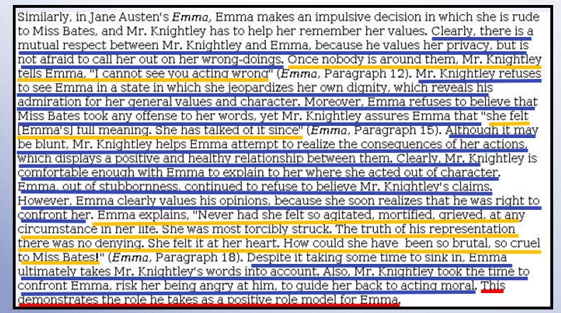
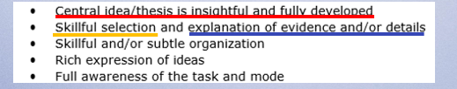
Score: 5/3
2nd body paragraph

Slide 23
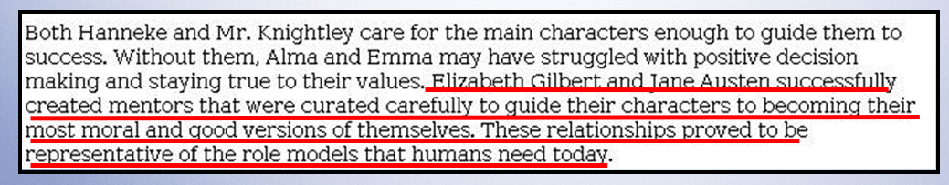
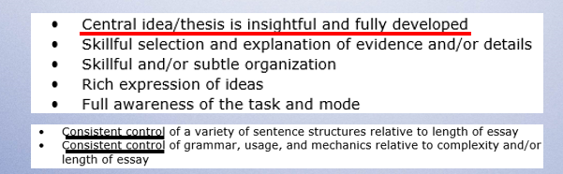
Score: 5/3
Conclusion

Slide 24
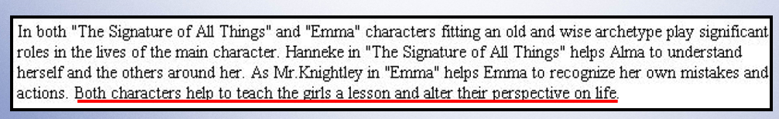
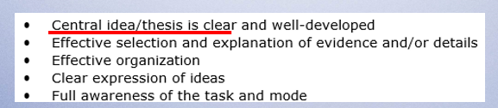
Score: 4/3
Introduction

Slide 25
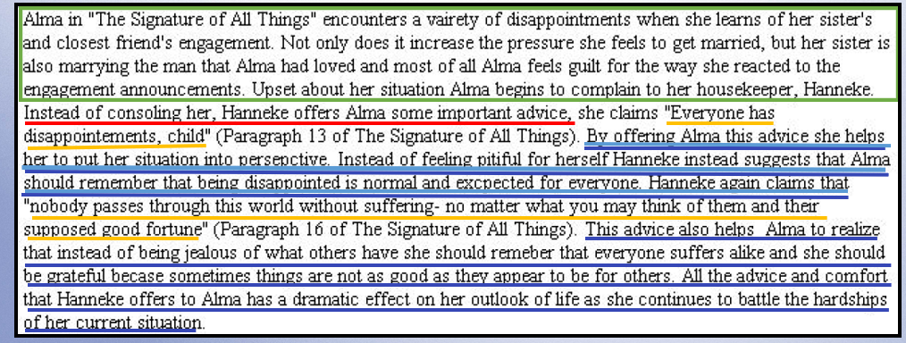
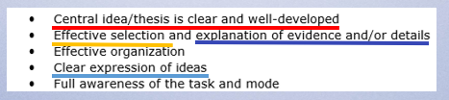
Score: 4/3
1st body paragraph

Slide 26
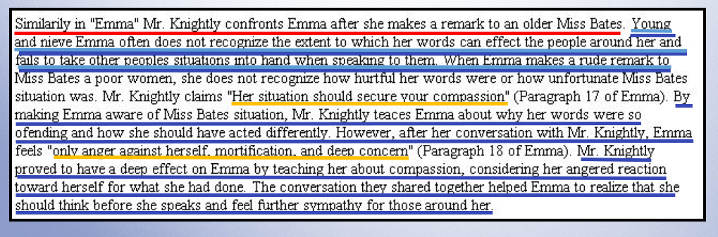
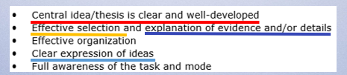
Score: 4/3
2nd body paragraph

Slide 27
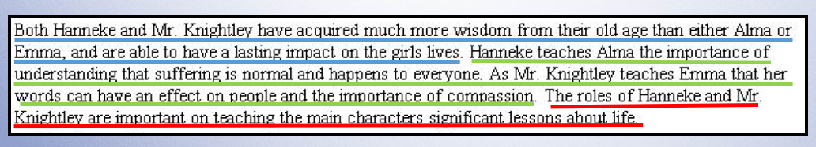
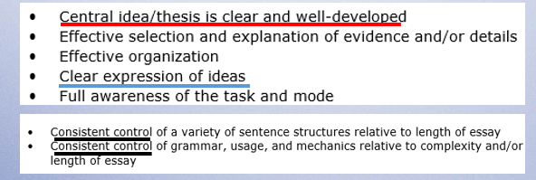
Score: 4/3
Conclusion

Slide 28
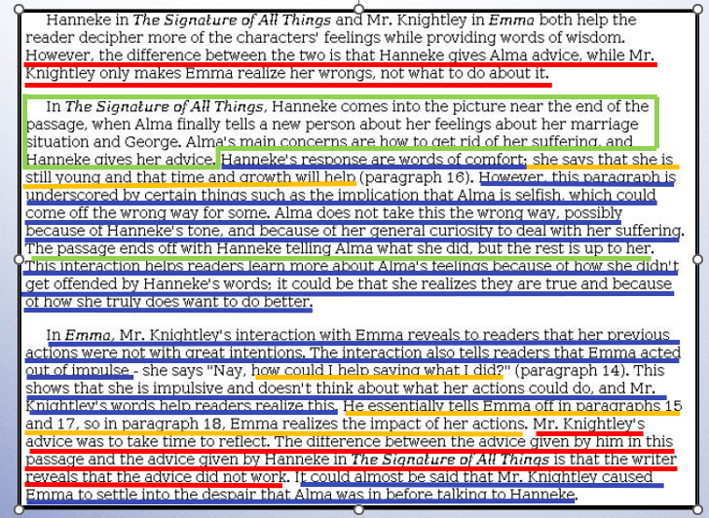
Score: 3/3

Slide 29
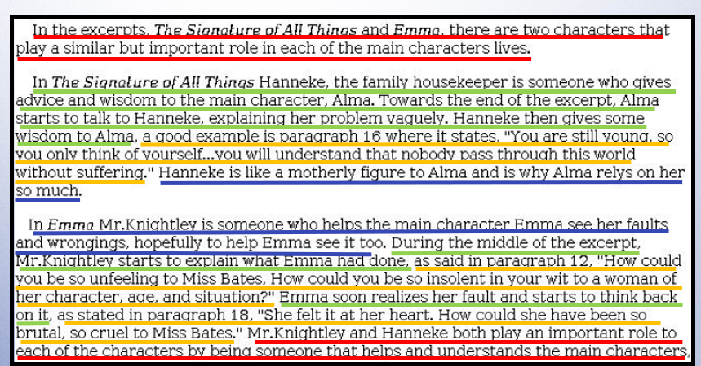
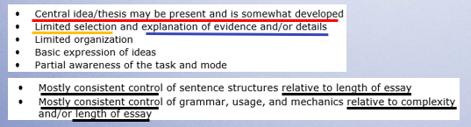
Score: 2/2

Slide 30
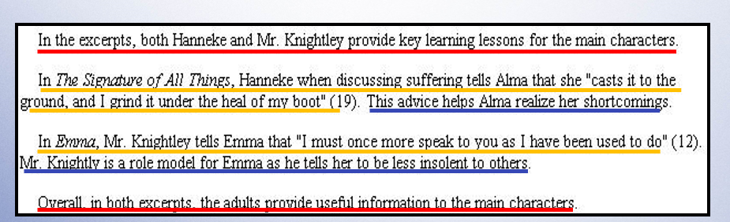
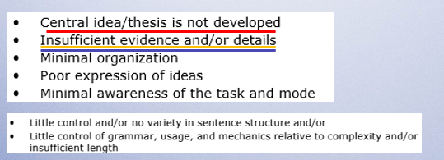
Score: 1/1

Slide 31
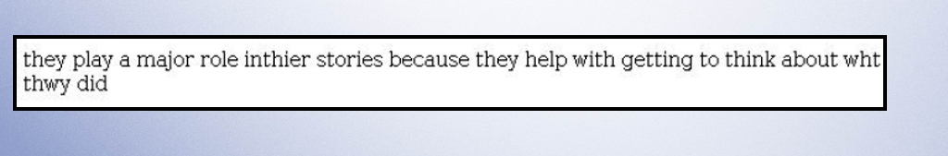
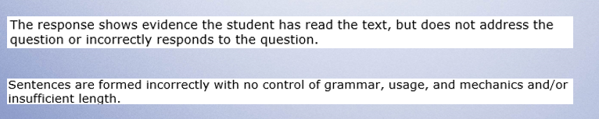
Score: 0/0

Slide 32
Takeaways
Idea Development:
Quality and development of central idea/thesis
  should be developed throughout the essay
Selection and explanation of evidence and/or details
  evidence from the passage(s) can be quoted, paraphrased, or a mix of both
Organization
  can be organized by ideas, passage, or other
Expression of ideas
  should be evident throughout essay
Awareness of task and mode
  should be evident immediately in the introduction and throughout the essay
Conventions:
Control of sentence structure
Control of grammar, usage, and mechanics

Slide 33
Practice of Grade 10 ES question
Revisit the essay prompt and excerpts
Read the essay response
Use the anchor papers and scoring guide to score the essay response
Choose the score that you think best represents the essay response

Slide 34
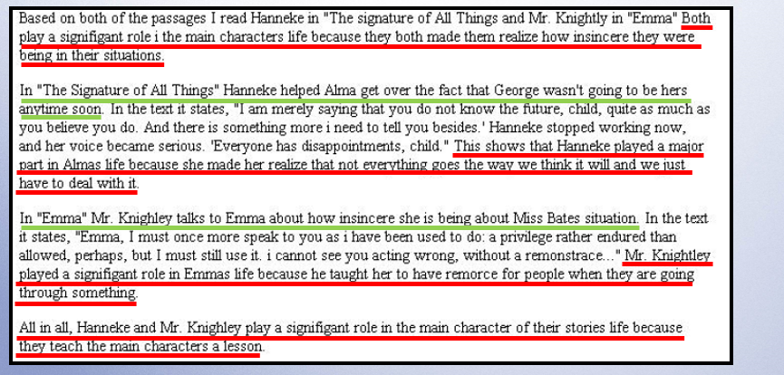
Response A
Idea Development Score: 2
Conventions Score: 2

Slide 35
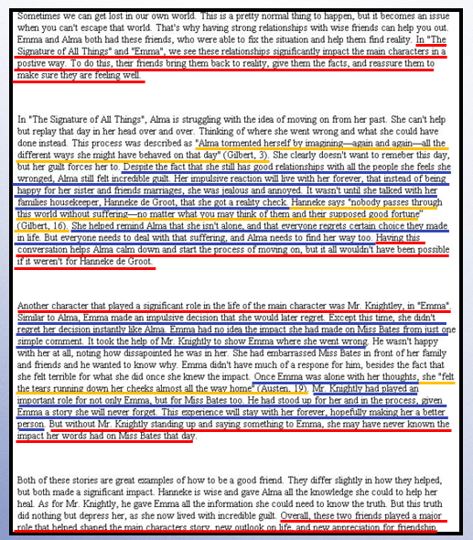
Response B
Idea Development
Score: 4
Conventions Score: 3

Slide 36
Response C
Idea Development Score: 0
Conventions Score: 0

Slide 37
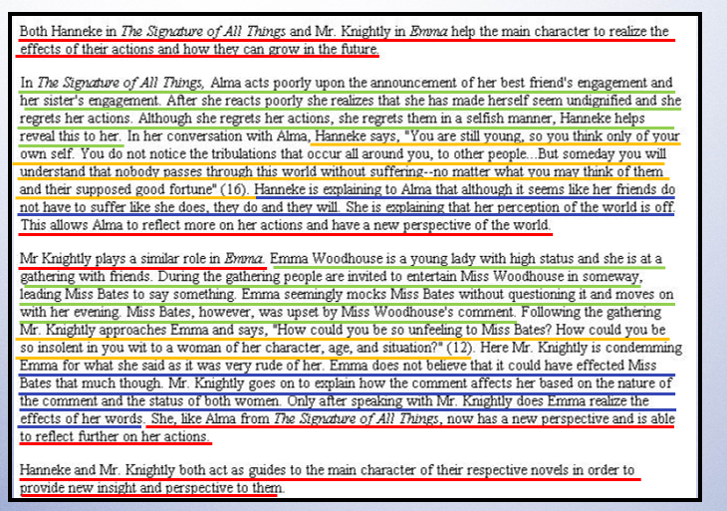
Response D
Idea Development Score: 3
Conventions Score: 3

Slide 38
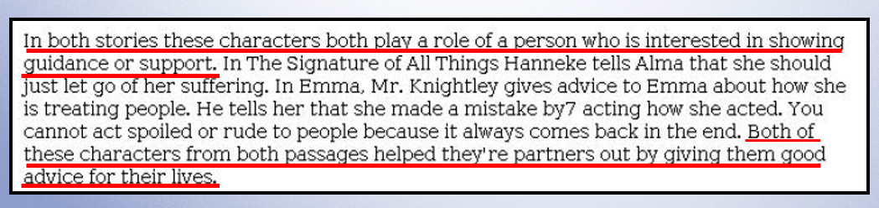
Response E
Idea Development Score: 1
Conventions Score: 1

Slide 39
MCAS ELA Resources on DESE Website
MCAS Resource | Link
ELA Rubrics | https://www.doe.mass.edu/mcas/tdd/ela.html?section=rubrics
Student Work Samples and Annotations | https://www.doe.mass.edu/mcas/student/default.html
Released Questions | http://mcas.pearsonsupport.com/released-items/ela/
ELA Test Designs | https://www.doe.mass.edu/mcas/tdd/ela.html?section=testdesign
Information about MCAS ELA Essay Scoring | https://www.doe.mass.edu/mcas/tdd/ela.html?section=other

Slide 40
Contact Information
DESE Office of Student Assessment for policy questions (e.g., test designs, accommodations)
Web: www.doe.mass.edu/mcas
Email: mcas@mass.gov
Phone: 781-338-3625
MCAS Service Center
Web: http://mcasservicecenter.com/
Phone: 1-800-737-5103

Slide 41

Thank you

